Slide 1
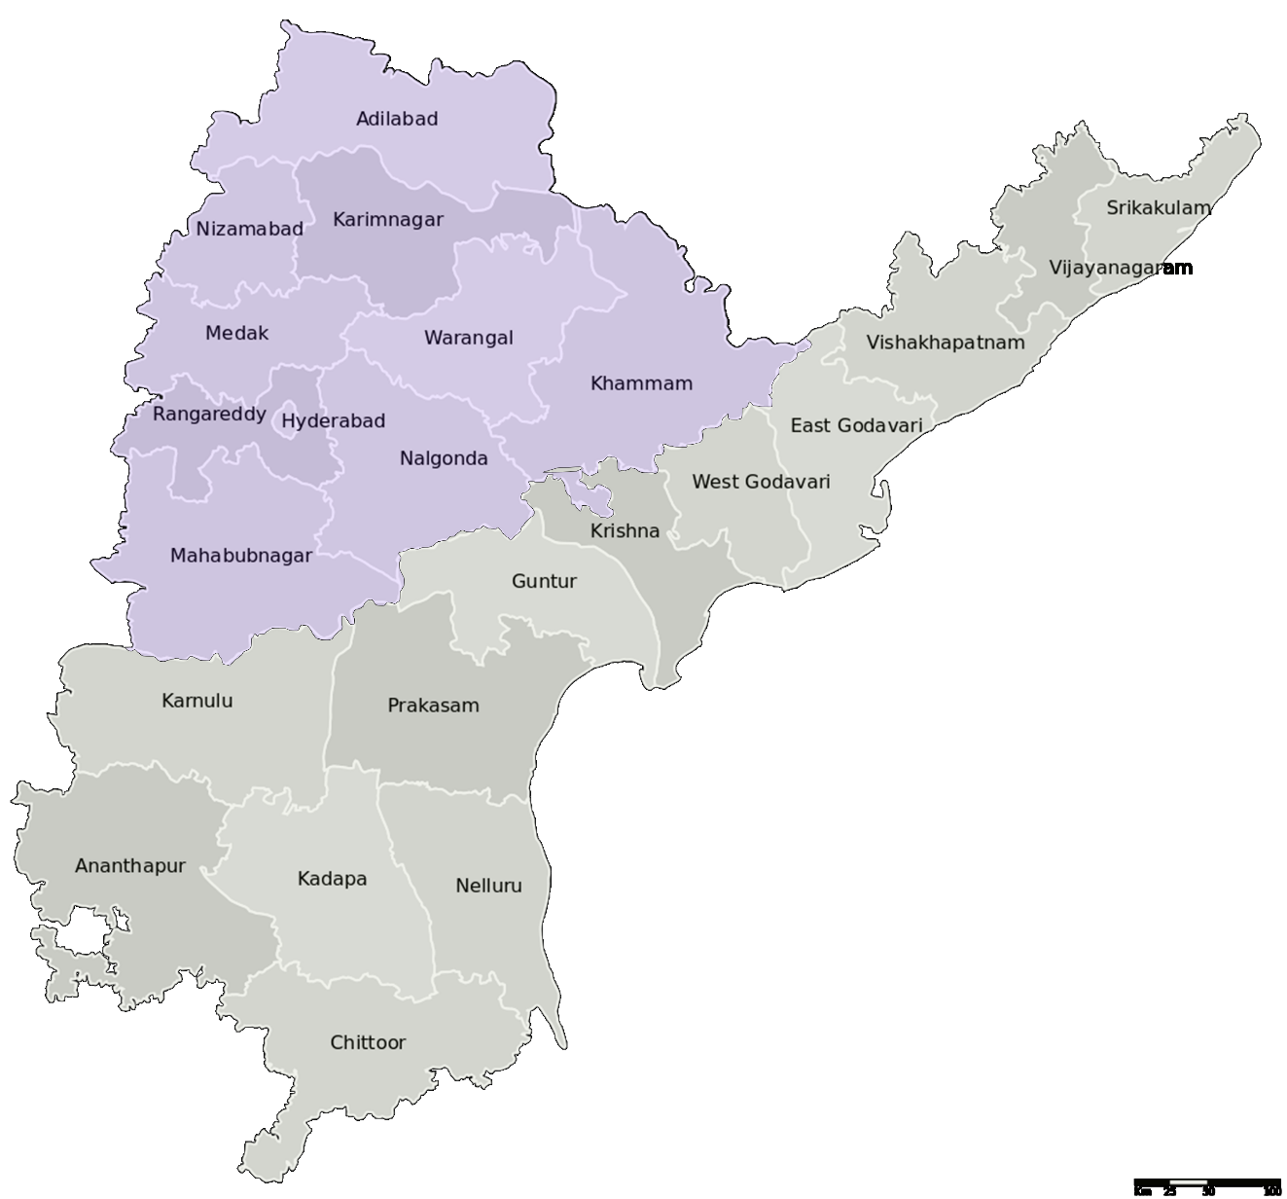
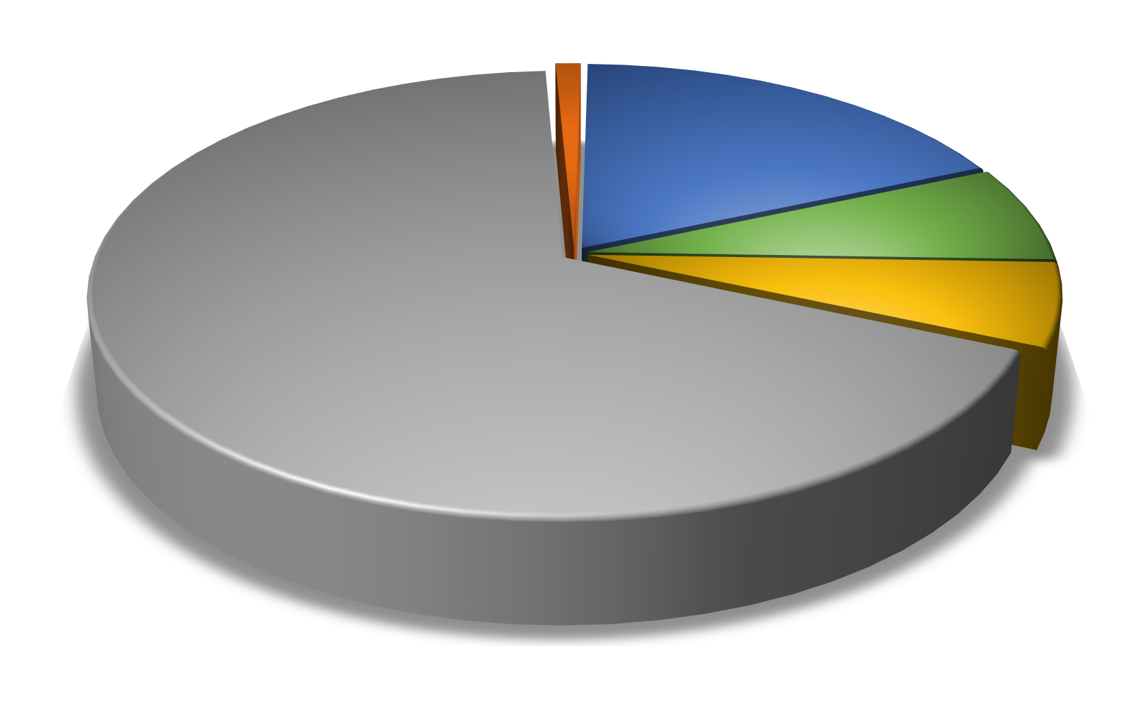
Others
1%
Subabul
18%
Casuarina
7%
Euca
67%
Imported
6%
Wood Consumption (2013-14)

