Slide 1

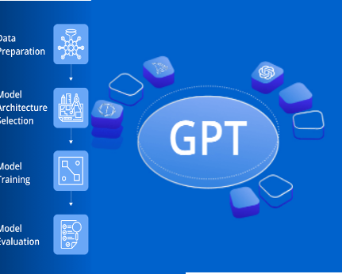
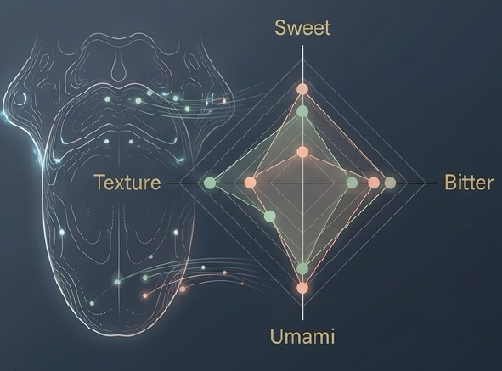
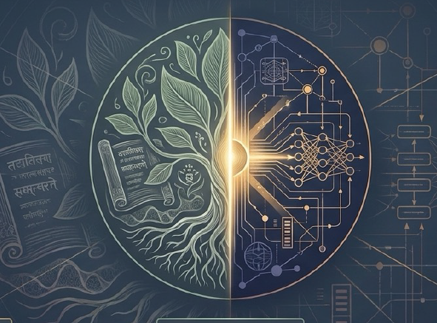
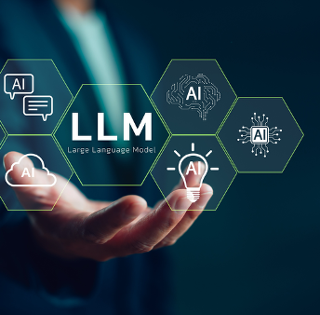
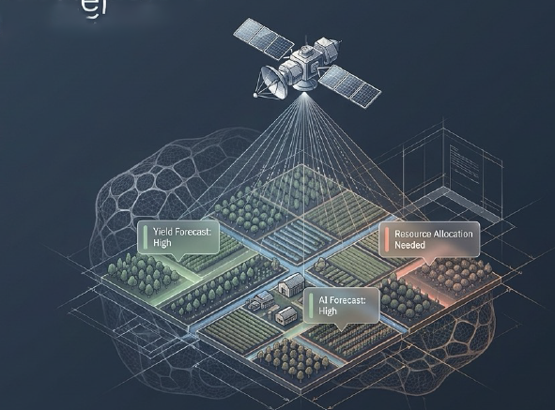
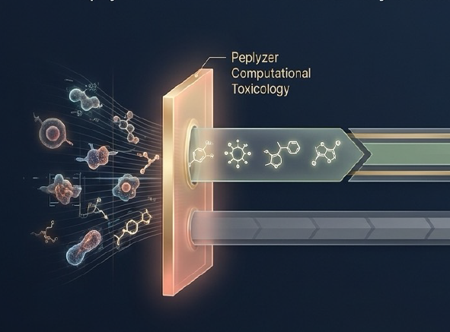

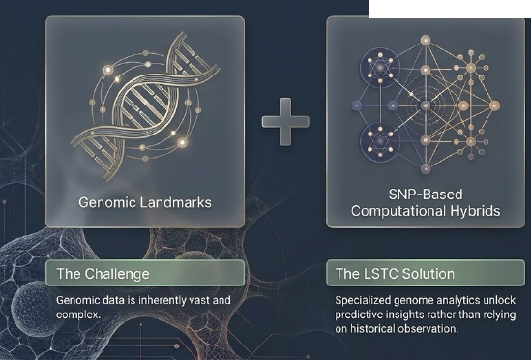
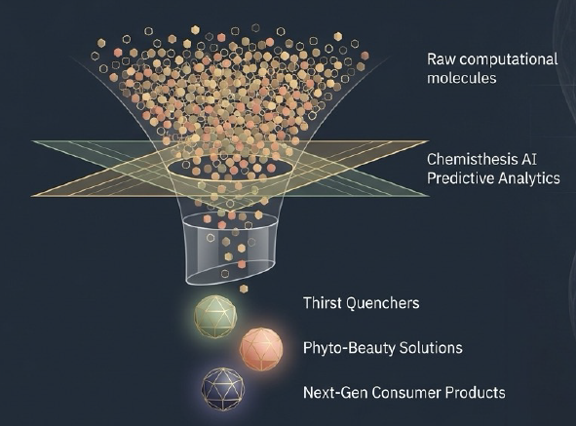
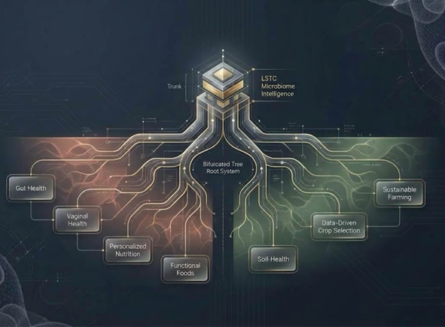
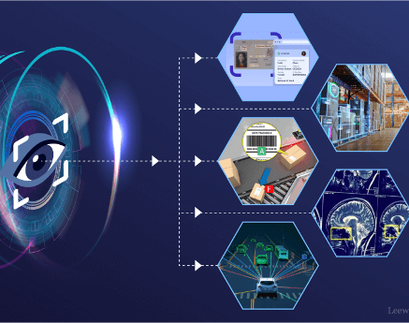

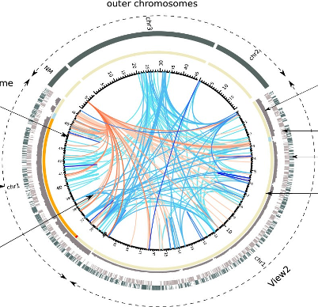
LSTC DIGITAL 3D FRAMEWORK
SENSORY IQ
iAYUR
DIGITAL
INNOVATION
DIGITAL ADOPTION
FOASTERING
DIGITAL
CULTURE
Generative Pre-trained system
SATELLITE IMAGING
PEPLYSER
Inhouse algorithms
DatEasi
LIMs
GenSuite
Digital Day
Seminars
To drive purposeful innovation by transforming LSTC into a data‑centric, simulation‑first, open digital science ecosystem
LLMs
GENOME ANALYSIS
CHEMISTHESIS
A comprehensive system for Sensory Prediciton
A GPT system for Ayurvedic knowledge
Deep analytics
MICROBIOME
Computer Vision based Age / Plantation predictions
Predicts Molecular safety early
LSTC’s DIGITAL JOURNEY
Aims to reduce the Time / Cost / Complexity
Computer Vision
Converting Genomic complexity into predictive intelligence
Accelerates discovery virtual molecular screening
Predictive analytics for Human personal care / Soil Health
CAPACITY BUILDING
INTELLIGENCE ACROSS INNOVATIVE SPECTRUM
LSTC ROAD MAP
FO
BA
NA
iAyur
Computer
Vision
Machine Learning
Deep learning
NLP
Computer Vision
Generative AI
Explainable AI (xAI)
Reinforcement learning
Quantum AI
Voice AI
AI Hardware
✓
Macro /
Systemic
✓
AI Sensory
Unified
Federated
Database
Domain
Specific
AI Agents
Responsible
AI
Governance
Bioinformatics
✓
✓
✓
Peplyser
Microbiome
✓
x
x
Genome
Analysis
x
Micro /
Molecular
Downstream consumer & Yield
x
Upstream discovery & safety
LSTC drives to create unified research database for various LLM based domain specific GPTs
FO: Fully Operational | BA: Basic Appreciation | NA: Not Available

