Slide 1
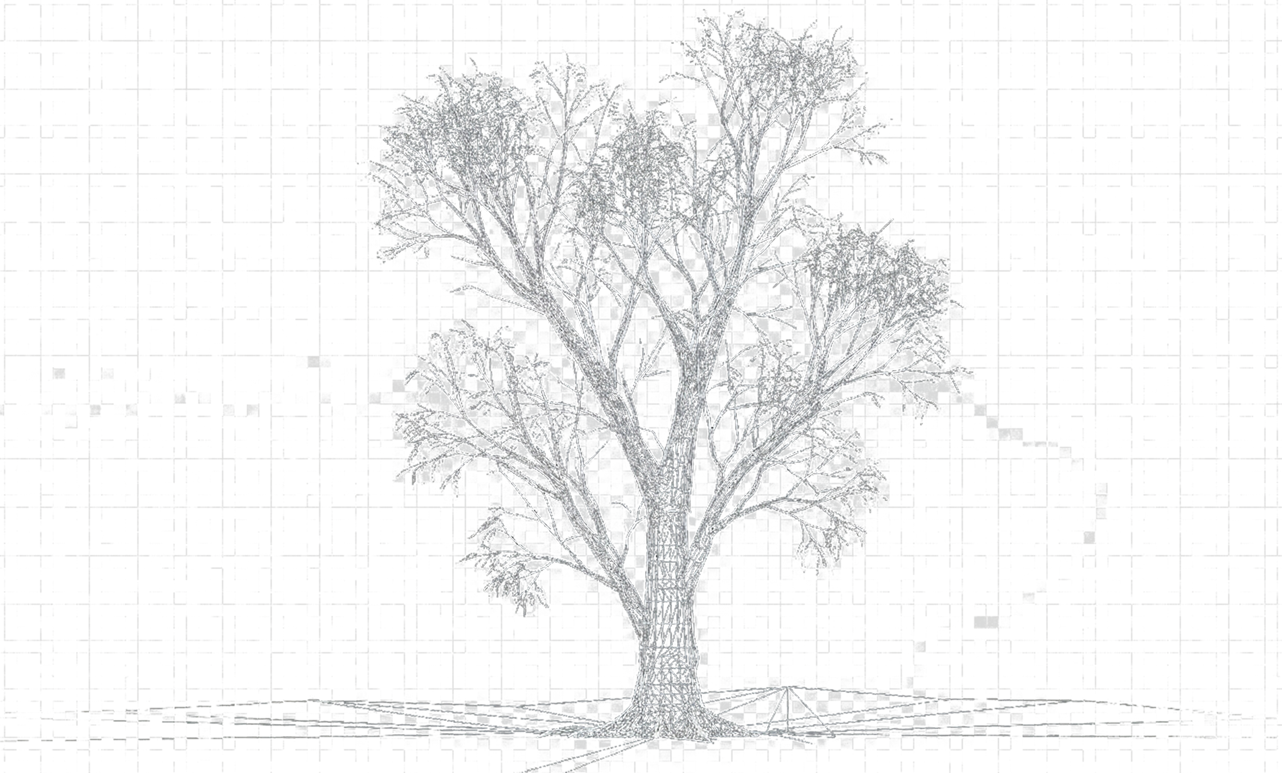
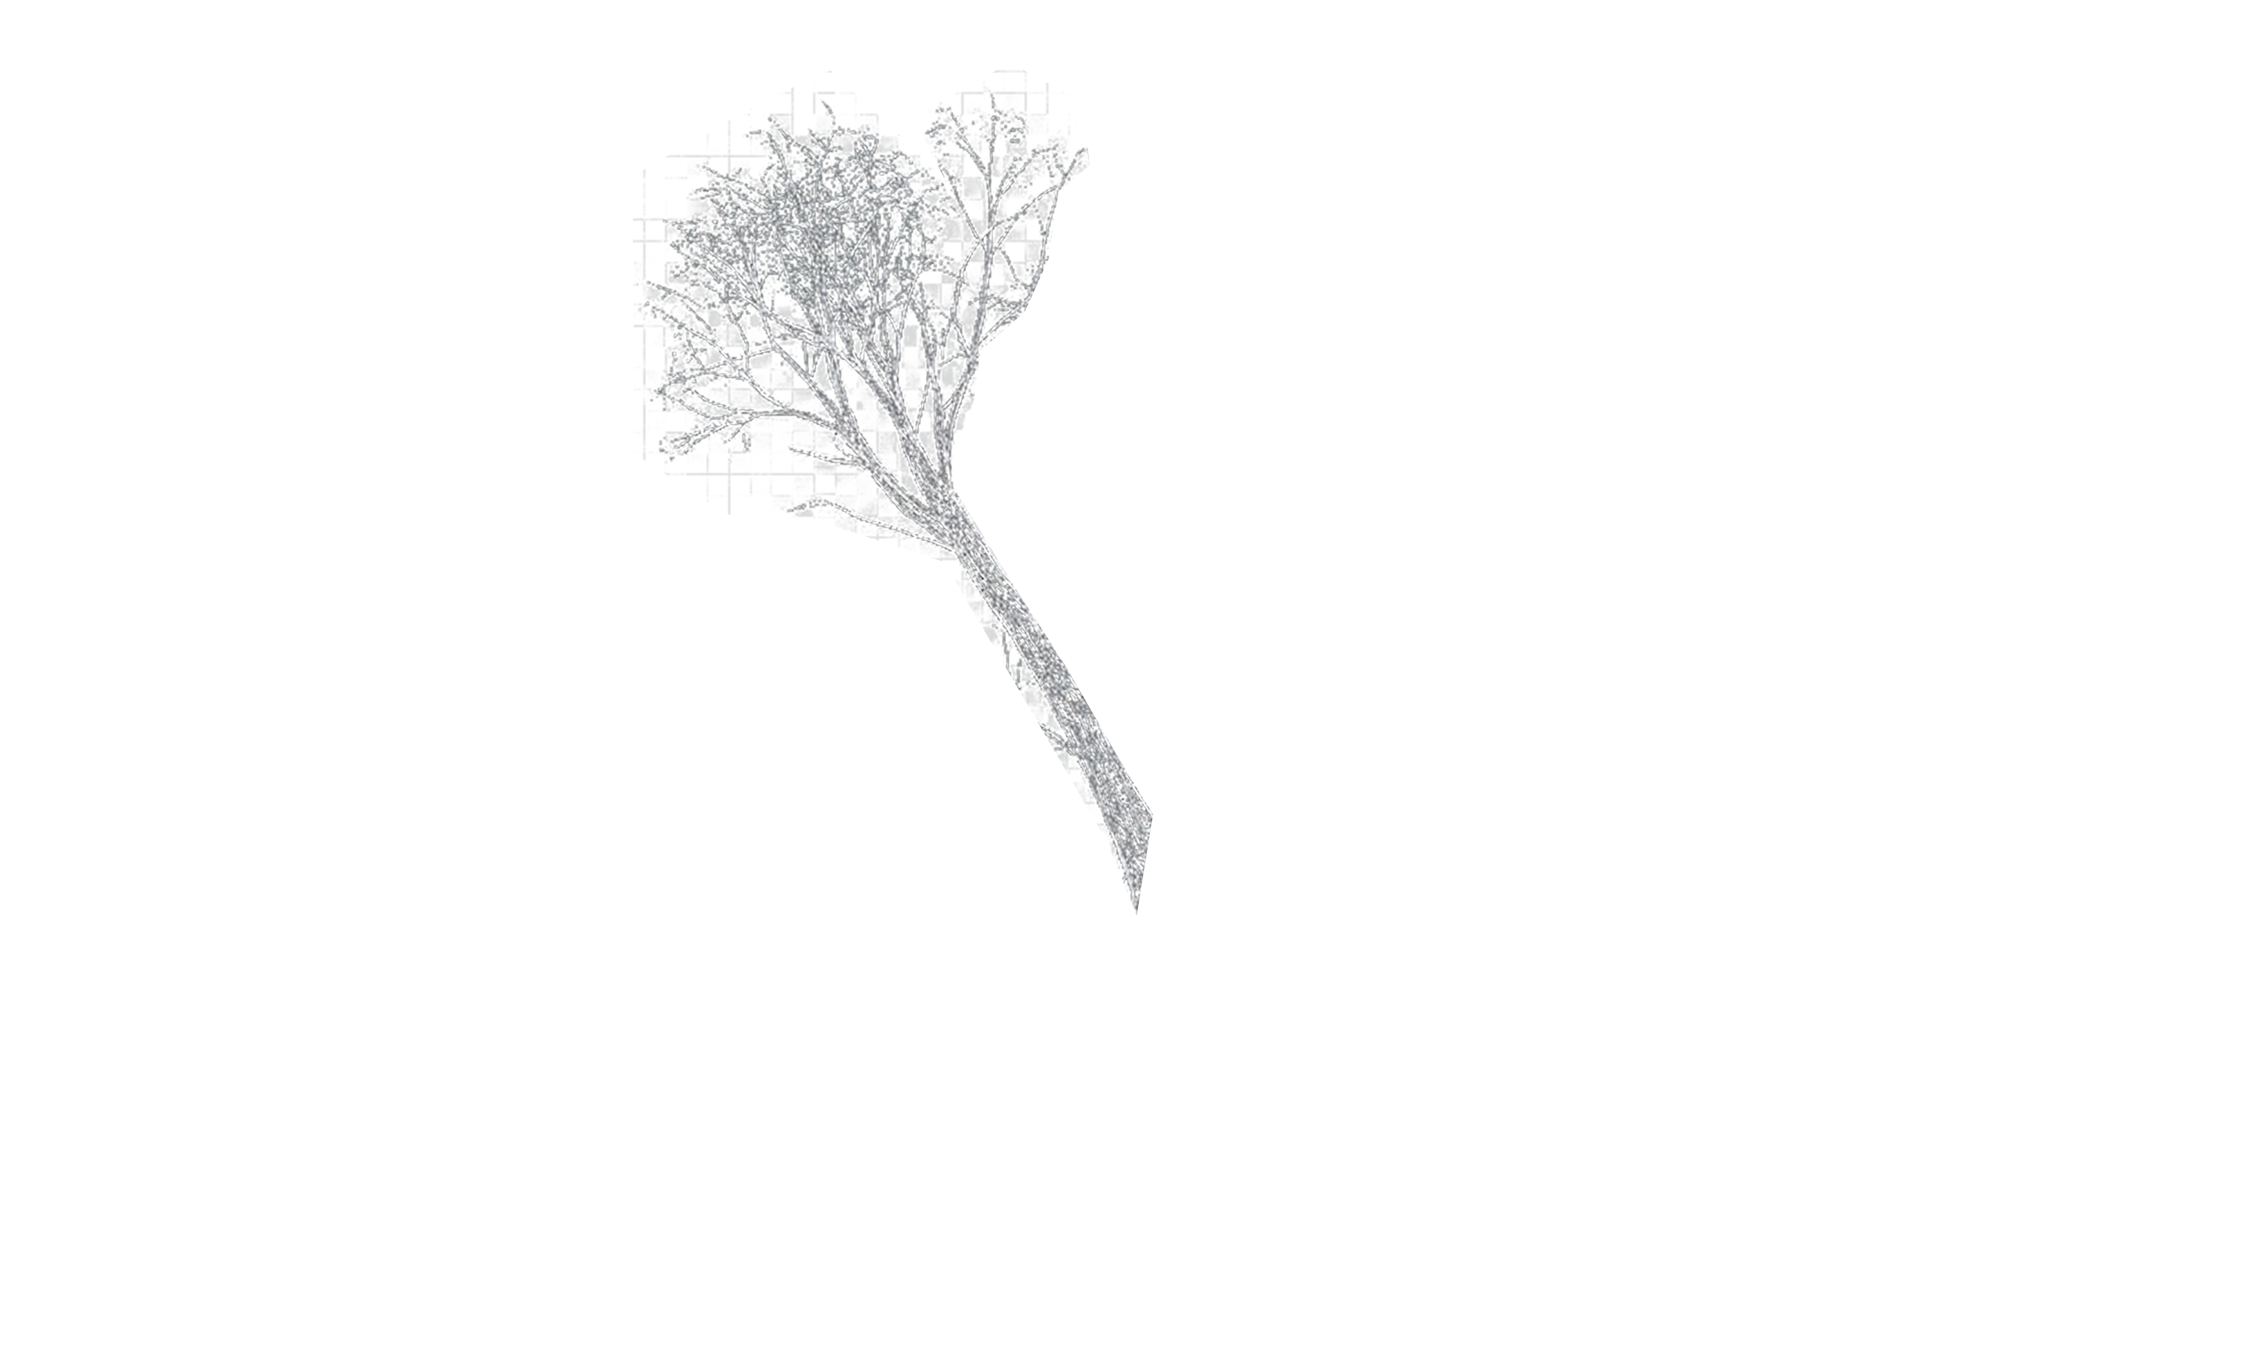
SILVI
The Blueprint for Growth

Slide 2

P O P L A R
Summary of M. Markers & Breeding Actionable

Slide 3
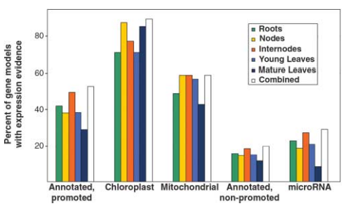
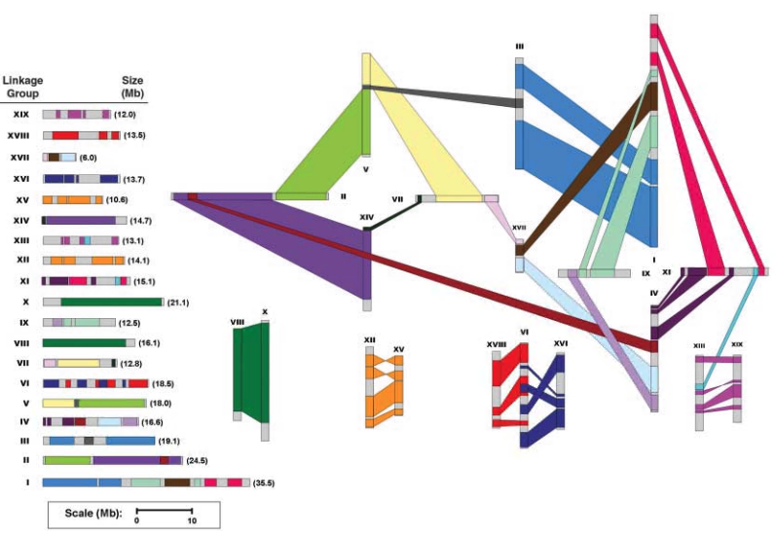
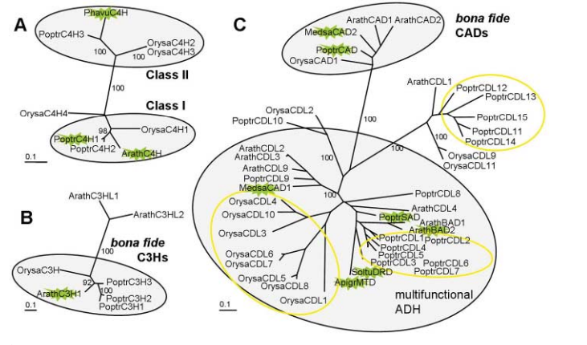
POPLAR FACTS
Well annotated 45K genes
A model system for plant Biology
Dioeceous
Anemophilic pollination
Crossable with available species
Genome size: ~500mb
Ploidy: 2n = 2x = 38 (Earlier 4x)
Rich Genomics / functional genomics tools
Availability of high-density genetic map.
Availability of sufficient SSRs & SNPs for genome scan
Well established orthologues / paralogues
Gene families' classifications

Slide 4
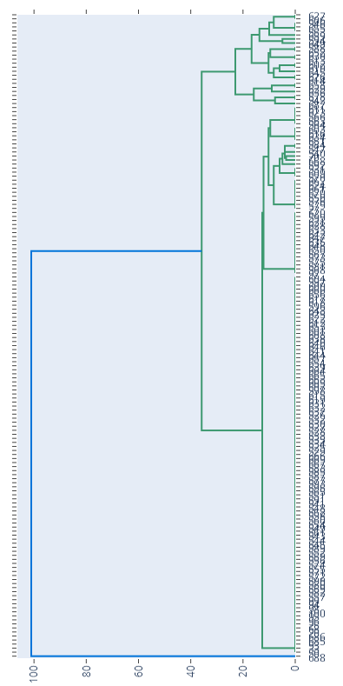

POPLAR
WIMCO Population at a Glance
Germplasm
Groups
Population Status
Group | GTs
Wimco collection | 18
Lalkuan collection | 11
Exotic collection | 70
Solan collection | 56
Populus gamblei | 1
Total | 156
97
Group 1
Group 2
96
95
Group 3
Group 4
3 distinct groups based SSR Genomic sampling
H_{e}= $1−\sum_{2}^{n}{p_{i}^{2}}$
H_{e} > H_{o} : Inbreeding
H_{e} < H_{o} : High heterozygotes
H_{e} > 0.5: great for improvement
Very high potential for seggregants with high trait diversity
High potential for hybrids
Current lower Trait diversity NOT necessarily be the indicator potential improvement

Slide 5
POPLAR
WIMCO Population actionable
Key metrics | Status | Breeding Actionable
Overall GD & AMOVA | He = 0.64 vs Ho = 0.79 Allelic diversity, Highly heterozygous, Not inbred, excess of heterozygotes Within populations – High (99%) Pop differentiation among W, S & G) – Low (1%) Private alleles (range 1.07 to 1.64) | Highly heterozygous, Not inbred, excess of heterozygotes Genetically almost identical, heavily shared germplasm pool. Individual groups hold unique alleles, beneficial for selective breeding.
PCoA | Three clusters Cluster1 - Distinct Wimco (Wimco – 39, 83, 108 & 109) Intermediate cluster (Intermix of all series) Cluster3 – Highly distinct (G3, G48 from Australia & Bhinmal) | Genetically distinct from central cluster Relatively similar Most valuable source of genetic divergence.

Slide 6
Tree Breeding Program Architecture Metrics
Selection Framework: Detailing Provenance Testing, Full-Sib Recurrent Selection, Half-Sib Progeny Testing, and Clonal Archiving.
3 Paths
200–300
20–30
Integrated Selection Lines
Preserved Clonal Lines
Elite Commercial Clones
Combines clonal trials, controlled full-sib breeding, and open-pollinated half-sib evaluation for maximum yield and diversity.
Elite ortets and parental clones maintained long-term in the central Archive Plantation for ongoing genetic conservation.
Selected for final deployment in Steckling Seed Orchards, delivering high volume timber and pulpwood gain to plantations.

Slide 7
Tree Improvement Master Flowchart
COMPLETE PROCESS ARCHITECTURE
Clonal Pathway
Full-Sib Cycle
Half-Sib Cycle
Archive
NATURAL STAND
SELECTED PHENOTYPES MASS SELECTION OR PLUS TREES
PATHWAY A: PROVENANCE
PATHWAY B: FULL-SIB CONTROLLED BREEDING
PATHWAY C: HALF-SIB LINE
CLONAL PROVENANCE TRIAL
FULL-SIB FAMILIES (TOP CROSS / POLYCROSS)
HALF-SIB FAMILIES
EVALUATE
STECKLING SEED ORCHARD
PROGENY TESTS
PROGENY TEST
COMMERCIAL PLANTATIONS
BEST SELECTED TREES CLONED (200 - 300 Clones)
BEST SELECTED ORTETS CLONED (200 - 300 Clones)
CLONAL TESTS
ARCHIVE PLANTATION
MULTI-LOCATIONAL CLONAL TESTS
RECURRENT CYCLE
2nd GEN FULL-SIB FAMILIES & PROGENY
STECKLING SEED ORCHARD & PLANTATIONS

Slide 8



Phenotypic Selection & Source Identification
STAGE 1 FOUNDATION
Natural Stand Selection
Plus Tree Identification
Breeding Branching
Wild populations provide foundational genetic diversity. Phenotypes are screened visually for superior growth, stem straightness, and pest resistance.
Mass selection screens thousands of candidate stems to isolate elite "Plus Trees" representing top 1% genetic superiority.
Selected material is directed into three concurrent pathways: Direct Clonal Trials, Controlled Full-Sib Crosses, and Open-Pollinated Half-Sib Lines.

Slide 9
Full-Sib Crossing & Recurrent Selection
PATHWAY BREAKDOWN
Controlled Breeding Control
1. TOP CROSS / POLYCROSS
Both parentages (maternal and paternal) are strictly known. Controlled crosses maximize specific combining ability and genetic gain.
2. FULL-SIB PROGENY TESTS
Rigorous Progeny Testing
Offspring performance is evaluated across site trials to verify additive genetic variance and remove inferior genotypes early.
3. CLONE BEST 200–300 TREES
Recurrent Breeding Loop
4. RECURRENT BREEDED FAMILIES
The top 200–300 individuals are cloned for secondary evaluation, forming the baseline for next-generation breeding cycles.

Slide 10
Half-Sib Line & MLT
COMMERCIAL DEPLOYMENT
Half-Sib Family Testing
Open-pollinated seeds from plus trees evaluate general combining ability (GCA) with reduced initial crossing costs.
1. HALF-SIB FAMILIES
2. PROGENY TEST
Ortet Selection (200–300 Clones)
Superior individual trees (ortets) within elite progeny rows are vegetatively propagated into distinct clonal lines.
3. ORTETS CLONED (200–300)
Multi-Locational Environmental Screening
Clones are deployed across diverse soil and climatic zones to test genotype-by-environment (G×E) interaction and stability.
4. MULTI-SITE CLONAL TESTS

Slide 11
Germplasm & Mass Production Integration
PRESERVATION & SCALING
CENTRAL HUB
MASS PROPAGATION
Archive Plantation
Steckling Seed Orchards
Serves as a safe gene bank storing all top-performing clones from both Full-Sib and Half-Sib lines. Protects long-term genetic gain against catastrophic losses.
Filters tested materials down to the top 20–30 elite clones to supply high-quality stecklings (rooted cuttings) and seeds for operational planting.
•
Preserves top 200–300 elite clones
•
Refines output to best 20–30 clones
•
Provides material for future breeding cycles
•
Rapid multiplication for commercial nurseries
•
Prevents genetic erosion over generations
•
Direct supply channel to industrial plantations

Slide 12
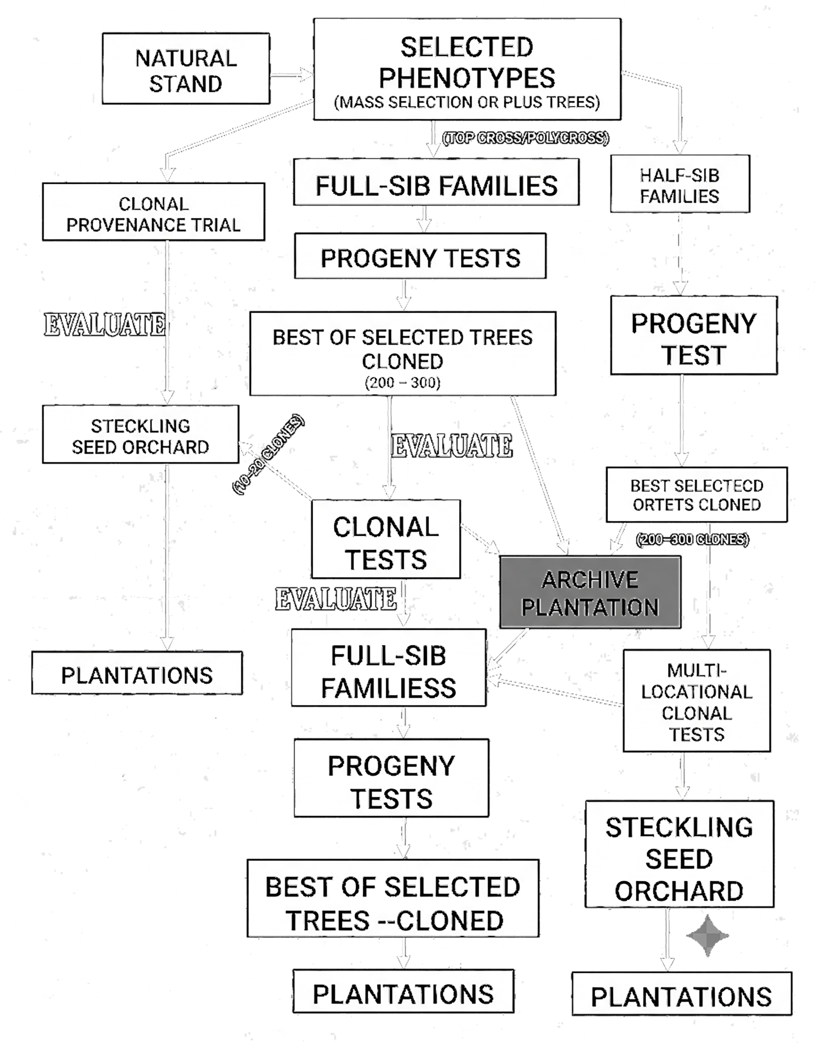
SUMMARY
Breeding Pipeline
Seed orchard Design
Genetic thinning
Breeding without Breeding (BwB)
Assessment of existing collections
Assessment of GCA/SCA for heterotic vigor
Current Clones

Slide 13

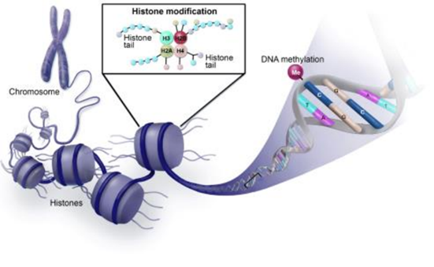
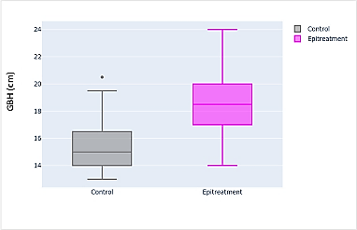
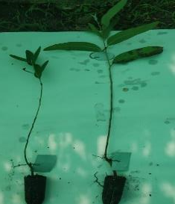
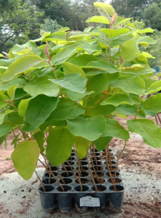
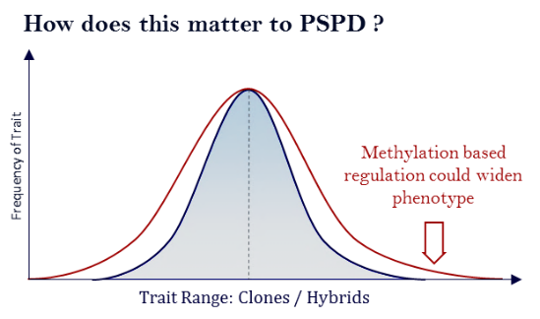
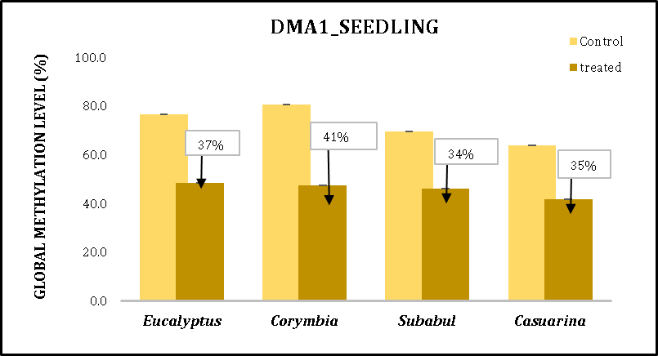
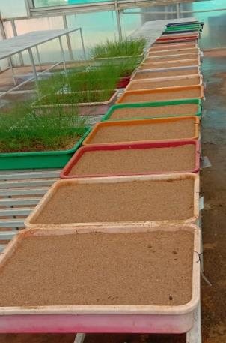
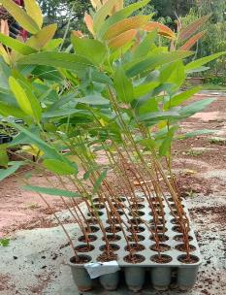
EPI
BREEDING
HYPOTHESIS
Treated Gen
SCALE UP
Epigenetic Signatures can alter the phenotype “permanently”
Method developed for all 4 trees with molecular confirmations
2023: Validation completed
2025: DEMO in progress

Slide 14
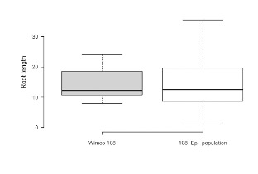
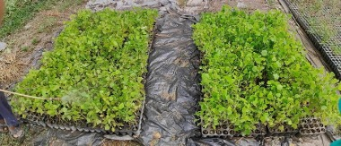
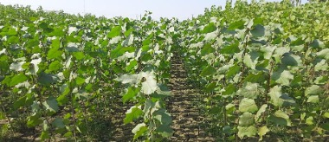
Epigenetic Breeding in Poplar for WY
Initial treatment shows encouraging results
WIMCO-83
WIMCO-113
Epi populations – 2 Genotypes
Field nursery plantation at WIMCO

Slide 15
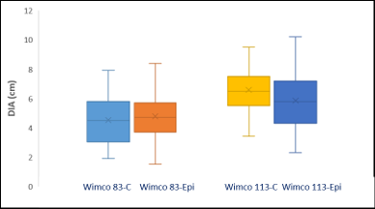
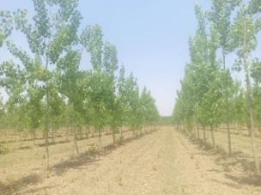
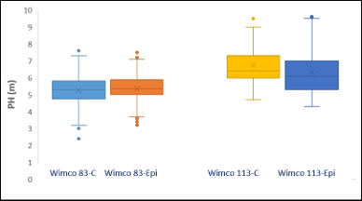
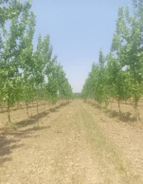
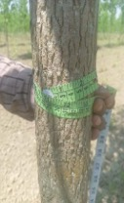
Epigenetic Breeding in Poplar for WY
Chandane Farm, WIMCO, 2.3 Yr data with encouraging results
Promising improved wood yield in Poplar -WIMCO Clones
Chandain farm, Rudrapur, WIMCO, DOP: 02/03/2024

Slide 16
-end-

