Slide 1

Global and Indian Coffee Scenario
Dr. Pradeepa Babu B N
Deputy Director (Research),
Coffee Board, Department of Commerce, Ministry of Commerce and Industry, Government of India.

Slide 2
MARKET INTELLIGENCE & EXPORTS

Slide 3
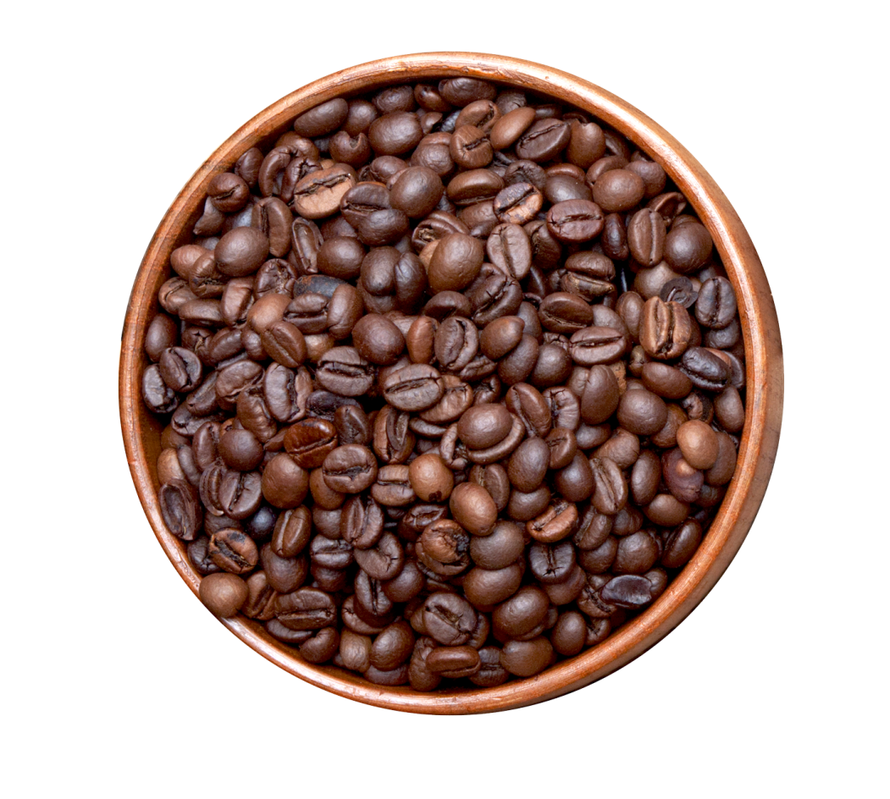
MARKET INTELLIGENCE & EXPORTS
  Exports:
  Market Intelligence:
Registration/renewal of exporters for export of coffee
Issue of RCMC/Export Permit/ICO certificate of origin
Approval of ‘Returns of Confirmations’ on proof of shipment
Implementation of Export promotion scheme
Issue/renewal of coffee curing units license
Market research/dissemination/Crop Estimation
Trade policy matters of coffee (FTAs, SPS & TBT etc.)
Foreign Trade Policy and GST matters on coffee
Digitization activities of the Coffee Board

Slide 4
Global Coffee Production – by Type
57%
43%
44%
Source: USDA Note: * projections for 2024/25

Slide 5
Global Coffee Production – by Type
57%
43%
44%
Source: USDA Note: * projections for 2024/25

Slide 6
Global Coffee Production – by Type
CAGR-1.71%
CAGR-1.11%
CAGR-2.99%
57%
43%
44%
Source: USDA Note: * projections for 2024/25

Slide 7
Coffee Production in Brazil and Viet Nam Vs. Rest of the World
Source: USDA Note: * projections for 2024/25

Slide 8
Global Coffee Consumption (lakh tonnes)
57%
43%
44%
Consumptio-CAGR-4.55%
Production-1.71%
Source: USDA Note: * projections for 2024/25

Slide 9
Coffee Productivity in Brazil and Viet Nam Vs. Rest of the World
Source: FAO

Slide 10
Global Coffee Production – by Region
Region | Production in lakh tonnes |  |  |  |  |  | % share in global coffee production
 | 2018-19 | 2019-20 | 2020-21 | 2021-22 | 2022-23 | Avg. (2018-19 to 2022-23)
Africa | 11.11 | 11.22 | 11.56 | 11.48 | 11.64 | 11.40 | 11%
Caribbean/Central America and Mexico | 12.82 | 11.59 | 11.85 | 11.79 | 11.84 | 11.98 | 12%
South America | 49.16 | 48.64 | 50.36 | 46.56 | 49.45 | 48.83 | 48%
Asia & Pacific | 28.84 | 29.58 | 28.75 | 31.26 | 29.83 | 29.65 | 29%
Total | 101.93 | 101.03 | 102.52 | 101.09 | 102.76 | 101.87 | 100%
60%
57%
43%
44%
Source: ICO

Slide 11
Global Coffee Production – by Region-By Type
57%
43%
44%
Source: ICO

Slide 12
Global Coffee Production – by Region-By Type
Region | Arabica | Robusta | Total
Africa | 11.22% | 11.48% | 11.33%
Caribbean/Central America and Mexico | 19.69% | 0.44% | 11.52%
South America | 61.76% | 29.64% | 48.13%
Asia & Pacific | 7.33% | 58.43% | 29.03%
Total | 100.00% | 100.00% | 100.00%
57%
43%
44%
About 80%
About 88%
Source: ICO

Slide 13
Major Arabica Coffee Producing Countries in the World
Country/Year | 2021/22 | 2022/23 | 2023/24 | Dec 2024/25* | Avg. 2021/22 to 2023/24 | % Share in Total
Brazil | 21.84 | 23.88 | 26.94 | 27.24 | 24.22 | 44.64%
Colombia | 7.08 | 6.42 | 7.66 | 7.74 | 7.05 | 13.00%
Ethiopia | 4.89 | 4.38 | 5.16 | 5.02 | 4.81 | 8.87%
Honduras | 2.88 | 3.42 | 3.00 | 3.18 | 3.10 | 5.71%
Peru | 2.52 | 2.09 | 2.40 | 2.61 | 2.34 | 4.30%
Mexico | 1.92 | 1.80 | 2.00 | 2.00 | 1.91 | 3.51%
Guatemala | 2.05 | 1.89 | 1.98 | 1.98 | 1.97 | 3.63%
Nicaragua | 1.63 | 1.46 | 1.32 | 1.52 | 1.47 | 2.71%
China | 1.08 | 1.08 | 1.08 | 1.08 | 1.08 | 1.99%
Indonesia | 0.77 | 0.72 | 0.81 | 0.84 | 0.77 | 1.41%
India | 0.95 | 1.00 | 0.89 | 0.84 | 0.95 | 1.74%
Costa Rica | 0.73 | 0.66 | 0.66 | 0.66 | 0.68 | 1.26%
Vietnam | 0.66 | 0.60 | 0.60 | 0.66 | 0.62 | 1.14%
Uganda | 0.59 | 0.59 | 0.60 | 0.60 | 0.60 | 1.10%
PN Guinea | 0.44 | 0.50 | 0.56 | 0.55 | 0.50 | 0.91%
Other | 2.24 | 2.19 | 2.18 | 2.20 | 2.20 | 4.06%
Total | 52.26 | 52.67 | 57.83 | 58.71 | 54.25 | 100.00%
58%
Source: USDA Note: * projections for 2024/25
India is the 11th largest producer of Arabica coffee

Slide 14
Major Robusta Coffee Producing Countries in the World
Year/Country | 2021/22 | 2022/23 | 2023/24 | Dec 2024/25* | Avg. 2021/22 to 2023/24 | % Share in Total
Vietnam | 18.29 | 16.38 | 15.90 | 17.40 | 16.86 | 37.26%
Brazil | 13.02 | 13.68 | 12.84 | 12.60 | 13.18 | 29.14%
Indonesia | 5.58 | 5.70 | 4.08 | 5.70 | 5.12 | 11.32%
Uganda | 3.04 | 3.35 | 3.24 | 3.24 | 3.21 | 7.09%
India | 2.47 | 2.52 | 2.75 | 2.88 | 2.58 | 5.70%
Malaysia | 1.20 | 1.20 | 0.80 | 0.90 | 1.07 | 2.36%
Cote d'Ivoire | 0.67 | 0.61 | 0.80 | 0.84 | 0.69 | 1.53%
Thailand | 0.39 | 0.42 | 0.45 | 0.42 | 0.42 | 0.93%
Tanzania | 0.33 | 0.33 | 0.36 | 0.38 | 0.34 | 0.75%
Mexico | 0.32 | 0.33 | 0.33 | 0.33 | 0.33 | 0.72%
Other | 1.47 | 1.45 | 1.44 | 1.52 | 1.45 | 3.21%
Total | 46.77 | 45.96 | 42.98 | 46.21 | 45.24 | 100.00%
65%
Source: USDA Note: * projections for 2024/25
India is the 5th largest producer of Robustacoffee

Slide 15
Major Coffee Producing Countries in the World
Year/Country | 2021/22 | 2022/23 | 2023/24 | Dec 2024/25* | Avg. 2021/22 to 2023/24 | % Share in total
Brazil | 34.86 | 37.56 | 39.78 | 39.84 | 37.40 | 37.59%
Vietnam | 18.95 | 16.98 | 16.50 | 18.06 | 17.48 | 17.57%
Colombia | 7.08 | 6.42 | 7.66 | 7.74 | 7.05 | 7.09%
Indonesia | 6.35 | 6.42 | 4.89 | 6.54 | 5.89 | 5.92%
Ethiopia | 4.89 | 4.38 | 5.16 | 5.02 | 4.81 | 4.83%
Uganda | 3.63 | 3.94 | 3.84 | 3.84 | 3.80 | 3.82%
India | 3.42 | 3.52 | 3.64 | 3.72 | 3.53 | 3.54%
Honduras | 2.88 | 3.42 | 3.00 | 3.18 | 3.10 | 3.12%
Peru | 2.52 | 2.09 | 2.40 | 2.61 | 2.34 | 2.35%
Mexico | 2.24 | 2.13 | 2.32 | 2.32 | 2.23 | 2.24%
Other | 12.21 | 11.78 | 11.62 | 12.05 | 11.87 | 11.93%
Total | 99.03 | 98.63 | 100.80 | 104.91 | 99.49 | 100.00%
55%
Source: USDA Note: * projections for 2024/25
India is the 7th largest producer of coffee in the World

Slide 16
Global Coffee Exports-by type
62%
38%
60%
40%
62%
38%
38%
Source: USDA Note: * projections for 2024/25

Slide 17
Top 10 Coffee Exporting Countries
Country/Year | 2021-22 | 2022-23 | 2023-24 | 2024-25* | Avg. 2021-22 to 2023-24 | % Share in total
Brazil | 24.69 | 23.68 | 23.42 | 29.78 | 25.39 | 32.38%
Viet Nam | 15.48 | 17.21 | 16.59 | 13.58 | 15.72 | 20.04%
Colombia | 7.51 | 6.94 | 6.42 | 7.43 | 7.08 | 9.02%
Indonesia | 4.24 | 4.20 | 3.88 | 4.32 | 4.16 | 5.31%
India | 4.02 | 4.07 | 3.80 | 4.15 | 4.01 | 5.12%
Uganda | 4.06 | 3.38 | 3.67 | 3.83 | 3.73 | 4.76%
Honduras | 3.65 | 2.70 | 3.21 | 2.71 | 3.07 | 3.91%
Ethiopia | 2.55 | 2.42 | 2.14 | 3.80 | 2.73 | 3.48%
Peru | 2.02 | 2.44 | 2.05 | 2.62 | 2.28 | 2.91%
Guatemala | 2.26 | 1.94 | 1.89 | 2.02 | 2.03 | 2.59%
Others | 7.92 | 8.57 | 7.98 | 8.39 | 8.22 | 10.48%
Total | 78.42 | 77.56 | 75.05 | 82.64 | 78.42 | 100.00%
52%
62%
38%
60%
40%
62%
38%
38%
Source: ICO Note: * estimates for 2024/25

Slide 18
Top 10 Coffee Importing Countries
Importing Country | 2021-22 | 2022-23 | 2023-24 | 2024-25* | Avg. 2021-22 to 2023-24 | % Share in total
EU | 26.20 | 46.61 | 45.55 | 41.31 | 39.92 | 37.44%
USA | 17.53 | 18.39 | 15.76 | 15.58 | 16.82 | 15.77%
Germany | 13.23 | 13.71 | 12.04 | 11.17 | 12.54 | 11.76%
Italy | 6.60 | 7.23 | 6.80 | 6.06 | 6.67 | 6.26%
France | 4.96 | 4.54 | 4.50 | 3.77 | 4.44 | 4.17%
Japan | 4.53 | 4.44 | 4.04 | 3.59 | 4.15 | 3.90%
Belgium | 3.99 | 4.46 | 3.59 | 2.86 | 3.73 | 3.49%
Spain | 3.65 | 4.00 | 3.70 | 3.51 | 3.72 | 3.49%
Russia | 4.12 | 3.50 | 3.51 | 2.69 | 3.45 | 3.24%
Netherlands | 3.29 | 3.81 | 3.56 | 3.11 | 3.44 | 3.23%
Canada | 3.25 | 3.47 | 3.18 | 2.96 | 3.21 | 3.01%
Other | 47.06 | 46.73 | 45.43 | 38.56 | 44.44 | 41.69%
Total | 112.20 | 114.29 | 106.12 | 93.87 | 106.62 | 100.00%
54%
62%
38%
60%
40%
62%
38%
38%
Source: ICO Note: * estimates for 2024/25

Slide 19
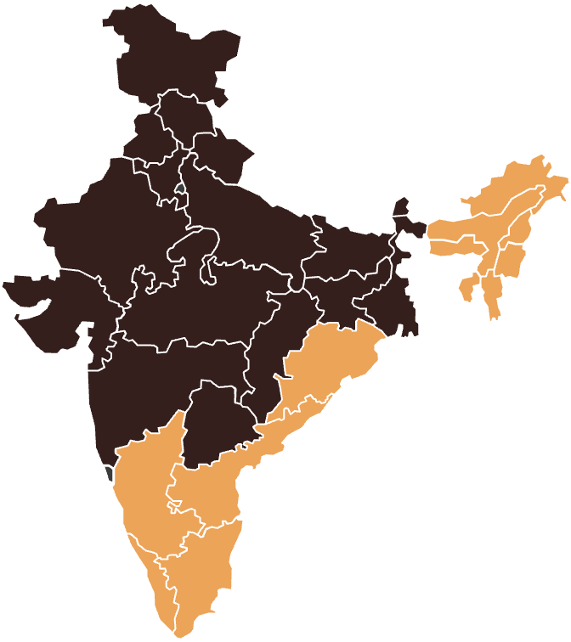
BASIC FACTS ABOUT INDIAN COFFEE SECTOR
Seventh largest producer in the world with a production share of 3.54%
Fifth largest Exporter in the world with a share of 5.12%
Area under coffee : 4.90 lakh ha
Holdings : 4.41 lakh
Production : 3.60 lakh MT(2023-24)
Productivity : National Avg.~824 Kg/Ha.
Exports : 3.84 lakh MT during
2023-24 (include re-exports)
Export earnings : US$ 1.29 billion
About 2 million people employed directly / indirectly
NE Region
1.25%
Karnataka
0.04%
50.64%
70.62%
NTAs
23.11%
3.61%
Kerala
17.63%
20.46%
Tamil Nadu
7.37%
5.36%
Source: Coffee Board

Slide 20
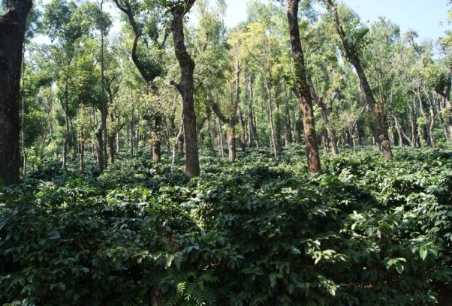
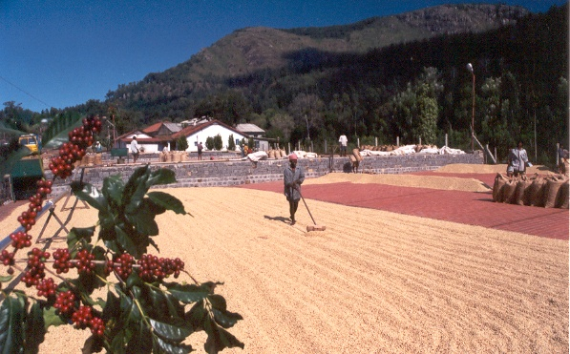
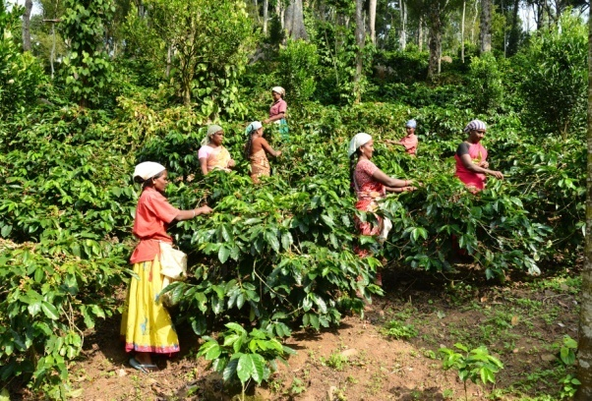
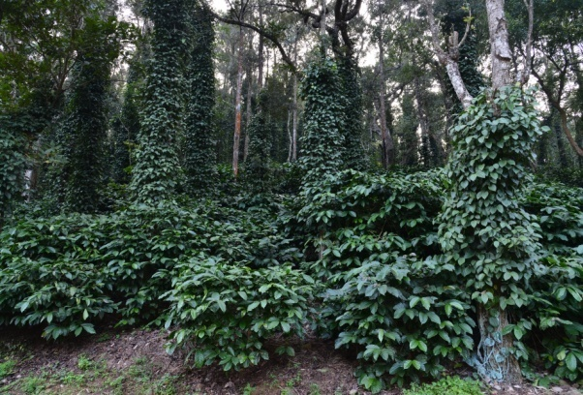
UNIQUENESS OF INDIAN COFFEES
Shade grown – Typical Forest Agro-system
Sustainable production and processing methods - Sun dried
Hand picked – Large human intervention
Scope for diversification – associated/inter crops

Slide 21
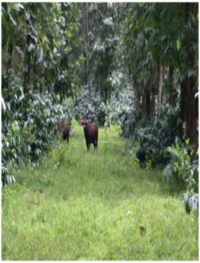

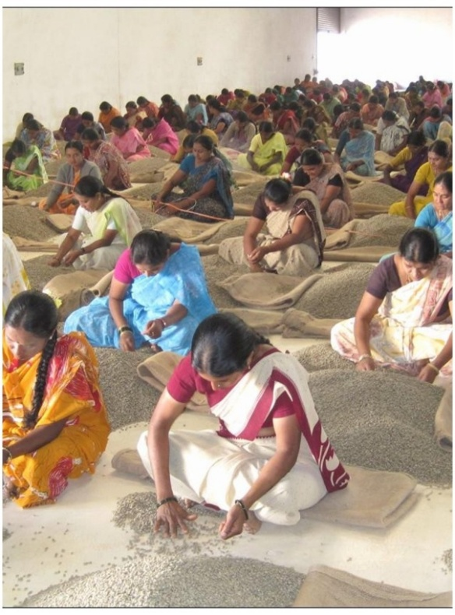
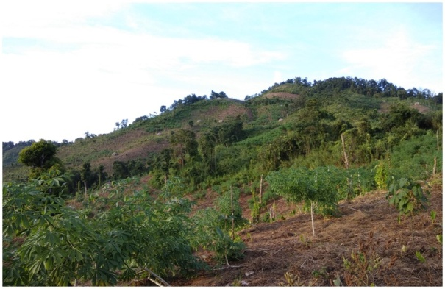
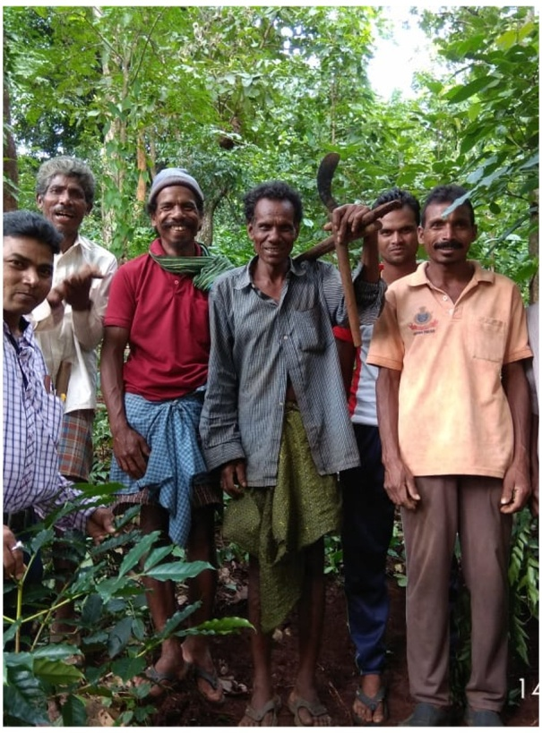
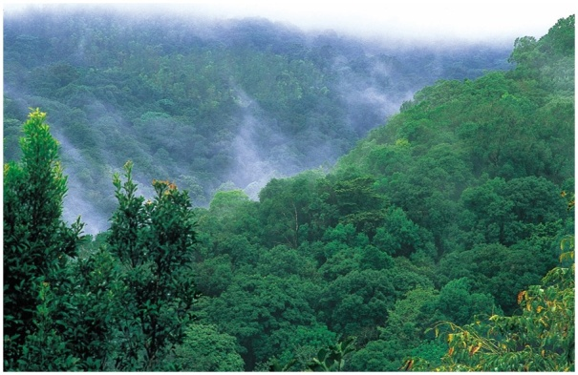
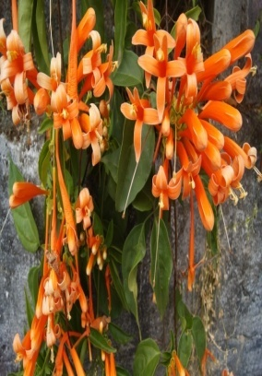
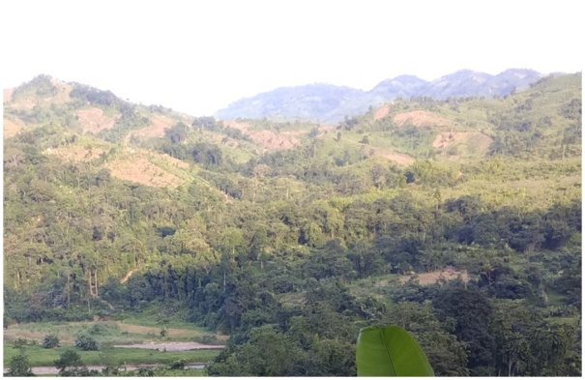
SIGNIFICANCE OF COFFEE SECTOR
Preservation of ecology, flora and fauna
Employment
Reforestation of
Podu lands
Livelihood
Largely cultivated in bio-sensitive regions (W/E.Ghats).
A boon to the preservation of ecology, flora and fauna
Provides livelihood for tribal farmers. Responsible for Socio-economic development in remotest/backward areas.
Over 20 lakh people directly and indirectly.
Rejuvenation of green cover in Eastern Ghats

Slide 22
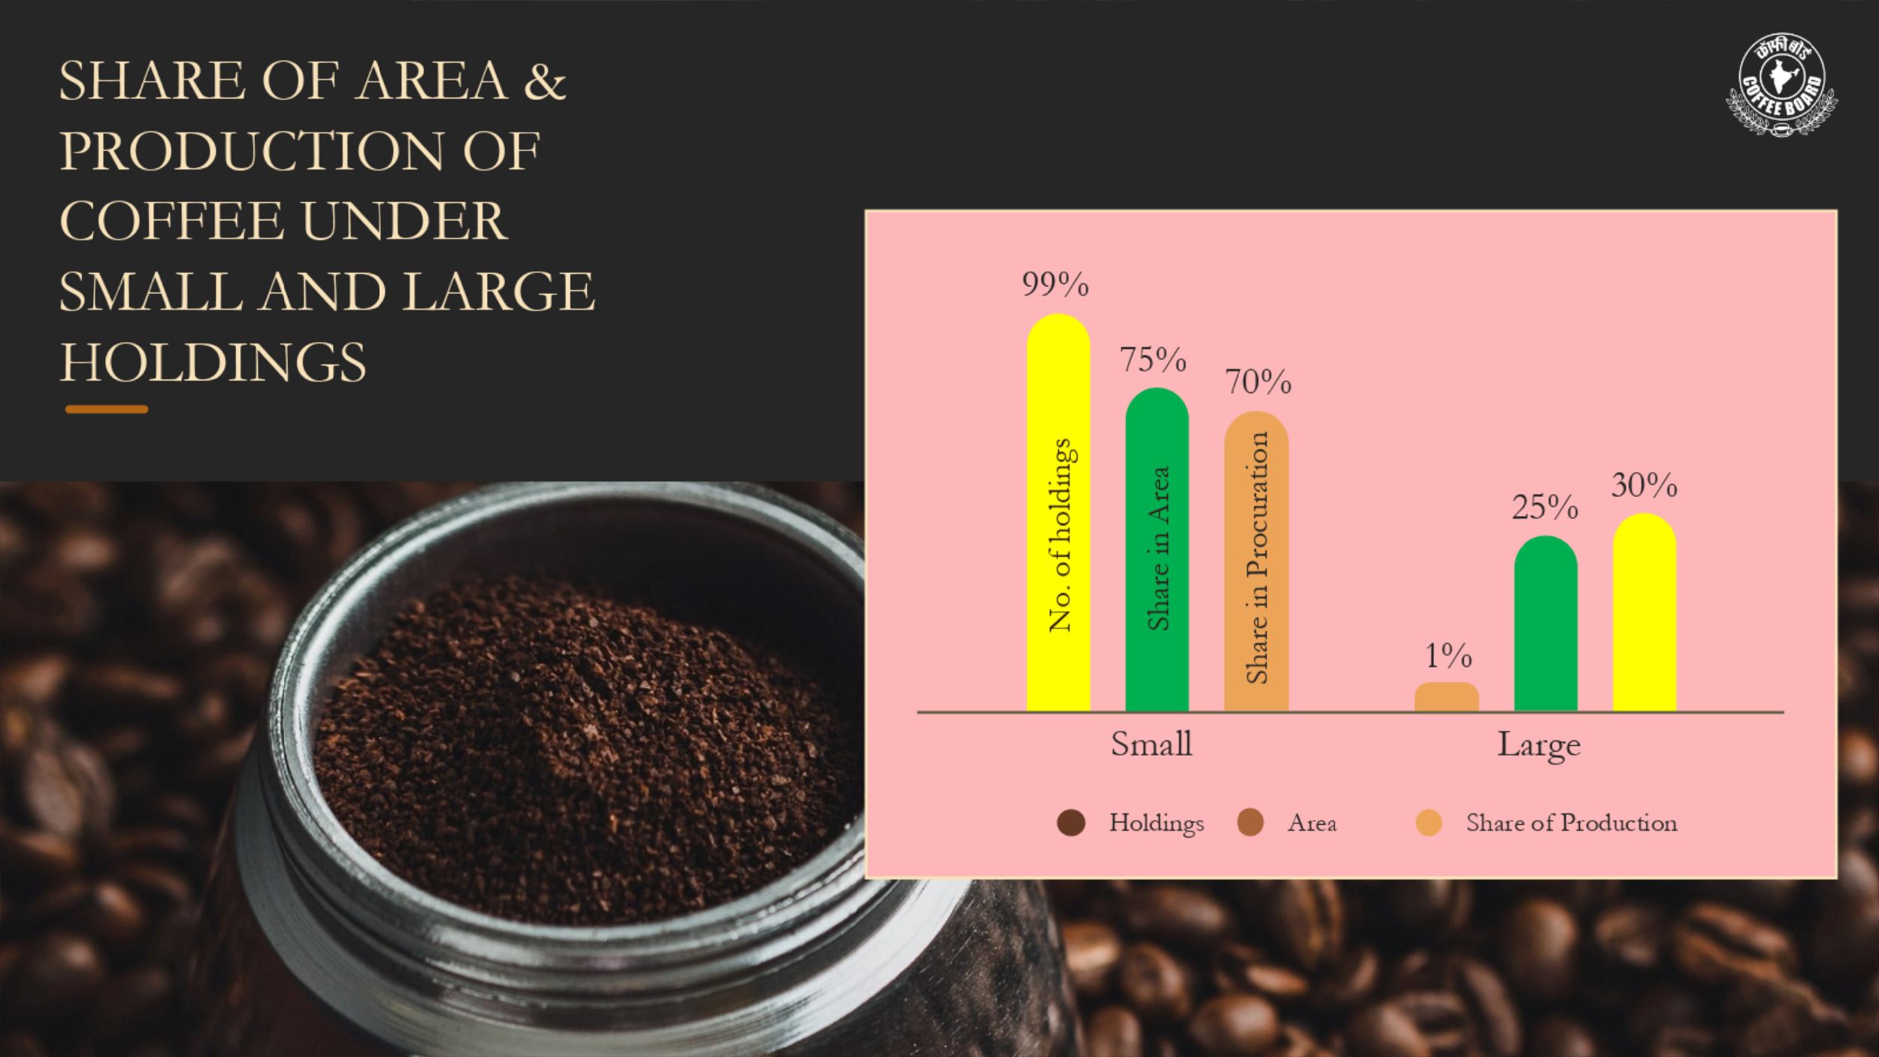
Source: Coffee Board

Slide 23
Decade Wise Coffee Area (Ha) And Production (MT)
Source: Coffee Board

Slide 24
Share of Arabica and Robusta in total area under coffee during last 8 decades (%)
Source: Coffee Board

Slide 25
Share of Arabica and Robusta in total production during last 8 decades (%)
Source: Coffee Board

Slide 26
Decade Wise Coffee Exports
Export Quantity in MT
Export Value USD million
Source: Coffee Board

Slide 27
Transformation of Coffee Exports (Incl. Re-exports) Since 1990s
Source: Coffee Board

Slide 28
Details of State wise Area under Coffee for last 3 years (in hectares)
State/District | 2021-22 | 2022-23 | 2023-24 | Avg. 2021-22 to 2023-24 | % Share in total
Karnataka | 246050 | 246550 | 248942 | 247181 | 51.46%
Kerala | 85880 | 85957 | 85957 | 85931 | 17.89%
Tamil Nadu | 35652 | 35685 | 35914 | 35750 | 7.44%
Andhra Pradesh | 94956 | 100963 | 107363 | 101094 | 21.05%
Odisha | 4424 | 4868 | 5351 | 4881 | 1.02%
NER | 4695 | 5647 | 6092 | 5478 | 1.14%
Total | 471657 | 479669 | 489619 | 480315 | 100.00%
77%
Source: Coffee Board

Slide 29
Details of State wise Production for last 3 years
State/District | Coffee Production in tonnes
 | 2021-22 | 2022-23 | 2023-24 | Avg. 2021-22 to 2023-24 | % Share in Total
Karnataka | 241650 | 248020 | 254575 | 248082 | 70.58%
Kerala | 69900 | 72425 | 73750 | 72025 | 20.49%
Tamil Nadu | 17970 | 18700 | 19340 | 18670 | 5.31%
Andhra Pradesh | 11765 | 12265 | 12210 | 12080 | 3.44%
Odisha | 565 | 465 | 465 | 498 | 0.14%
North Eastern Region | 150 | 125 | 160 | 145 | 0.04%
All India | 342000 | 352000 | 360500 | 351500 | 100%
96%
Source: Coffee Board

Slide 30
Share of Arabica and Robusta in total Production-State wise
Source: Coffee Board

Slide 31
Details of State wise Productivity for last 3 years (Kg/Ha.)
State/District | 2021-22 | 2022-23 | 2023-24
Karnataka | 1062 | 1089 | 1118
Kerala | 823 | 852 | 867
Tamil Nadu | 530 | 553 | 568
Andhra Pradesh | 153 | 153 | 145
Odisha | 135 | 110 | 110
North Eastern Region | 101 | 81 | 76
Total | 797 | 814 | 824
Source: Coffee Board

Slide 32
State and Type wise Productivity (Kg/Ha.)
Source: Coffee Board

Slide 33
India’s consumption increased at moderate pace in last decade
Coffee consumption volume (GBE equivalent to ‘000 MT)
Note: 2024P is based on inputs from the consumer survey study conducted by CRISIL to determine coffee consumption in India; domestic coffee consumption estimates as per CRISIL MI&A
Source: Coffee Board of India, International Coffee Organization(ICO), CRISIL MI&A
Coffee consumption in India increased from 84,000 MT in coffee year (CoY) 2012 to 91,000 MT in CoY 2023 and is estimated at 90,000-95,000 MT in CoY 2024
Increase in share of instant coffee, rise in per capita income and discretionary spending in both rural as well as urban areas led to rise in coffee consumption
Urban areas continue to see rising café culture and higher out of home (OOH) consumption
Coffee consumption is driven by India’s younger demographics, developing taste preference and rising demand for niche and specialty coffee
Source: Coffee Board

Slide 34
Consumption share of instant coffee increased to 60-65%
Consumption volume break-up based on type of coffee consumed
Coffee preferences have seen a significant shift in the last decade with traditionally dominant roasted and ground/filter coffee seeing lesser uptake as the decade progressed
The share of ground /filter coffee in total domestic consumption volume decreased from 82% in 2010 to 35-40% in 2022 showing a significant shift in the type of coffee consumed
Hassle-free preparation, café culture and rising prices of robusta coffee (3.5% in the last decade) have contributed to this shift
At home consumption contributes to 93-94% of coffee consumption in India
34
Source: Coffee Board

Slide 35
India’s Coffee Exports including the re-exports during the last five years
Financial Year | Quantity (tonnes) | Value (Rs. in Crores) | Value (USD million)
2019-20 | 326554 | 5199 | 734
2020-21 | 310647 | 5451 | 735
2021-22 | 413942 | 7656 | 1016
2022-23 | 396346 | 8984 | 1146
2023-24 | 387852 | 10486 | 1286
Source: Coffee Board

Slide 36
Top 15 Export Destinations for Indian Coffees
SL NO | COUNTRY | 2019-20 (tonnes) | 2020-21 (tonnes) | 2021-22 (tonnes) | 2022-23 (tonnes) | 2023-24 (tonnes) | Avg. 2019-20 to 2023-24 | % Share in Total
1 | ITALY | 63605 | 59002 | 75502 | 58276 | 63999 | 64077 | 17.50%
2 | GERMANY | 34099 | 32205 | 37949 | 42792 | 37151 | 36839 | 10.06%
3 | RUSSIA | 26862 | 16179 | 24802 | 38664 | 25257 | 26352 | 7.20%
4 | UAE | 2753 | 4662 | 9316 | 17476 | 21478 | 11137 | 3.04%
5 | BELGIUM | 19941 | 23856 | 29495 | 27096 | 18756 | 23829 | 6.51%
6 | TURKEY | 10723 | 6029 | 15497 | 19431 | 16508 | 13638 | 3.72%
7 | POLAND | 16503 | 11749 | 12790 | 16126 | 14814 | 14396 | 3.93%
8 | MALAYSIA | 7735 | 8588 | 8317 | 10983 | 11729 | 9471 | 2.59%
9 | LIBYA | 3811 | 9790 | 10722 | 11821 | 10971 | 9423 | 2.57%
10 | JORDAN | 7604 | 9197 | 17837 | 14087 | 10844 | 11914 | 3.25%
11 | U.S.A. | 7037 | 8072 | 10422 | 10081 | 9040 | 8930 | 2.44%
12 | UK | 4427 | 3388 | 4300 | 5945 | 7567 | 5125 | 1.40%
13 | KUWAIT | 6675 | 6647 | 6032 | 6364 | 7235 | 6591 | 1.80%
14 | GREECE | 5607 | 5503 | 7725 | 6527 | 6183 | 6309 | 1.72%
15 | SAUDI ARABIA | 3152 | 3793 | 5352 | 6341 | 6093 | 4946 | 1.35%
 | OTHERS | 106021 | 101985 | 137883 | 104334 | 116029 | 113251 | 30.92%
 | TOTAL | 326554 | 310647 | 413941 | 396346 | 383653 | 366228 | 100.00%
34%
70%
Source: Coffee Board

Slide 37
State-wise Coffee Exports
State | 2023-24 (USD million) | % Share in Total
KARNATAKA | 814 | 63.29%
ANDHRA PRADESH | 247 | 19.22%
KERALA | 91 | 7.05%
TAMIL NADU | 70 | 5.44%
TELANGANA | 25 | 1.95%
MAHARASHTRA | 22 | 1.72%
OTHERS | 17 | 1.34%
Total | 1286 | 100.00%
Source: DGCIS

Slide 38

European Union is the Major Destination
European Union is the major destination for India’s coffee exports with the share of about 54% of India’s total coffee exports.
European Union accounts for about 70% India’s green coffee exports, about 18% of soluble coffee exports and 22% of Roast and Ground coffee exports.
Source: Coffee Board

Slide 39
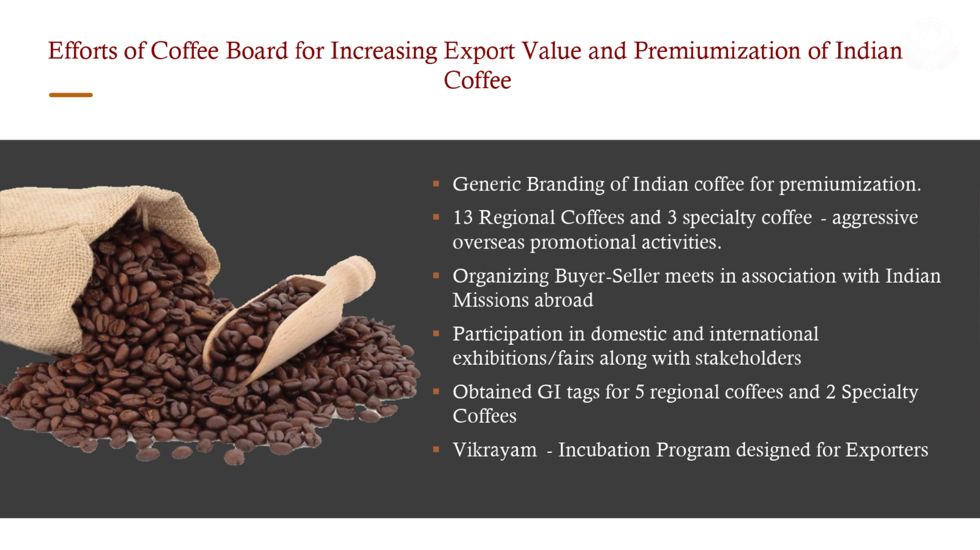

Slide 40
European Union Deforestation Regulation(EUDR)-An Overview
Prevents products (cocoa, coffee, soy, wood, palm oil, rubber, and cattle) linked to deforestation from entering the EU market
As per the EUDR Regulation any company in EU importing coffee has to prove coffee has been sourced from deforestation-free areas.
Coffee HS lines covered under EUDR
Chapter -0901 Coffee, whether or not roasted or decaffeinated; coffee husks and skins; coffee substitutes containing coffee in any proportion
Chapter | HS Code at six digits level | Description
09 | 090111 | Coffee (excl. roasted and decaffeinated)
09 | 090112 | Decaffeinated coffee (excl. roasted)
09 | 090121 | Roasted coffee (excl. decaffeinated)
09 | 090122 | Roasted, decaffeinated coffee
09 | 090190 | Coffee husks and skins; coffee substitutes containing coffee in any proportion

Slide 41
European Union Deforestation Regulation
EUDR Timeline
EUDR has been in force since 29th June 2023, mandates that specific commodities and products sold or exported
The law intend to minimize the EU’s contribution to global deforestation or forest degradation (in case of only wood).
EUDR requires European companies to prove that coffee traded by them were not produced on the land that was deforested after 31 December 2020.
New time line-effective from 30th December 2025 (30th June 2026 for small operators)
EUDR Main Requirement: Importers require to produce a due diligence statement proving their coffees are not contributing to the deforestation/forest degradation and coffee produced in accordance with relevant legislations of the country.
EUDR regulations mandates the businesses to furnish the traceability data down to the farm level, encompassing geolocation data ensuring traceability to the specific plot of land.

Slide 42
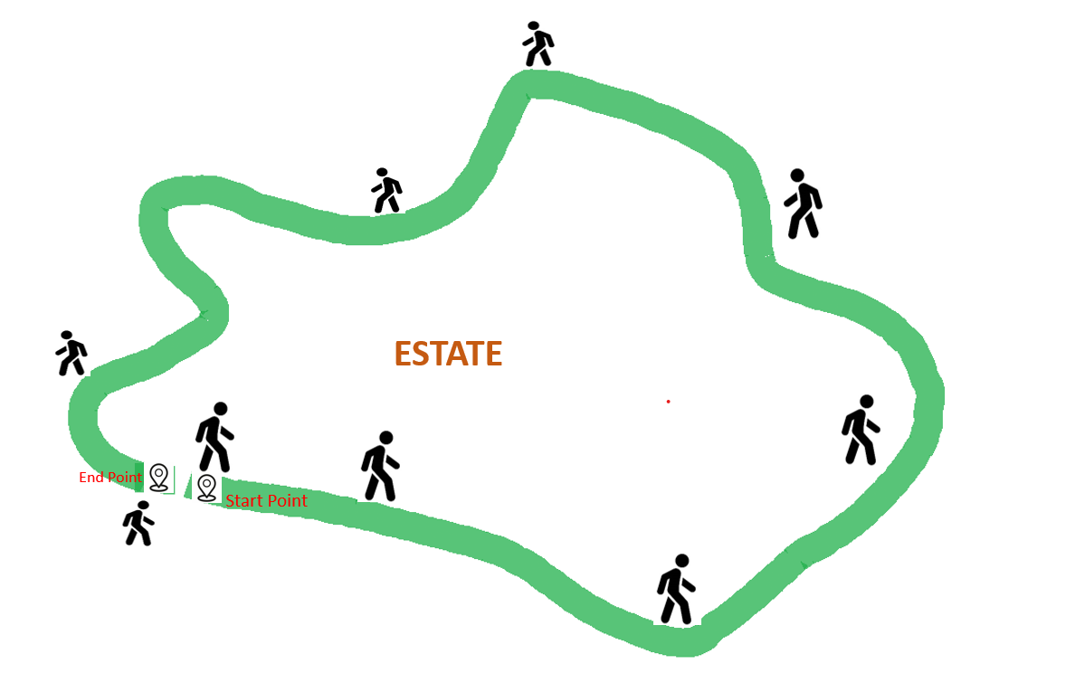
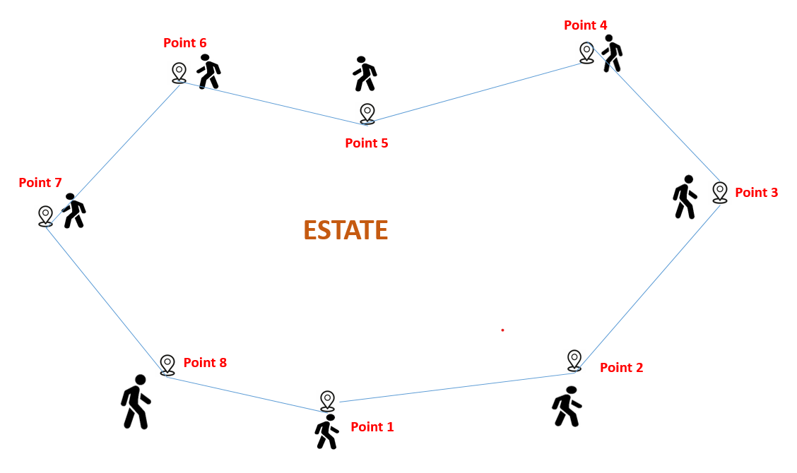
Generating Polygon/Geolocation to meet the EUDR Compliances
The Coffee Board has developed a mechanism in India Coffee App for generating the Polygons using GPS coordinates of coffee estate boundaries.
Generating Polygon with two options:
First option- Farmer has to walk around the estate;
system will capture the location for the same.
Second option- Farmers has to mark minimum 4 &
there is no limit for maximum number of points,
the system will consume the points will come up
with a Polygon

Slide 43
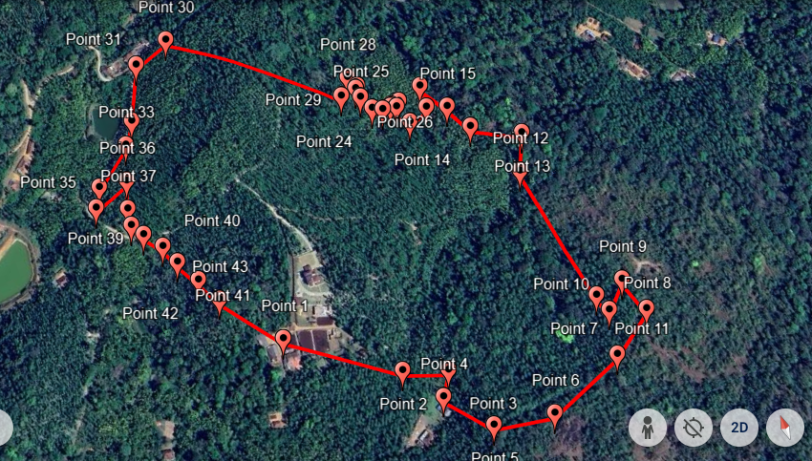
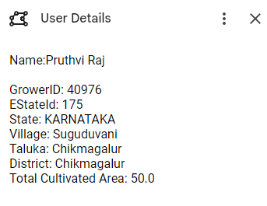
Generating Polygon/Geolocation to meet the EUDR Compliances
The generated polygon information will be submitted to the importers in KML/GeoJSN file format.
These mechanism has been integrated in India coffee App where in Coffee farmers can generate the polygon of their estate on their own.

Slide 44
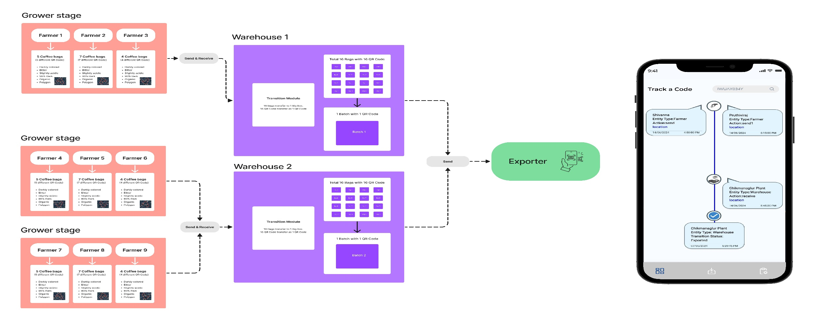
Coffee Board’s Traceability Approach
The entire traceability data including polygons and Geo locations will be stored in Government Servers. Only coded information will be provided to the importers.

Slide 45
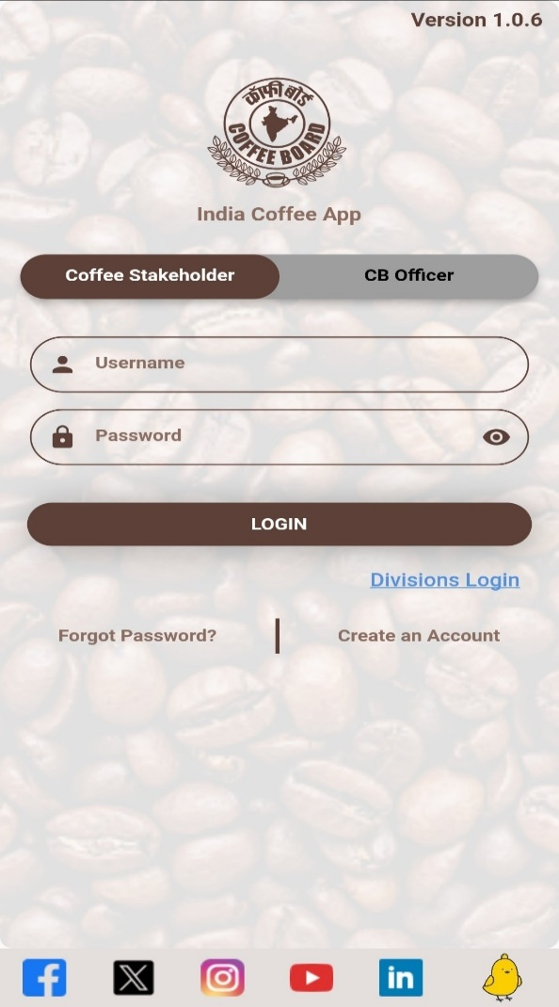
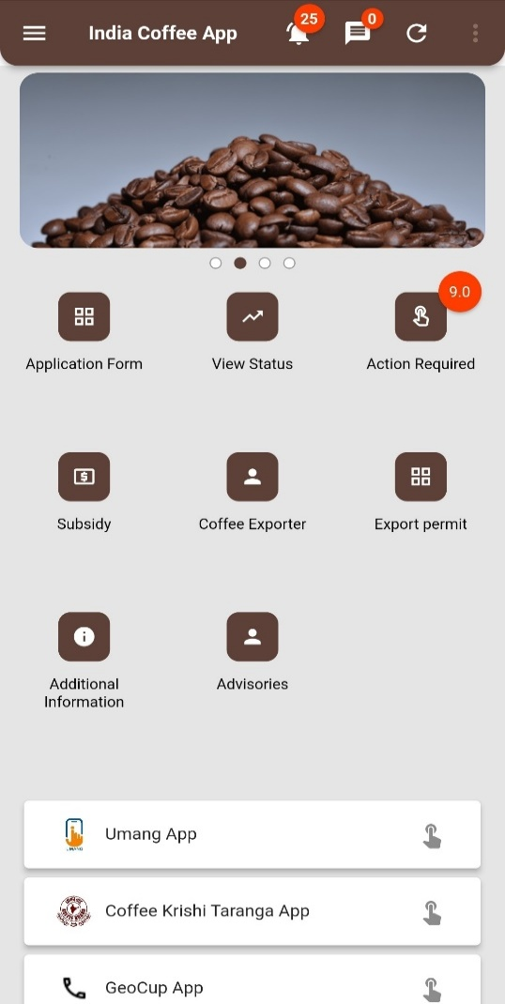
India Coffee APP
‘India Coffee App’ is one stop solution to avail all the products, services and information of the Coffee Board by the Stakeholders on real time basis.
This integrated mobile app will also help the Coffee Board to deliver the products and services to stakeholders more efficiently.

Slide 46
SWOT Analysis
Strengths-India | Strengths-Vietnam
Coffee in India is grown under a canopy of thick natural shade in ecologically sensitive regions of the Western and Eastern Ghats. This is one of the 25 biodiversity hotspots of the world. Coffee contributes significantly to sustain the unique bio- diversity of the region. India grows at least 13 unique varieties of coffee. Some of these shade trees produce fruits and also pepper vines are grown on these shade trees which become an additional source of income for the growers. Indian coffee production system is more sustainable since it is grown under agroforestry system. Indian coffee has created a niche for itself in the international market and the Indian Coffees are earning high premium, particularly Indian Robusta which is highly preferred for its good blending quality. Arabica Coffee from India is also well received in the international market. Large shade trees provide a habitat for native wildlife, support soil health, fight erosion which helps the growers to get the sustainable and biodiversity certificates for their coffees. India is one of the largest manufacturer of Instant coffee in the World. No MRLS issues | Vietnam has advantages in terms of natural conditions, weather and land- Vietnam has a natural advantage because of its location in the belt of Northern Hemisphere. It has fascinating weather, high humidity, stable rain and especially volcanic soils which boost the growth, Vietnam has a strength in coffee productivity in worldwide- coffee yield Vietnam is the second largest coffee producer in the world. It is reported that, there is an abundant labor force and cheap, high rate of young population with diligent, hard-working, enthusiastic characteristics. Vietnam coffee started building its brand and name in the world. Cheaper Origin MRL issues

Slide 47
SWOT Analysis
Weakness-India | Weakness-Vietnam
Limited Branding of Indian Coffee White Stem Borer damage in Arabica coffee plantations. India is a minor player in the global coffee market with the share of about 3.5% in production and 5% of Global exports. Hence, India is not in a position to influence the coffee prices. Increased labour wages in the Coffee plantations. Indian coffees are grown in Hilly areas (undulating terrain) under shade trees which makes difficult to mechanize the farms. | Quality standards and food hygiene are still low. Vietnam coffee is not high valued. In Vietnam Coffee is grown under very low shade or open conditions/basin by applying more of chemical inputs with intensive style where there are no thick canopy of shade trees and in this manner of production, the coffee doesn’t last very long (not sustainable) and degrades the environment. It is reported that, beans grown in direct sunlight taste worse than coffee grown under shade. More susceptible to adverse climatic conditions especially rising temperature

Slide 48
SWOT Analysis
Opportunities-India | Opportunities-Vietnam
Brand building-GI for Indian Coffees Quality Enhancement- Traceable coffees, certified, organic and specialty coffees Boosting domestic consumption Improvement of marketing systems-Bringing transparency in the Marketing system by adopting Block chain technologies. Research and development of for improving the production, productivity and quality of coffee. Alternative Species | Value addition at origin Moving towards sustainable cultivation practices

Slide 49
SWOT Analysis
Threats-India | Threats-Vietnam
Consistent increase in input cost can erode competitiveness of Indian coffee in the international markets. Impact of Climate Change Dwindling Arabica Coffee | Due to intensive production practices coffee trees are exhausted quickly after every harvest. As a result, replanting should be carried out after every 10-15 years of planting which stresses huge investment followed by 3-4 years gestation period. Vietnamese primarily focus on the quantity instead of improving the quality of coffee which may be deterrent for future coffee export trade due to growing demand for quality coffees in the importing countries. Erratic weather may bring unforeseen damage to crop production, the weather in Vietnam continued getting impact from El Nino phenomenon, it become the one of main causes of the water shortage issue for irrigation, which badly affect the robusta coffee production.

Slide 50
Differential for Indian Robusta Coffee Over ICE Europe
During 2024 US$ 996/tonne for Rob parchment and US$ 415 /tonne
Source: ICO

Slide 51
Specialty Coffee Prices
Source: Emory University’s Goizueta Business School and a committed roster of specialty coffee cooperatives, exporters, importers, and roasters.

Slide 52
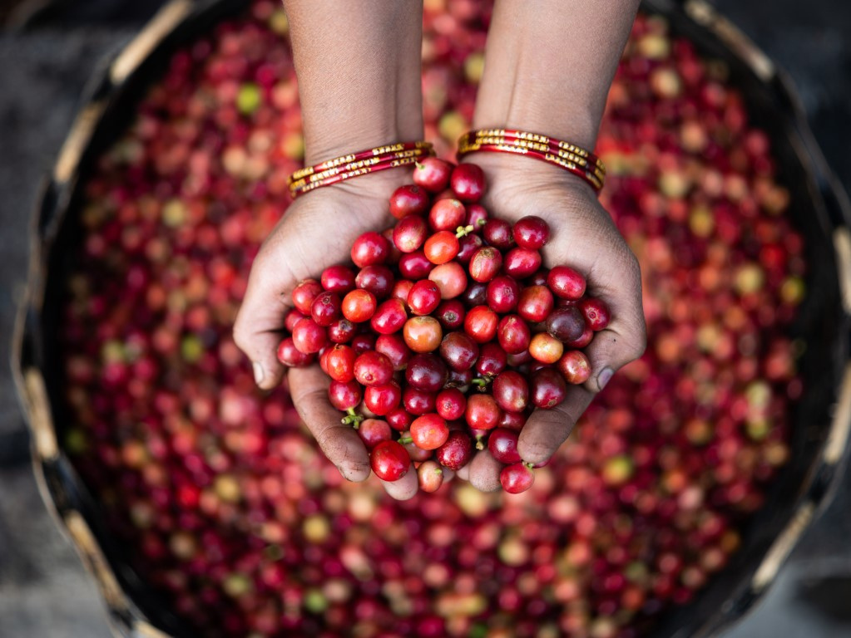
THANK YOU

