Slide 1
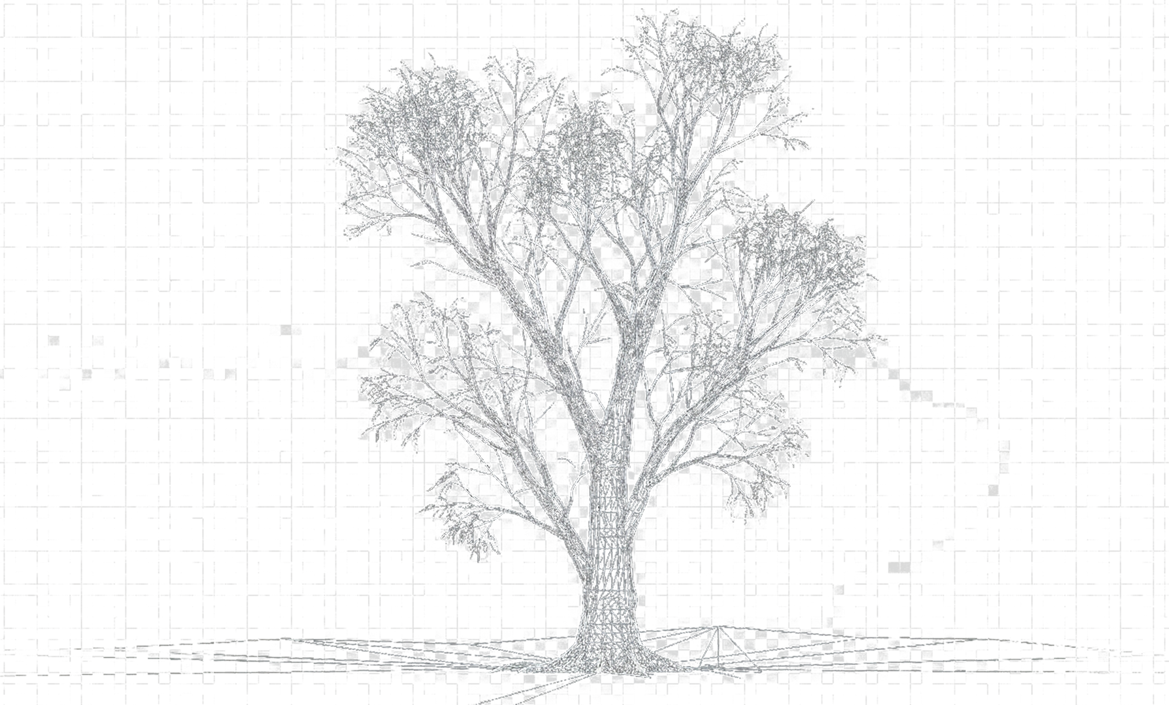
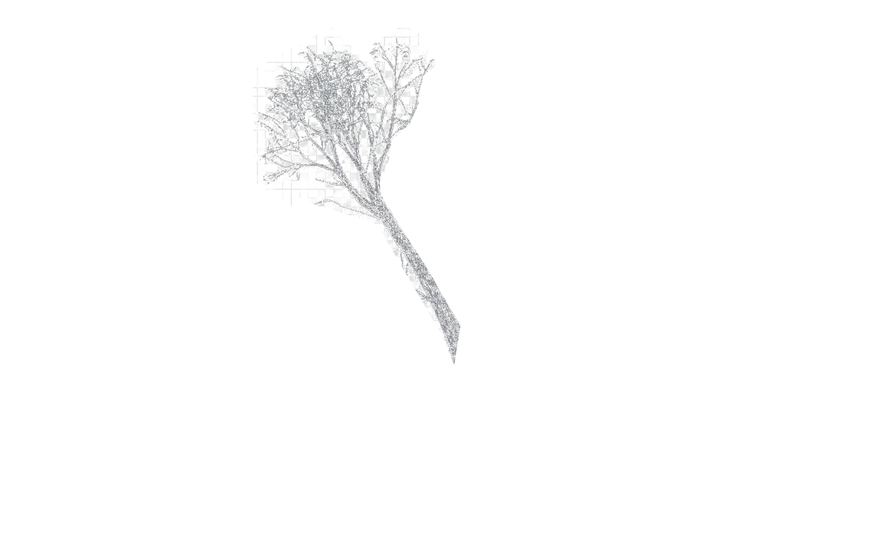
SILVI
The Blueprint for Growth
20 Years of Breeding Lessons, Resource Reality & Next-Gen Strategy

Slide 2



Contents
Tree Improvement
PF shift & Resources
DATA
Euca
Poplar
Subabul
Casuarina
Corymbia
Current Issues
SWOT
Shift from Species to Platform
RoadMap (Platform)
RoadMap (Leadership)
Current Practices
Data-Lake pipeline
Implementation

Slide 3
TREE IMPROVEMENT

Slide 4




B
ack
to
asics
Population Vs Individual Selection
Powerful Measure of allelic diversity in a population
HW on a Population ~ p+ q = 1
Original Population
Selection
Cycle 1
Selection
Cycle 2
Family collections
Expected Heterozygosity H_{e}= $1−\sum_{1}^{n}{p_{i}^{2}}$
Frequency
Average performance
Observed Heterozygosity Ho​ = $\frac{\sum_{1}^{n}{Nhet}}{N}$
High selection pressure
∆g
Inbreeding Coefficient $F=1−\frac{H_{o}}{H_{e}}$
$$\text{∆}\text{g} =h2.δp.\frac{Si}{l}$$
ℎ² : 𝐻𝑒𝑟𝑖𝑡𝑎𝑏𝑖𝑙𝑖𝑡𝑦
δ_{𝑝} : 𝑃ℎ𝑒𝑛𝑜𝑡𝑦𝑝𝑖𝑐 𝑣𝑎𝑟𝑖𝑎𝑡𝑖𝑜𝑛
S𝑖 : 𝑆𝑒𝑙𝑒𝑐𝑖𝑡𝑜𝑛 𝐼𝑛𝑡𝑒𝑛𝑠𝑖𝑡𝑦
𝑙 : 𝐺𝑒𝑛𝑒𝑟𝑎𝑡𝑖𝑜𝑛 𝑐𝑦𝑐𝑙𝑒
H_{e} > H_{o} : Inbreeding, deficiency of heterozygotes
H_{e} < H_{o} : High heterozygotes, Disassortative Mating
H_{e} > 0.5: Generally great for Improvement
Genetic Gain

Slide 5

B
ack
to
asics
$δp$ ~ $\int_{1}^{i}{δg}+e+(δg.e)$
Original Population
New introduction require time to “adapt” to the new environment (~3 gen).
Adaption @ individual family level
Frequency
Ideal domestication for improvement
Family 1
Family 2
Family 3
Family 4
Stratified family representation is essential for striking the balance between good He and adaptive genetic variance max(σA​ )
Stratification
Selections
OP

Slide 6
EUCALYPTUS

Slide 7

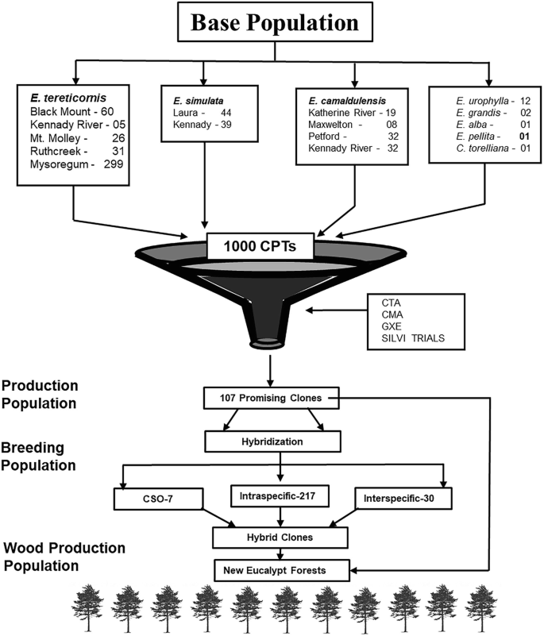
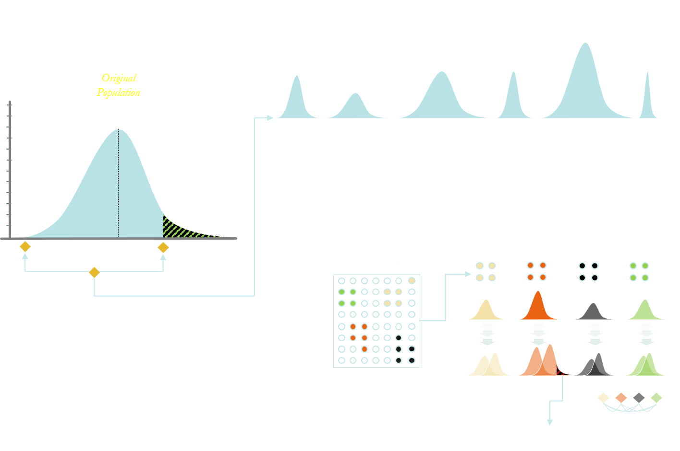
EUCALYPTUS
ITC 23/25/26*
series
ITC 18* series
ITC 20*
series
1800-1972
1972-1990
1990-2008
2008+
Missed or To be Done
Mysore gum
10 seedlots
~MPM / IFGTB
40 seedlots
IFGTB
100 families
ITC
250 families
Family wise stratified domestication
Mini Australia
To maintain He
To capture adaptive genetic variance max(σA​ )
Direct Selections
IFGTB / BCM Clones

Slide 8
EUCALYPTUS
Weakness
Land for domestication / adaptation pipeline
Lack of Core breeding pipeline
Informed breeding integration
Opportunities
Continuous advancement Germplasm (mini Australia) for Adaptive genetic variance max(σA​ ) for sustainable growth
actionable
Land for core breeding
Resource restructuring

Slide 9
SUBABUL

Slide 10
SUBABUL
Seed deployment - potential
Subabul Planting Propagules
Yield potential
Strategies for subabul productivity
2%
Hyco seedlings
Promoting clonal plantations
Seeds on par with clones
95%
Direct seeds
3%
Clones
Potential WY @ 3 Yrs. (MT / ac)
Seeds from unknown
Seeds from K8
Seeds from Clones
C16
C146
ITC 2553
ITC 2554
ITC 2555
Lack of uniformity
Poor survival due to inbreeding depression
Termination of genetic gain
Seeds:
biotic stress tolerant
Less expensive propagules
No lodging
Clones:
High yielding

Slide 11
SUBABUL
plan for B_{w}B: seed = clone
LEUCAENA
CURRENT PRACTICE
APPROACH TO IMPROVE THE SEED PERFORMANCE
L. Leucocephala ssp. leucocephala.
L. Leucocephala ssp. glabra.
L. diversifolia
G. Gain in seeds from developed clone
Orchard with Genetically diverse material
µ₁
µ_{x}
Short
Bushy
high seeding
Tall
Straight
Poor seeding
Shy rooter
Superior WY
µ_{x}
µ₁
C 16
K 636
C 146
∂₁
∂₁
∂_{y}
∂_{x}
∂_{1,} ~ ∂_{x}
µ_{1 <} µ_{x}
∂_{1,} µ_{1 >} ∂_{x,} µ_{x}
Self pollinated species ~> 95 % selfing
Seeds directly from clones is a selfed seeds; will continue to loosen the genetic vigor due to inbreeding depression
Seeds from diverse material has potential improve the population mean

Slide 12





SUBABUL
Breeding plan
Germplasm collection
SHORT TERM
Pre-selection
Pure seed orchard
Seed delivery
Understand the genetic diversity
Business Directives
LONG TERM
Families pre-selected with high “He”
Families pre-selected with high “Ho”
Clone (~<20%)
WY > 30 t/ac
Low Lodging
Low branching
Wilt free
Seed: (~>80%)
On par with Clone
CC - Hybrids
Segregants
Clonal Trials
Seed orchard
Seed delivery
DNA Markers
Epigenetics
External Collaboration
Disease resistance

Slide 13
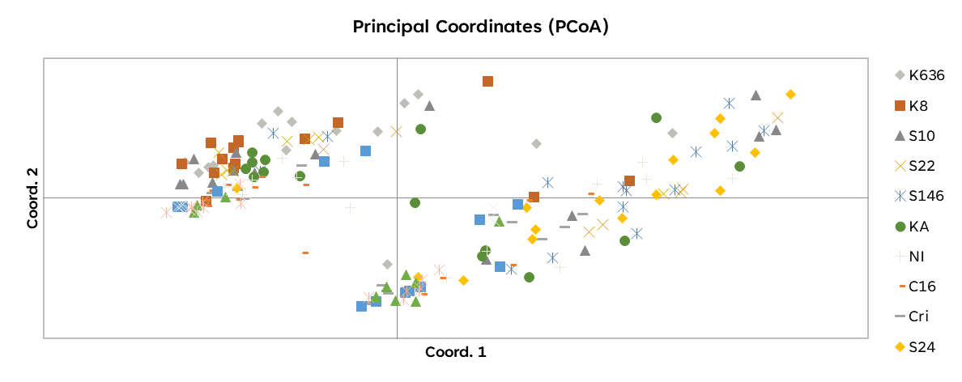
SUBABUL
plan for B_{w}B: seed = clone
Genetic affinity-based grouping
L. l. ssp. Leucocephala outcrossing proportion
Original Hawaii collection
Crida collections
Based on Parental Progeny allelic frequencies
3 families were isolated for seed orchard
Identified two major genetic groups to exhibit the potential of heterotic seeds
SSP: Leucocephala : 3 out of 12 families showed signs of outcrossing rate
SSP: diversifolia & glabra: being tested.
Self Pollination ( ~> 95%) being the serious challenge, families in all the collections are being tested for high outcrossing rate

Slide 14
SUBABUL
Actionable
Weakness
Challenging hybridization
Under Resourced for various development pipeline
Poor operational integration
Opportunities
Seed on par with clone
actionable
FTEs: Move from species to platform-based approach
Requires strong integration with genomics

Slide 15
POPLAR

Slide 16
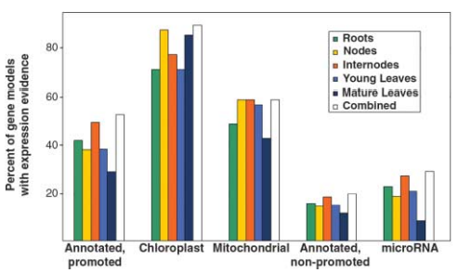
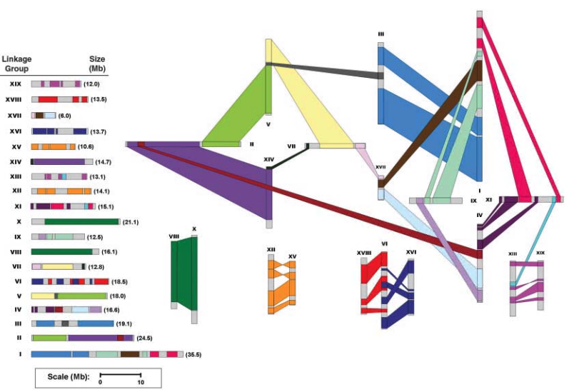
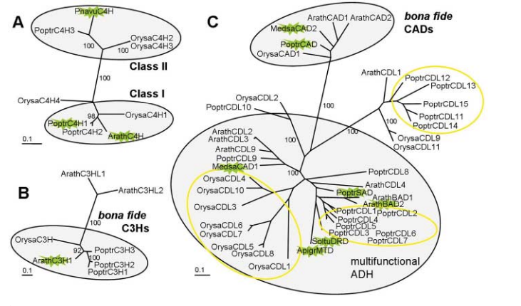
POPLAR FACTS
Well annotated 45K genes
A model system for plant Biology
Dioeceous
Anemophilic pollination
Crossable with available species
Genome size: ~500mb
Ploidy: 2n = 2x = 38 (Earlier 4x)
Rich Genomics / functional genomics tools
Availability of high-density genetic map.
Well established orthologues / paralogues
Gene families' classifications

Slide 17
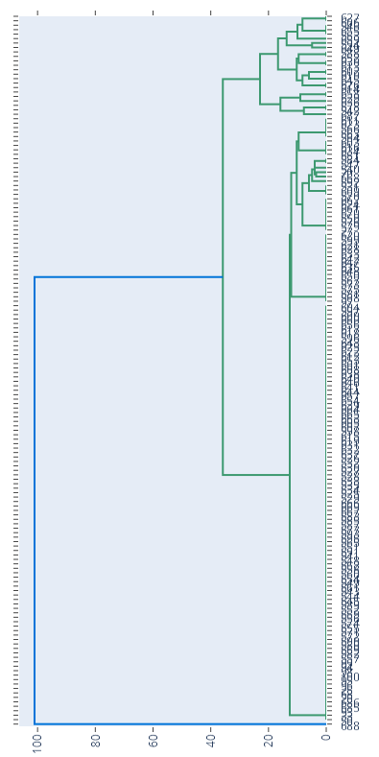

POPLAR
Population at a Glance
Germplasm
Groups
Population Status
Group | GTs
Wimco collection | 18
Lalkuan collection | 11
Exotic collection | 70
Solan collection | 56
Populus gamblei | 1
Total | 156
97
Group 1
Group 2
96
95
Group 3
Group 4
3 distinct groups based SSR Genomic sampling
H_{e}= $1−\sum_{2}^{n}{p_{i}^{2}}$
H_{e} > H_{o} : Inbreeding
H_{e} < H_{o} : High heterozygotes
H_{e} > 0.5: great for improvement
Very high potential for seggregants with high trait diversity
High potential for hybrids
Current lower TD NOT necessarily be the indicator potential improvement

Slide 18
POPLAR
Population at a Glance
Key metrics | Status | Actionable
Overall GD & AMOVA | He = 0.64 vs Ho = 0.79 Allelic diversity, Highly heterozygous, Not inbred, excess of heterozygotes Within populations – High (99%) Pop differentiation among W, S & G) – Low (1%) Private alleles (range 1.07 to 1.64) | Highly heterozygous, Not inbred, excess of heterozygotes Genetically almost identical, heavily shared germplasm pool. Individual groups hold unique alleles, beneficial for selective breeding.
PCoA | Three clusters Cluster1 - Distinct Wimco (Wimco – 39, 83, 108 & 109) Intermediate cluster (Intermix of all series) Cluster3 – Highly distinct (G3, G48 from Australia & Bhinmal) | Genetically distinct from central cluster Relatively similar Most valuable source of genetic divergence.

Slide 19
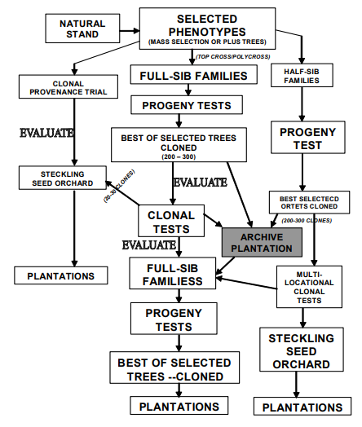
POPLAR
Breeding design for poplar
Seed orchard Design
Genetic thinning
Breeding without Breeding (BwB)
Assessment of existing collections
Assessment of GCA/SCA for heterotic vigor
Current Clones
..From Dimen

Slide 20
CASUARINA

Slide 21
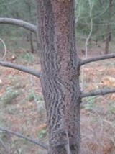
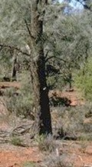
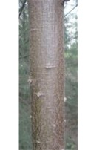
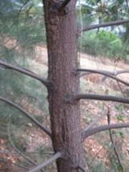
CASUARINA
15 cultivable species
Important Casuarina sps and unique traits
Ranking from 1 - 100 (100-best)
Growth
Adaptability
Stem
straightness
Wood
properties
coppicing
CR
CJ
CC
CE
Coastal species lacks adaptation & coppicing
C. equisetifolia
C. cristata
C. cunninghamiana
C. junghuhniana
2012
Introduced 115 families
18 seed lots
Decent He (Intra >0.5; Inter >0.6) for improvement
Smooth stem, Upward branches
Rough stem, Upward branches
Slight yellow, greenish stem
Rough stem, Drooping branches
Domestication of C.j was believed to the way forward for India

Slide 22

CASUARINA
A farmers’ friendly alternative
GEN^{n}
STRENGTH
PET
K Series clones / Seeds
GEN1
PET
Farmers’ Friendly
BCTMP suitability
Decent H_{e} (Intra >0.5; Inter >0.6) for improvement
Good hold on GeBV
CSO
M, S series
Trait value
SSO
ITC1761
Weakness
Adaptive genetic variance max(σA​ )
Poor collection & Flowering distribution of C.e
Under Resourced for various development pipeline
Energy spent higher on popularization
∆g
G.thinning
Genetic Gain
$$\text{∆}\text{g} =h2.δ p.\frac{Si}{l}$$
ℎ₂:𝐻𝑒𝑟𝑖𝑡𝑎𝑏𝑖𝑙𝑖𝑡𝑦
δ 𝑝:𝑃ℎ𝑒𝑛𝑜𝑡𝑦𝑝𝑖𝑐 𝑣𝑎𝑟𝑖𝑎𝑡𝑖𝑜𝑛
S𝑖:𝑆𝑒𝑙𝑒𝑐𝑖𝑡𝑜𝑛 𝐼𝑛𝑡𝑒𝑛𝑠𝑖𝑡𝑦
𝑙:𝐺𝑒𝑛𝑒𝑟𝑎𝑡𝑖𝑜𝑛 𝑐𝑦𝑐𝑙𝑒
Opportunities
Directional selection with generation advancement improves trait value (WY/PY/etc.)
Well validated with GeBV, hence model can be developed in hybrids
Responses well in Epi-treatments
Expects
FTEs: Move from species to platform-based approach
Back-end pipeline requires – Land for SO, GGTs, particularly C.g and C.c

Slide 23
CORYMBIA

Slide 24
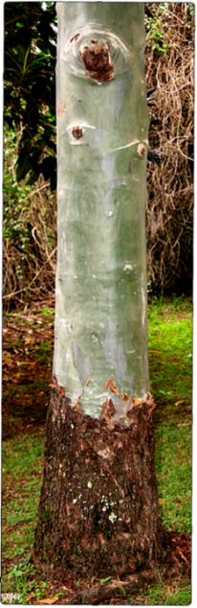
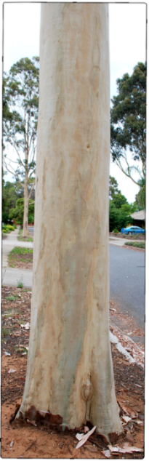
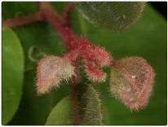
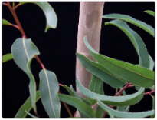

CORYMBIA
A High pulp yield candidate
Major PURE species & kraft pulp yield
World wide – Corymbia: Timer wood
E. globulus (54%)
E. obliqua
E. Camaldulensis (43-46%)
E. tereticornis
E. Deglupta
Distribution in Australia
E. grandis (57%)
E. camaldulensis
E. cladocalyx
E. diversicolor
E. lehmannii
E urophylla (54%)
E. saligna
✔
E. globulus (54%)
E. viminalis
E. rostrata.
E. nitens (54%)
E. camaldulensis
E. Tereticornis
C. torelliana
C. citriodora
1–15% survival
E.uro.
E.glo.
E.gran.
Array of Hybrid clones
✗
ITC 2081 (50.75%)
[First Corymbia Hybrid]
✔
E.camal
✗
Initial challenges
Rooting (corrected)
Grading procedure (standardised)
Bushy in the first 1.5 years
Yield is 5-8% less than current hybrids
Successful hybrids
Has upper limit on PY (46-48%)
Abiotic stress susceptibility

Slide 25
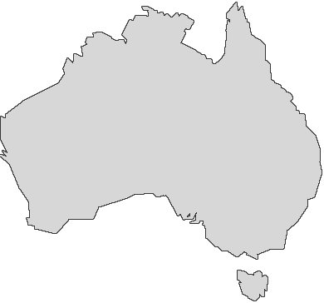
CORYMBIA
A High pulp yield candidate
CORYMBIA CURRNET BREEDING PIPLELINE
2030
Two New Hybrid Clones
STRENGTH
2027
Two New Hybrid Clones
Global first commercial hybrids of CT x CCc, CCv
Family collection represent H_{e} >0.6
Highest PY 50.75% (24 x 4 = 96 Cr /Yr @ 6000 t/day)
150 Selections
Ideotype
22 Selections
Grafted slns. for canopy, Leaf size, & Low branch
2023
Weakness
ITC 2081
2019
Poor flowering / seeding
Lack of C.c (CCV) domestication
Lack of Parental genetic gain trails (missing max(σA​ ) )
Under Resourced & Hybrid model requirement for GS
Grafted selections for Stem borer tolerance
15 selections from CT and CV
2016
Opportunities
60 selections from CC, CT and CV
Exploration of C. citriodora (pure species)
Direct commercial hybrids (due to 365 flowering of CT)
Grafted selections for PY
2015
120 selections from CC, CT and CV
Grafted selections for GROWTH
2012
Expects
CSIRO New Germplasm - Evaluation
CT, CC & CV
FTEs: Move from species to platform-based approach
Back-end pipeline requires – Land for SO, GGTs

Slide 26
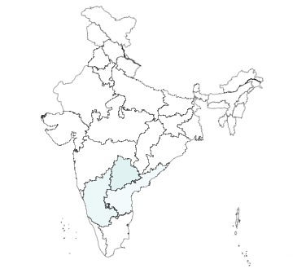
CORYMBIA
CREATION OF NEW OPPORTUNITIES FOR CORYMBIA MULTIPLICAITON
Guided multiplication units (for next season)
# | Place | Potential no of saplings (Lakhs) | Current Status | Expects from PSPD
1 | Malvalli (Mysore) | 2 | Mother plants ready | Sale Order
2 | Forest Department (KA) - MoU | 3 | Proposed, Identified | Sale Order
3 | BCM (Private Nursery) | 2 | Mother bed established | Sale Order
4 | Trichy | 3 | Mother bed planted | Experimental
5 | Laxmipuram (Ours) | 3 | Established system | -
6 | Ongole (Mannetikota) | 2 | Mother bed established | Sale Order
7 | AP - FDC | 2 | Upcoming
The growth of Corymbia multiplication can be significantly improved from second rotation onwards
17 lakhs of 2081 will be available for 2027 planting

Slide 27
SHIFT REQUIRED
Actionables
Redesign breeding pipeline to explore Adaptive genetic variance max(σA​) at provenance / family level
Resource shift to Platform based approach
Land for breeding stock / advancement (adaptive trials)
Data Integration

Slide 28
Resources

Slide 29
RESOURCES
Current Issues
Gaps in expertise vs operative
Data Lake – almost impractical
Most FTEs are under utilized
Lack of Junior FTEs and unstructured L5

Slide 30
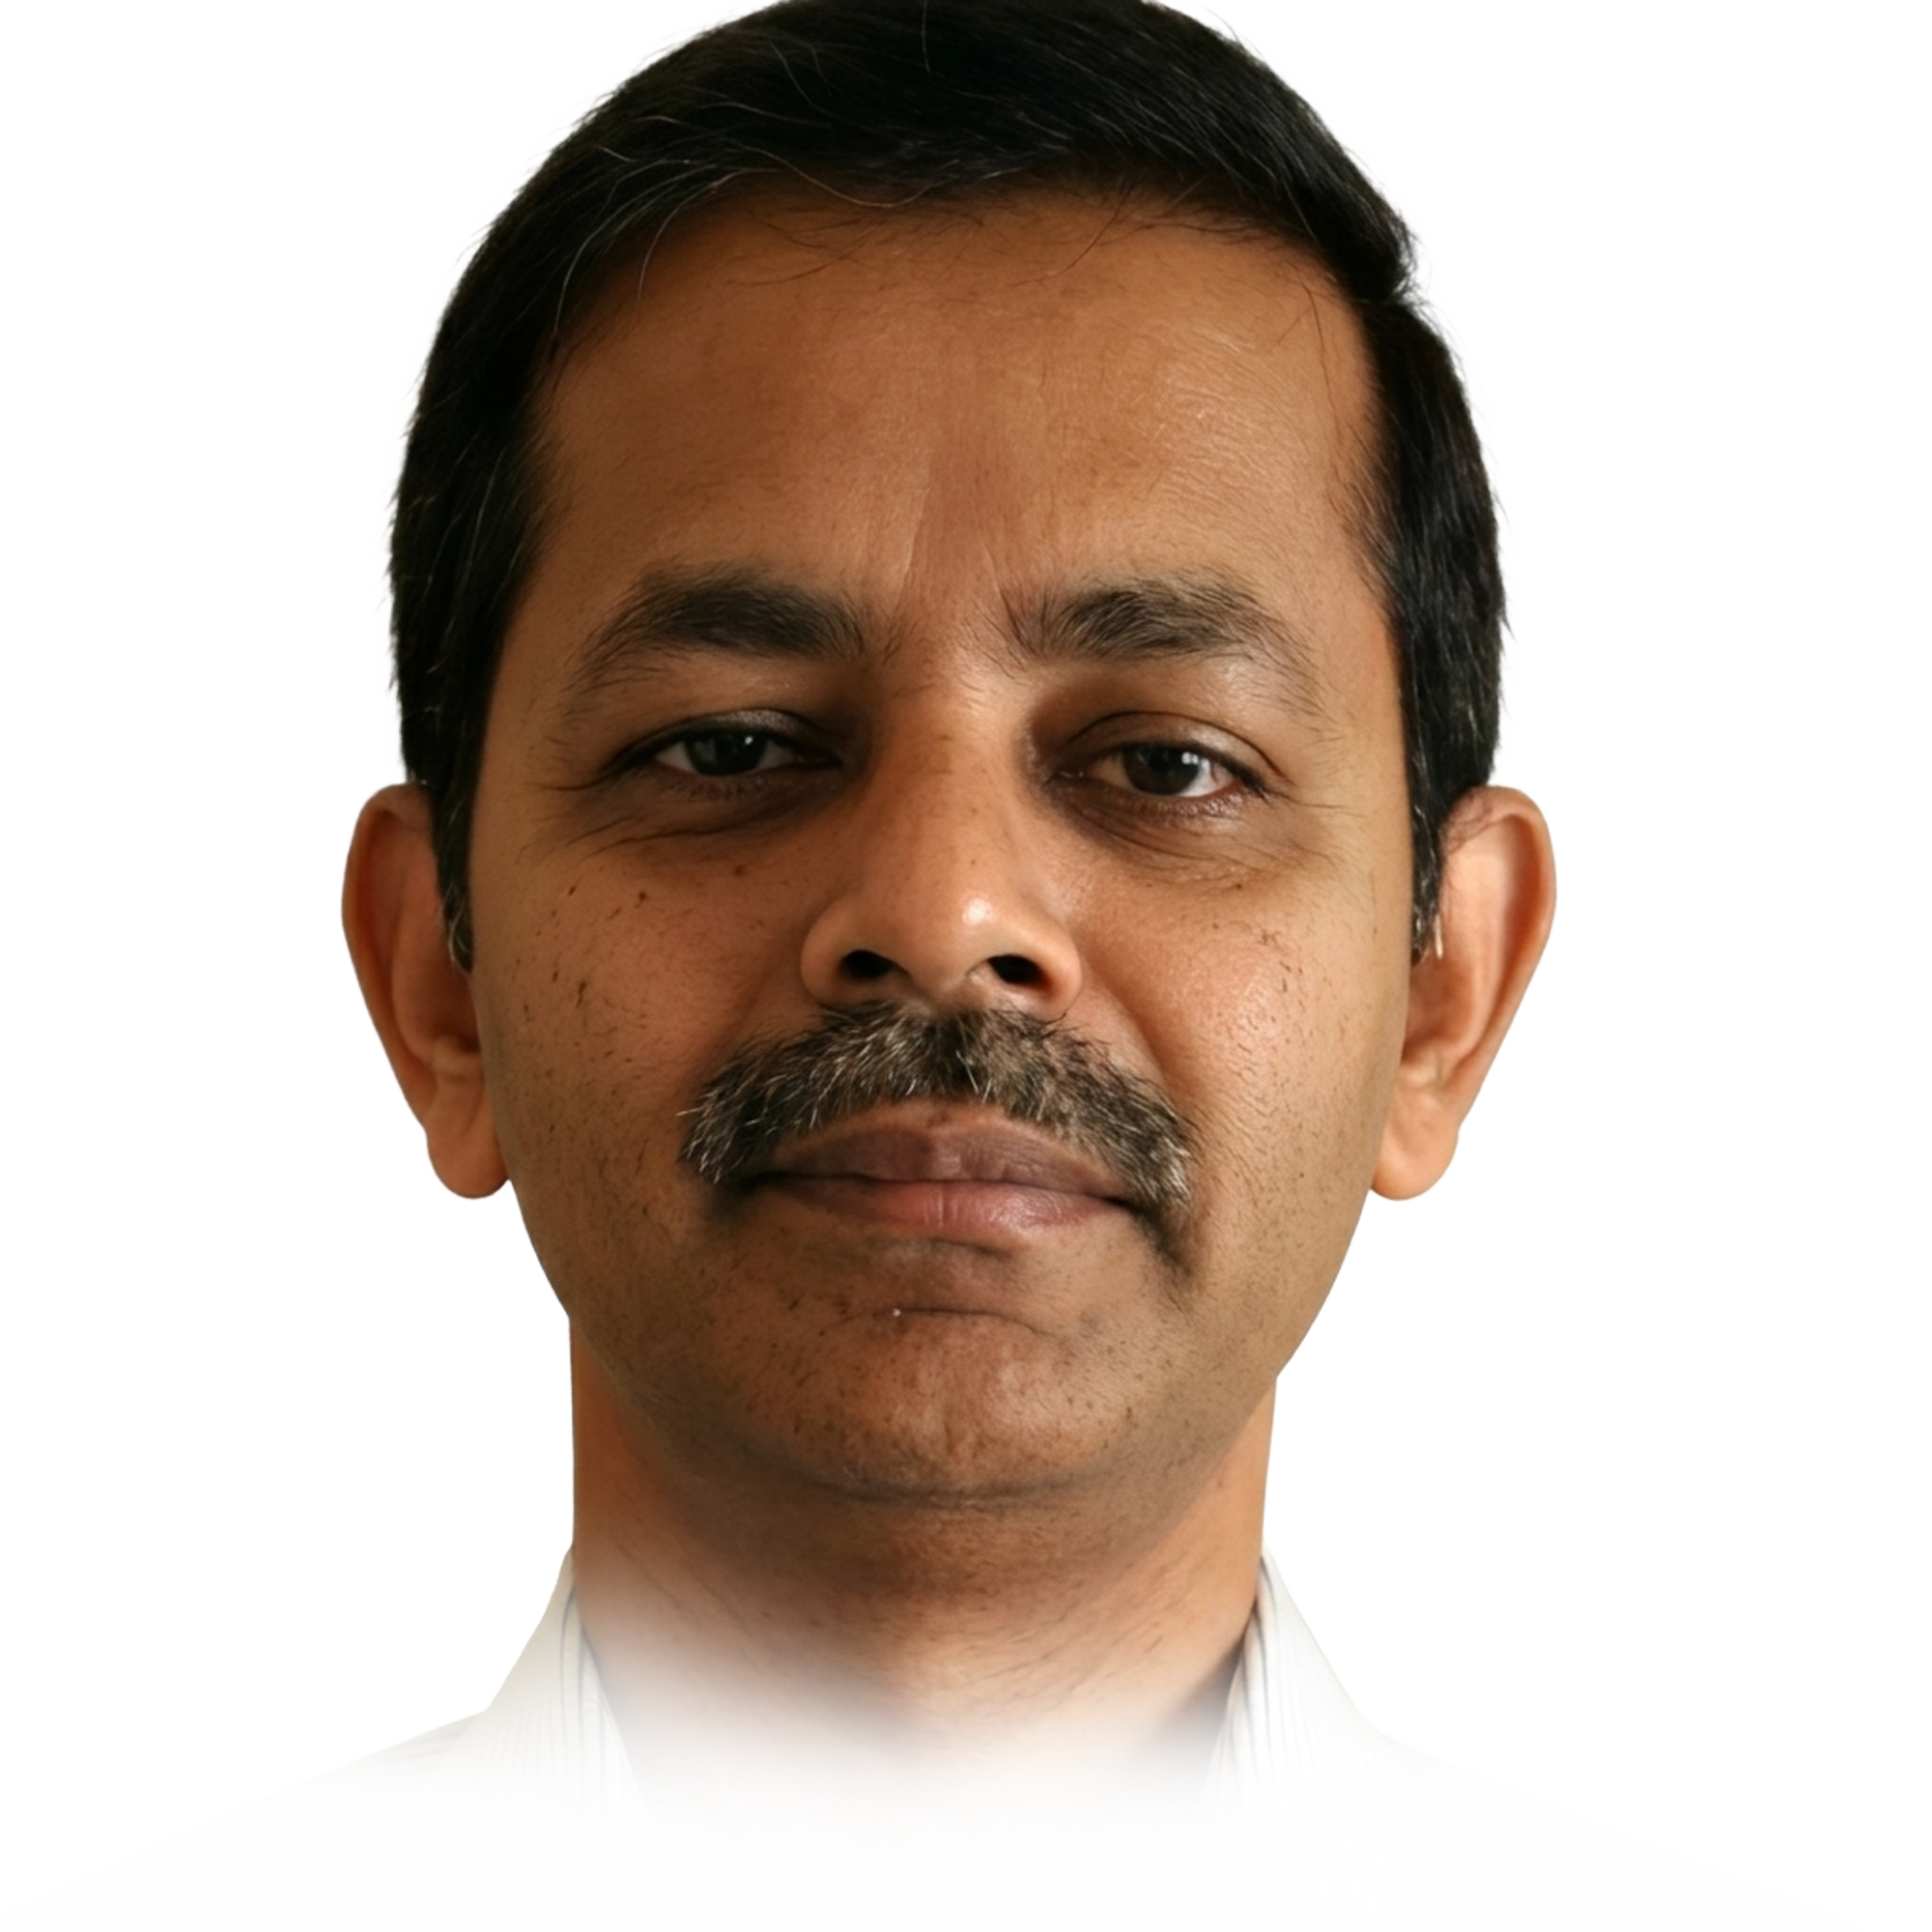

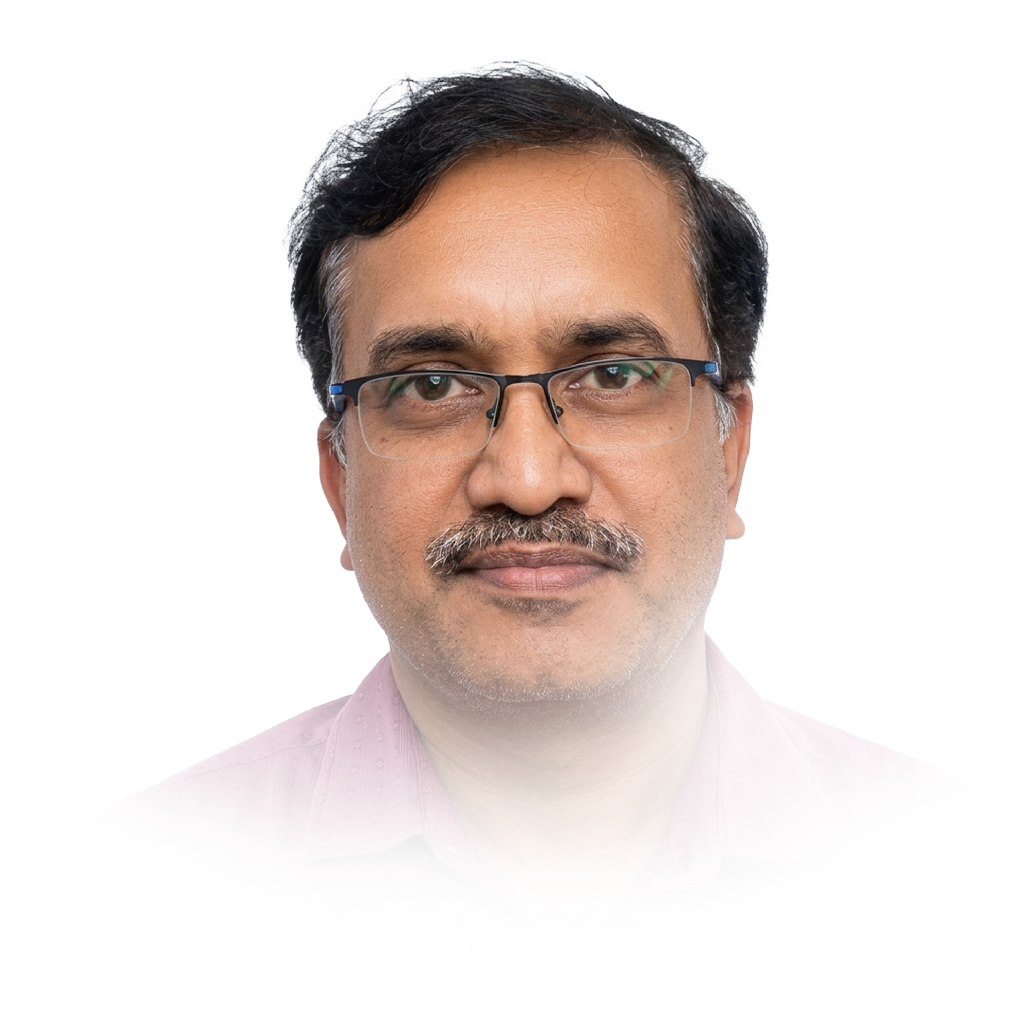
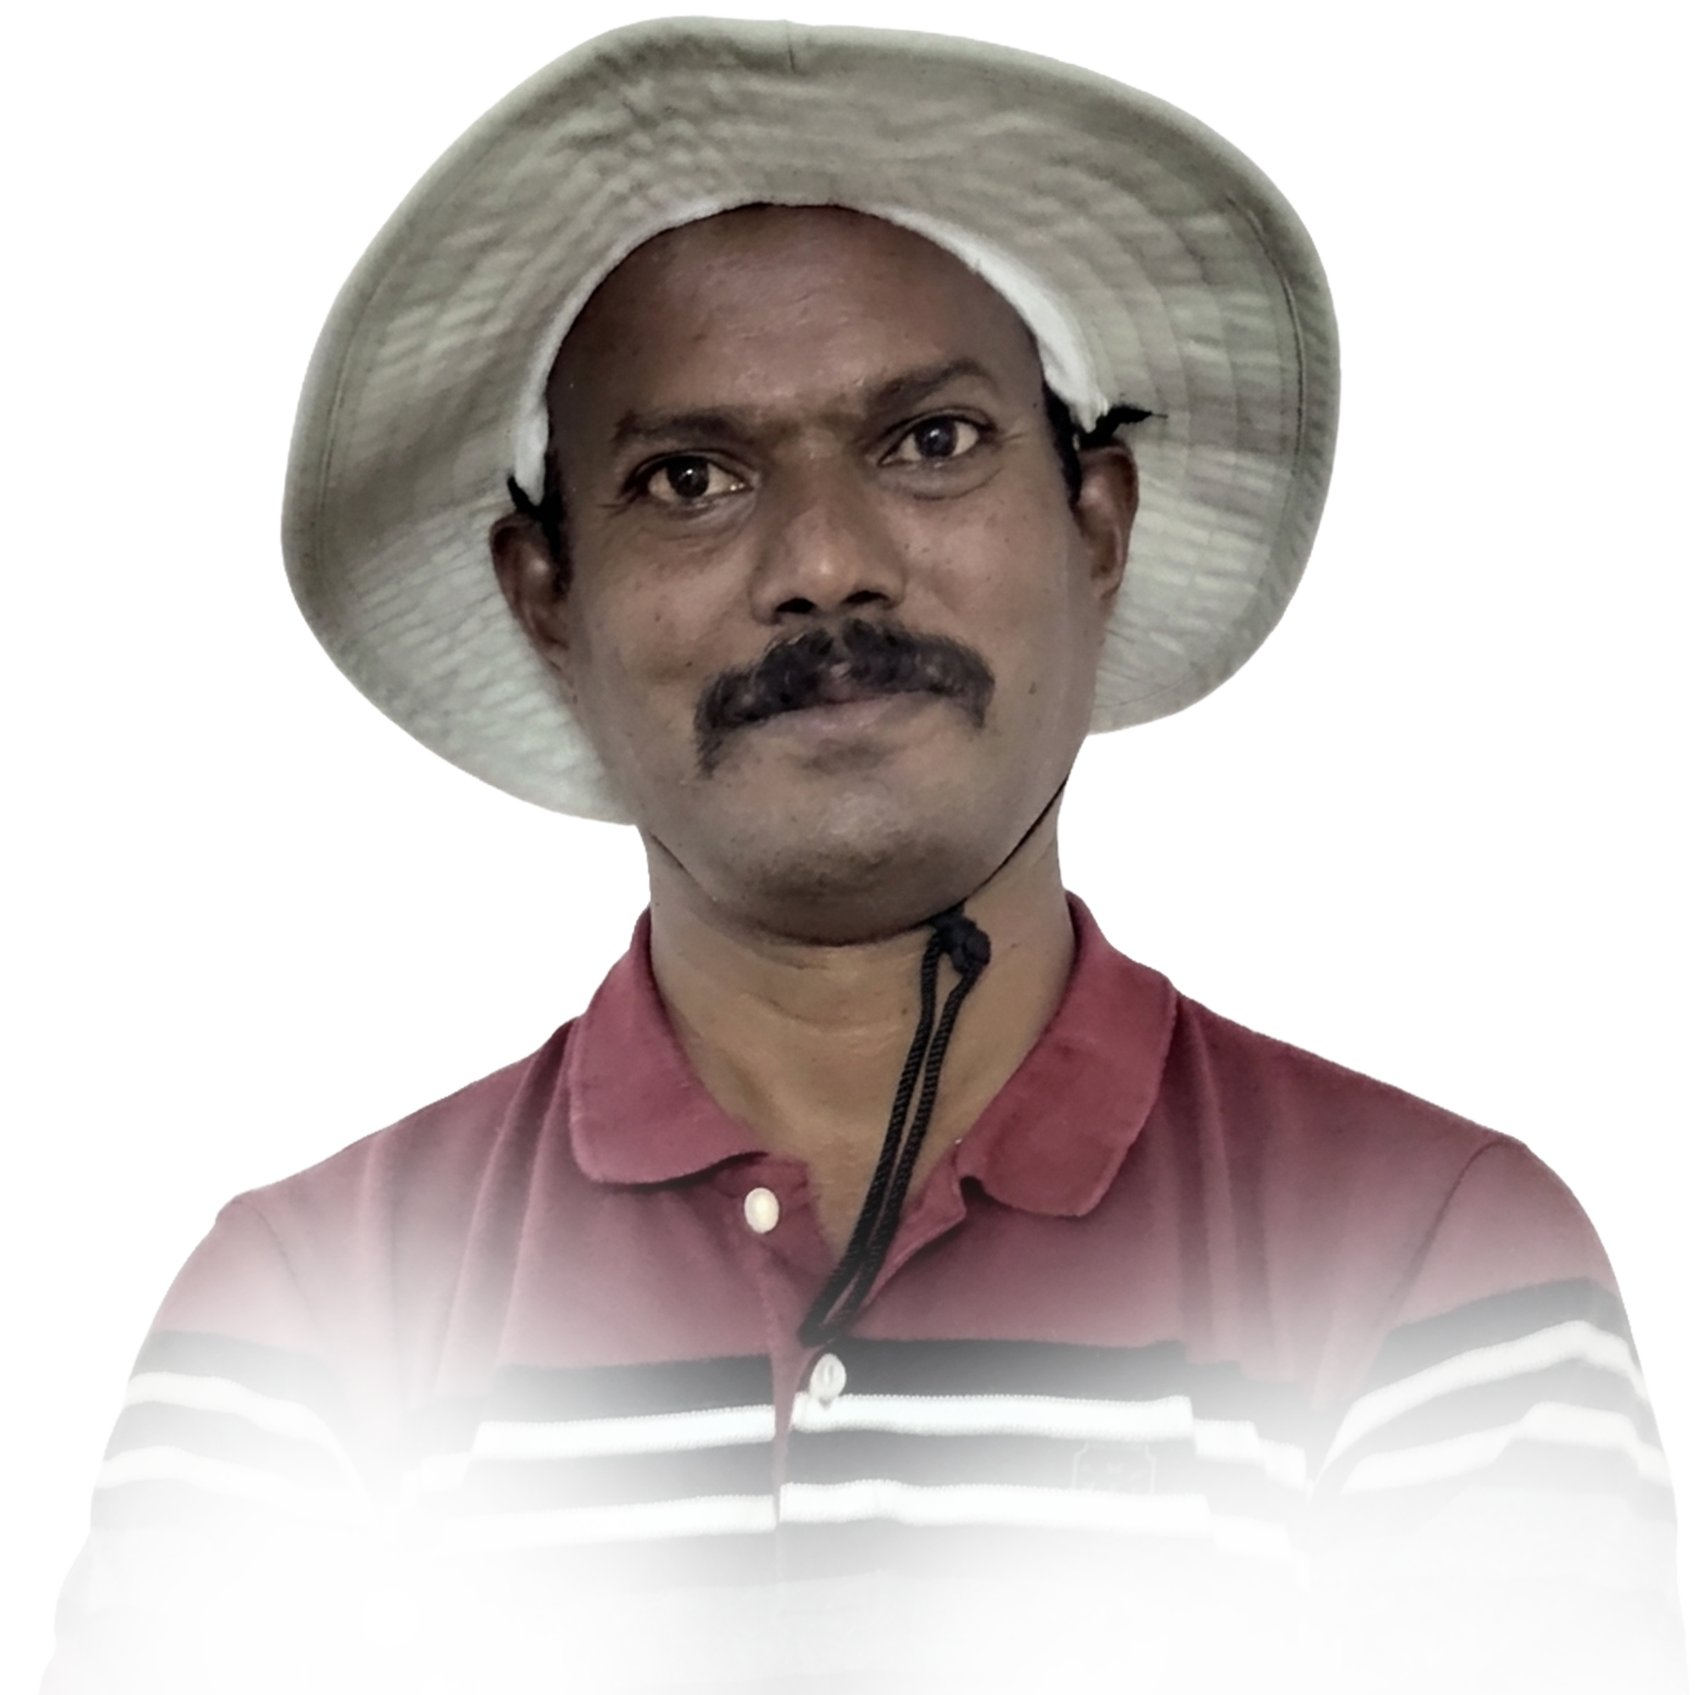

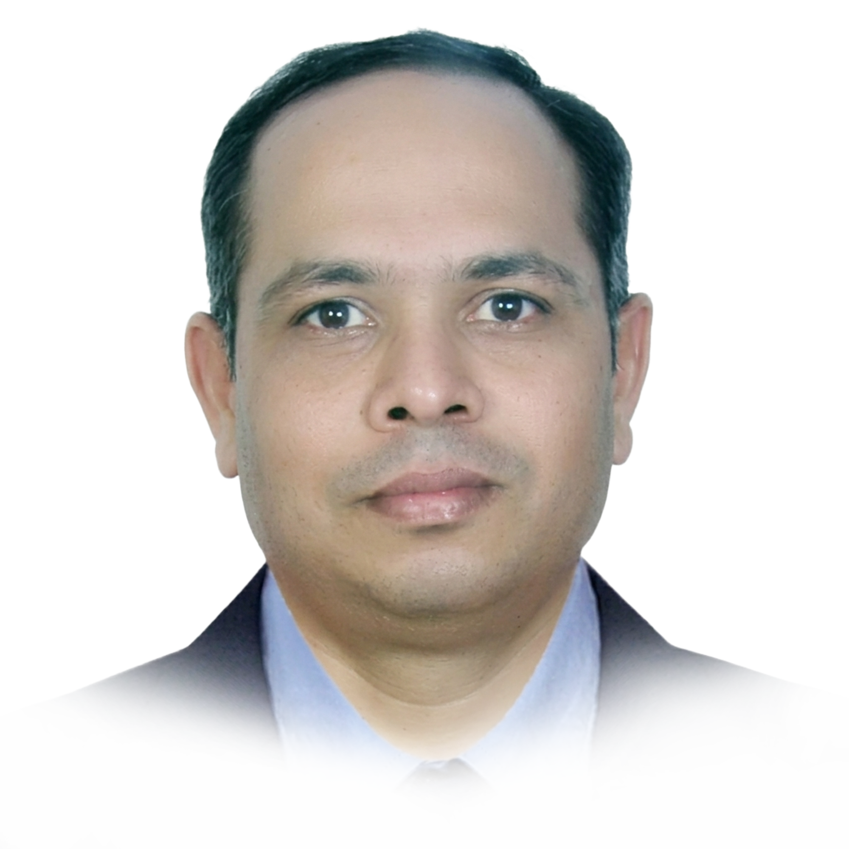
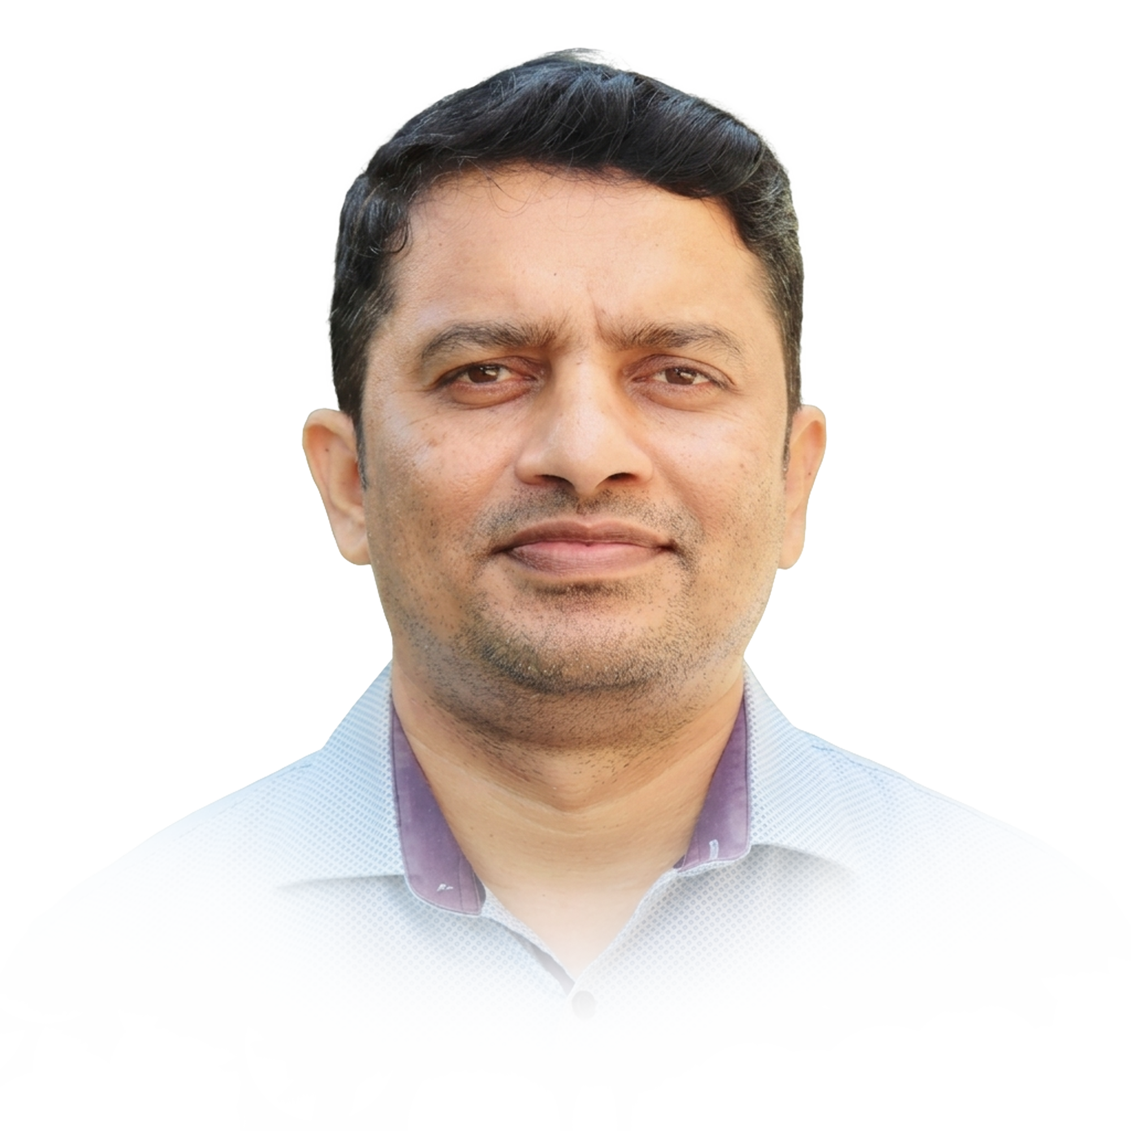
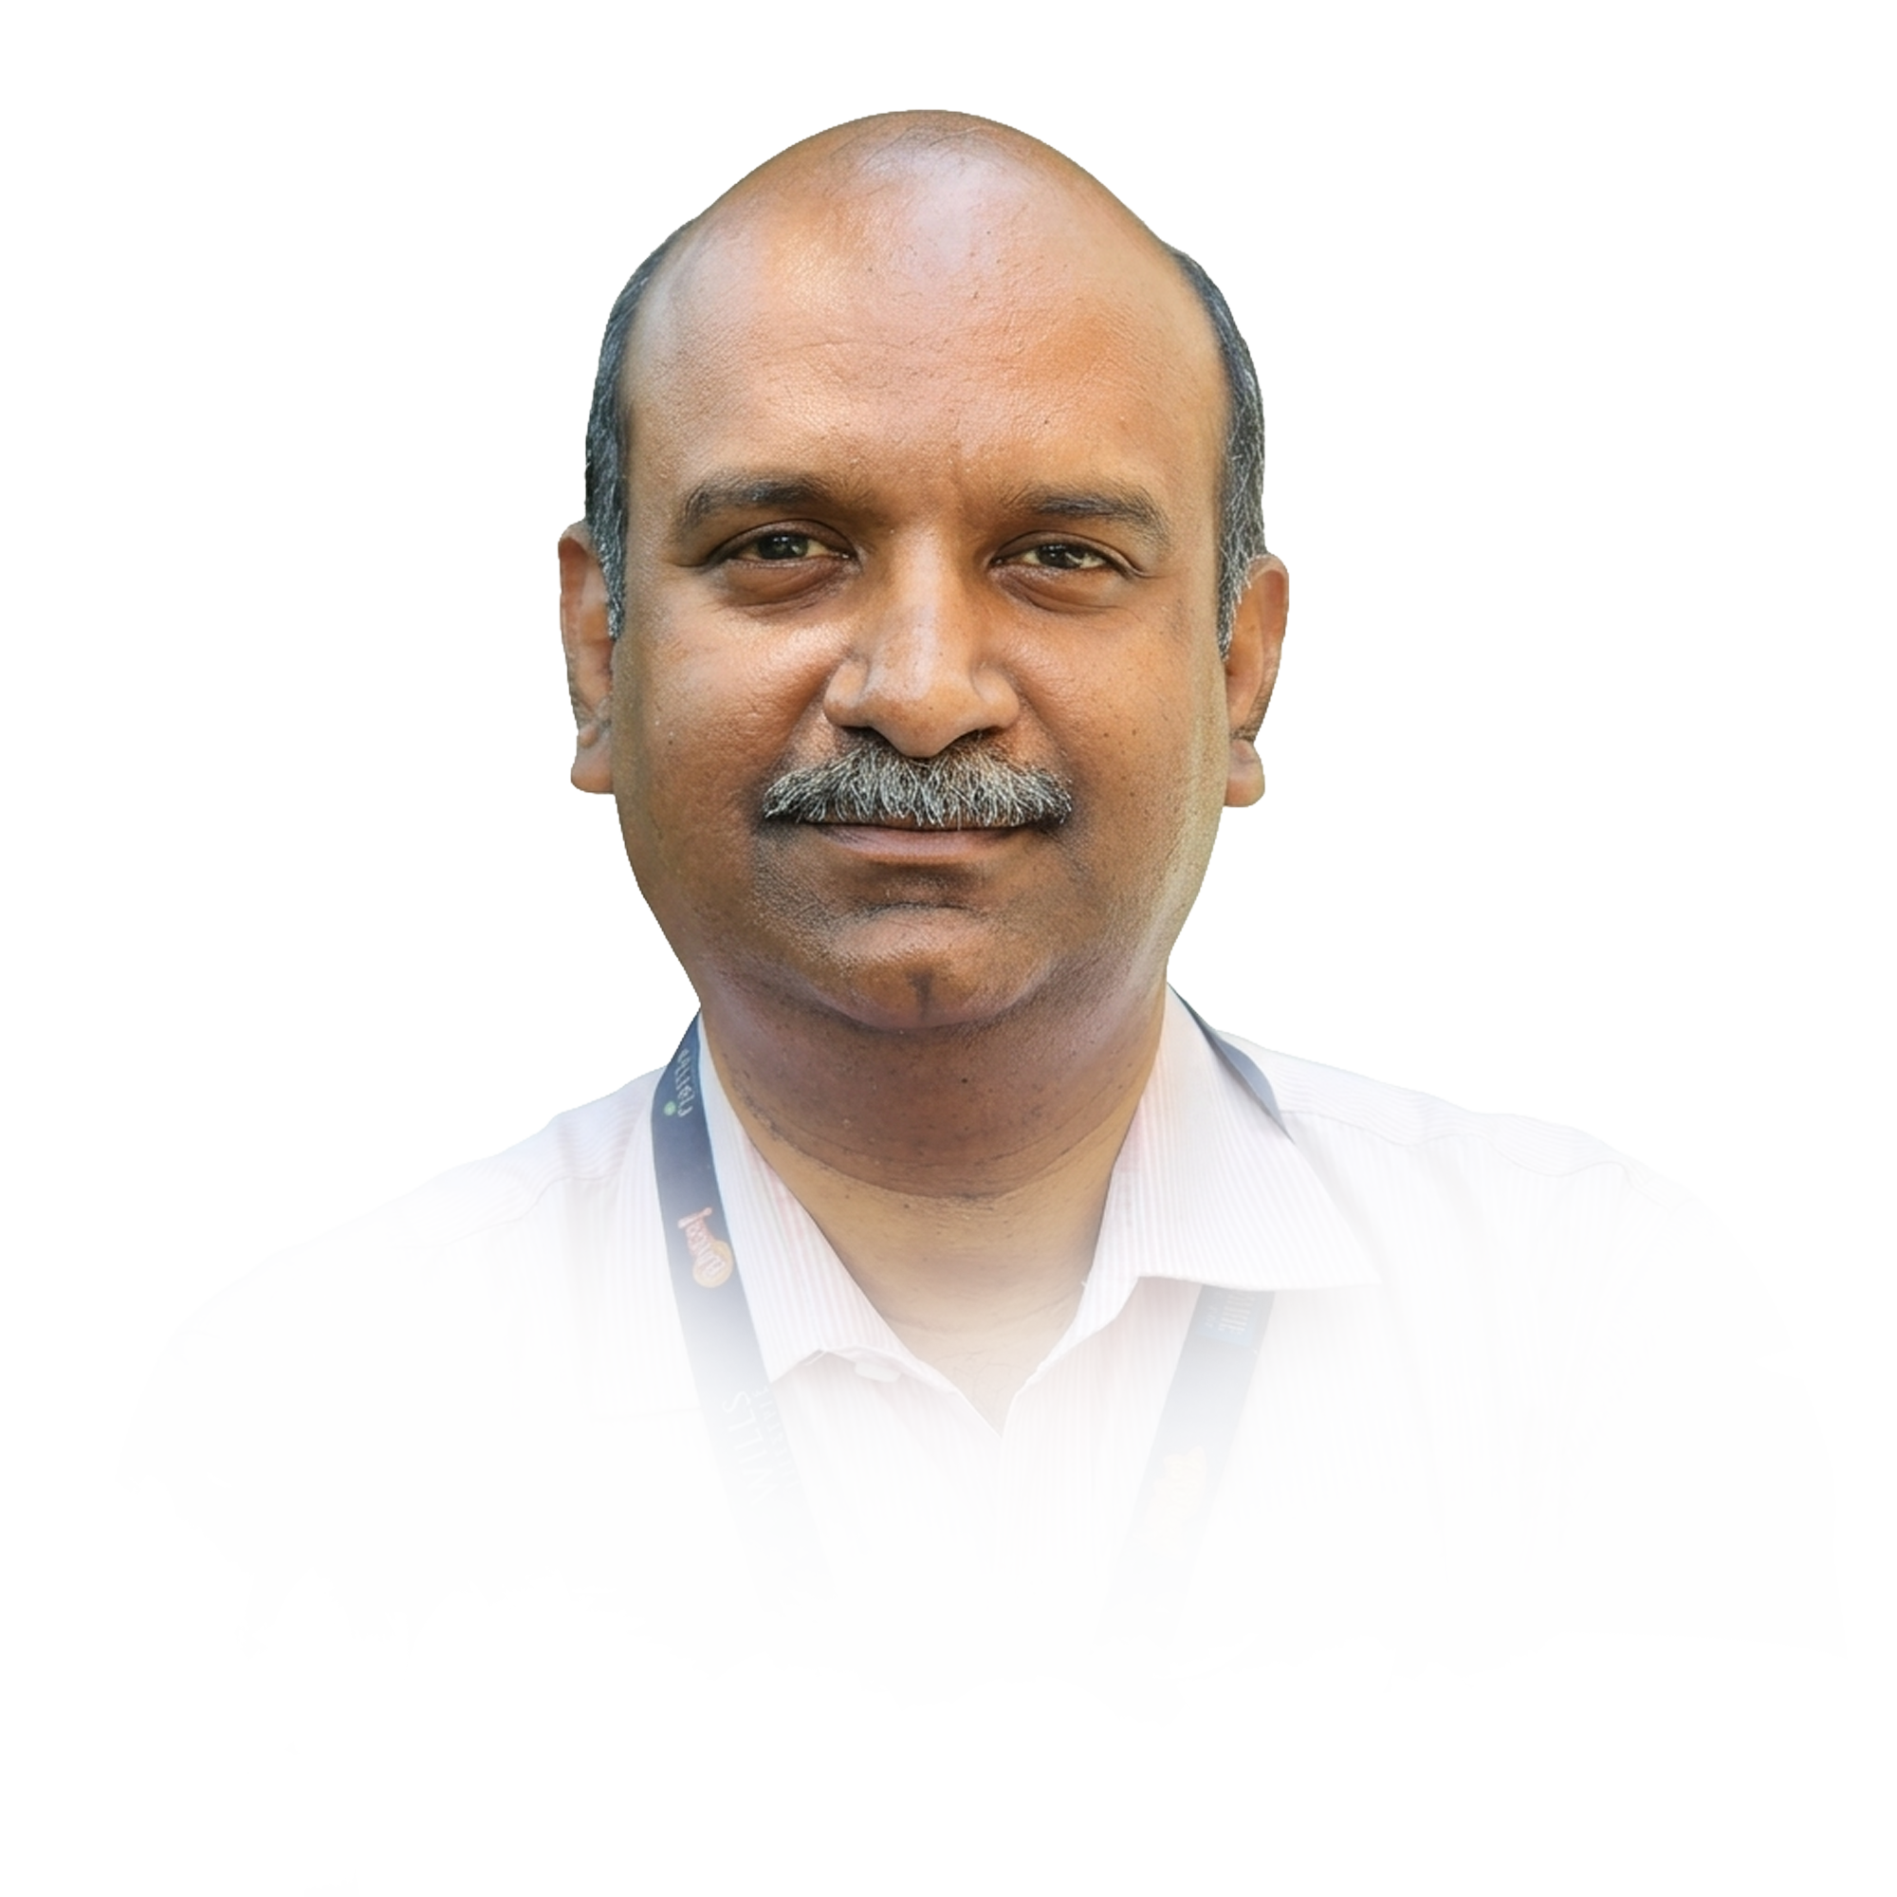
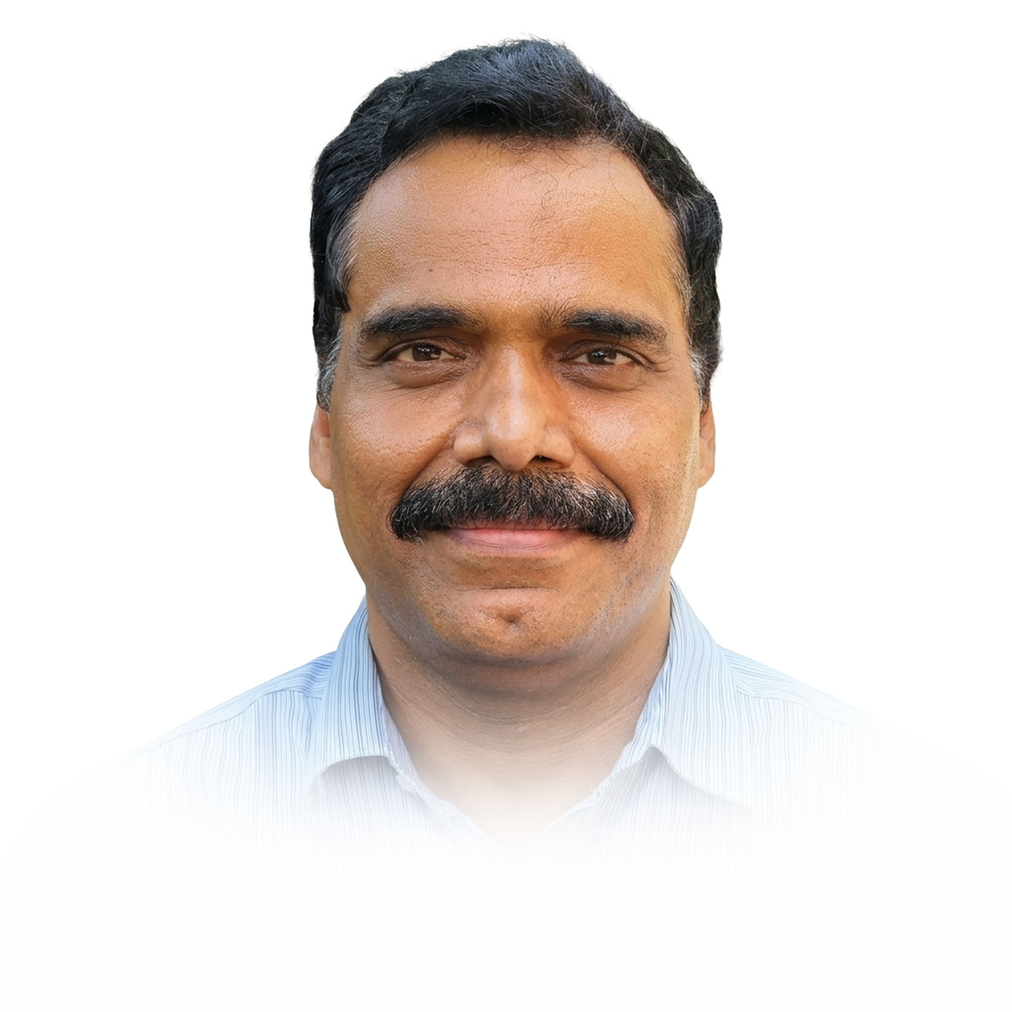
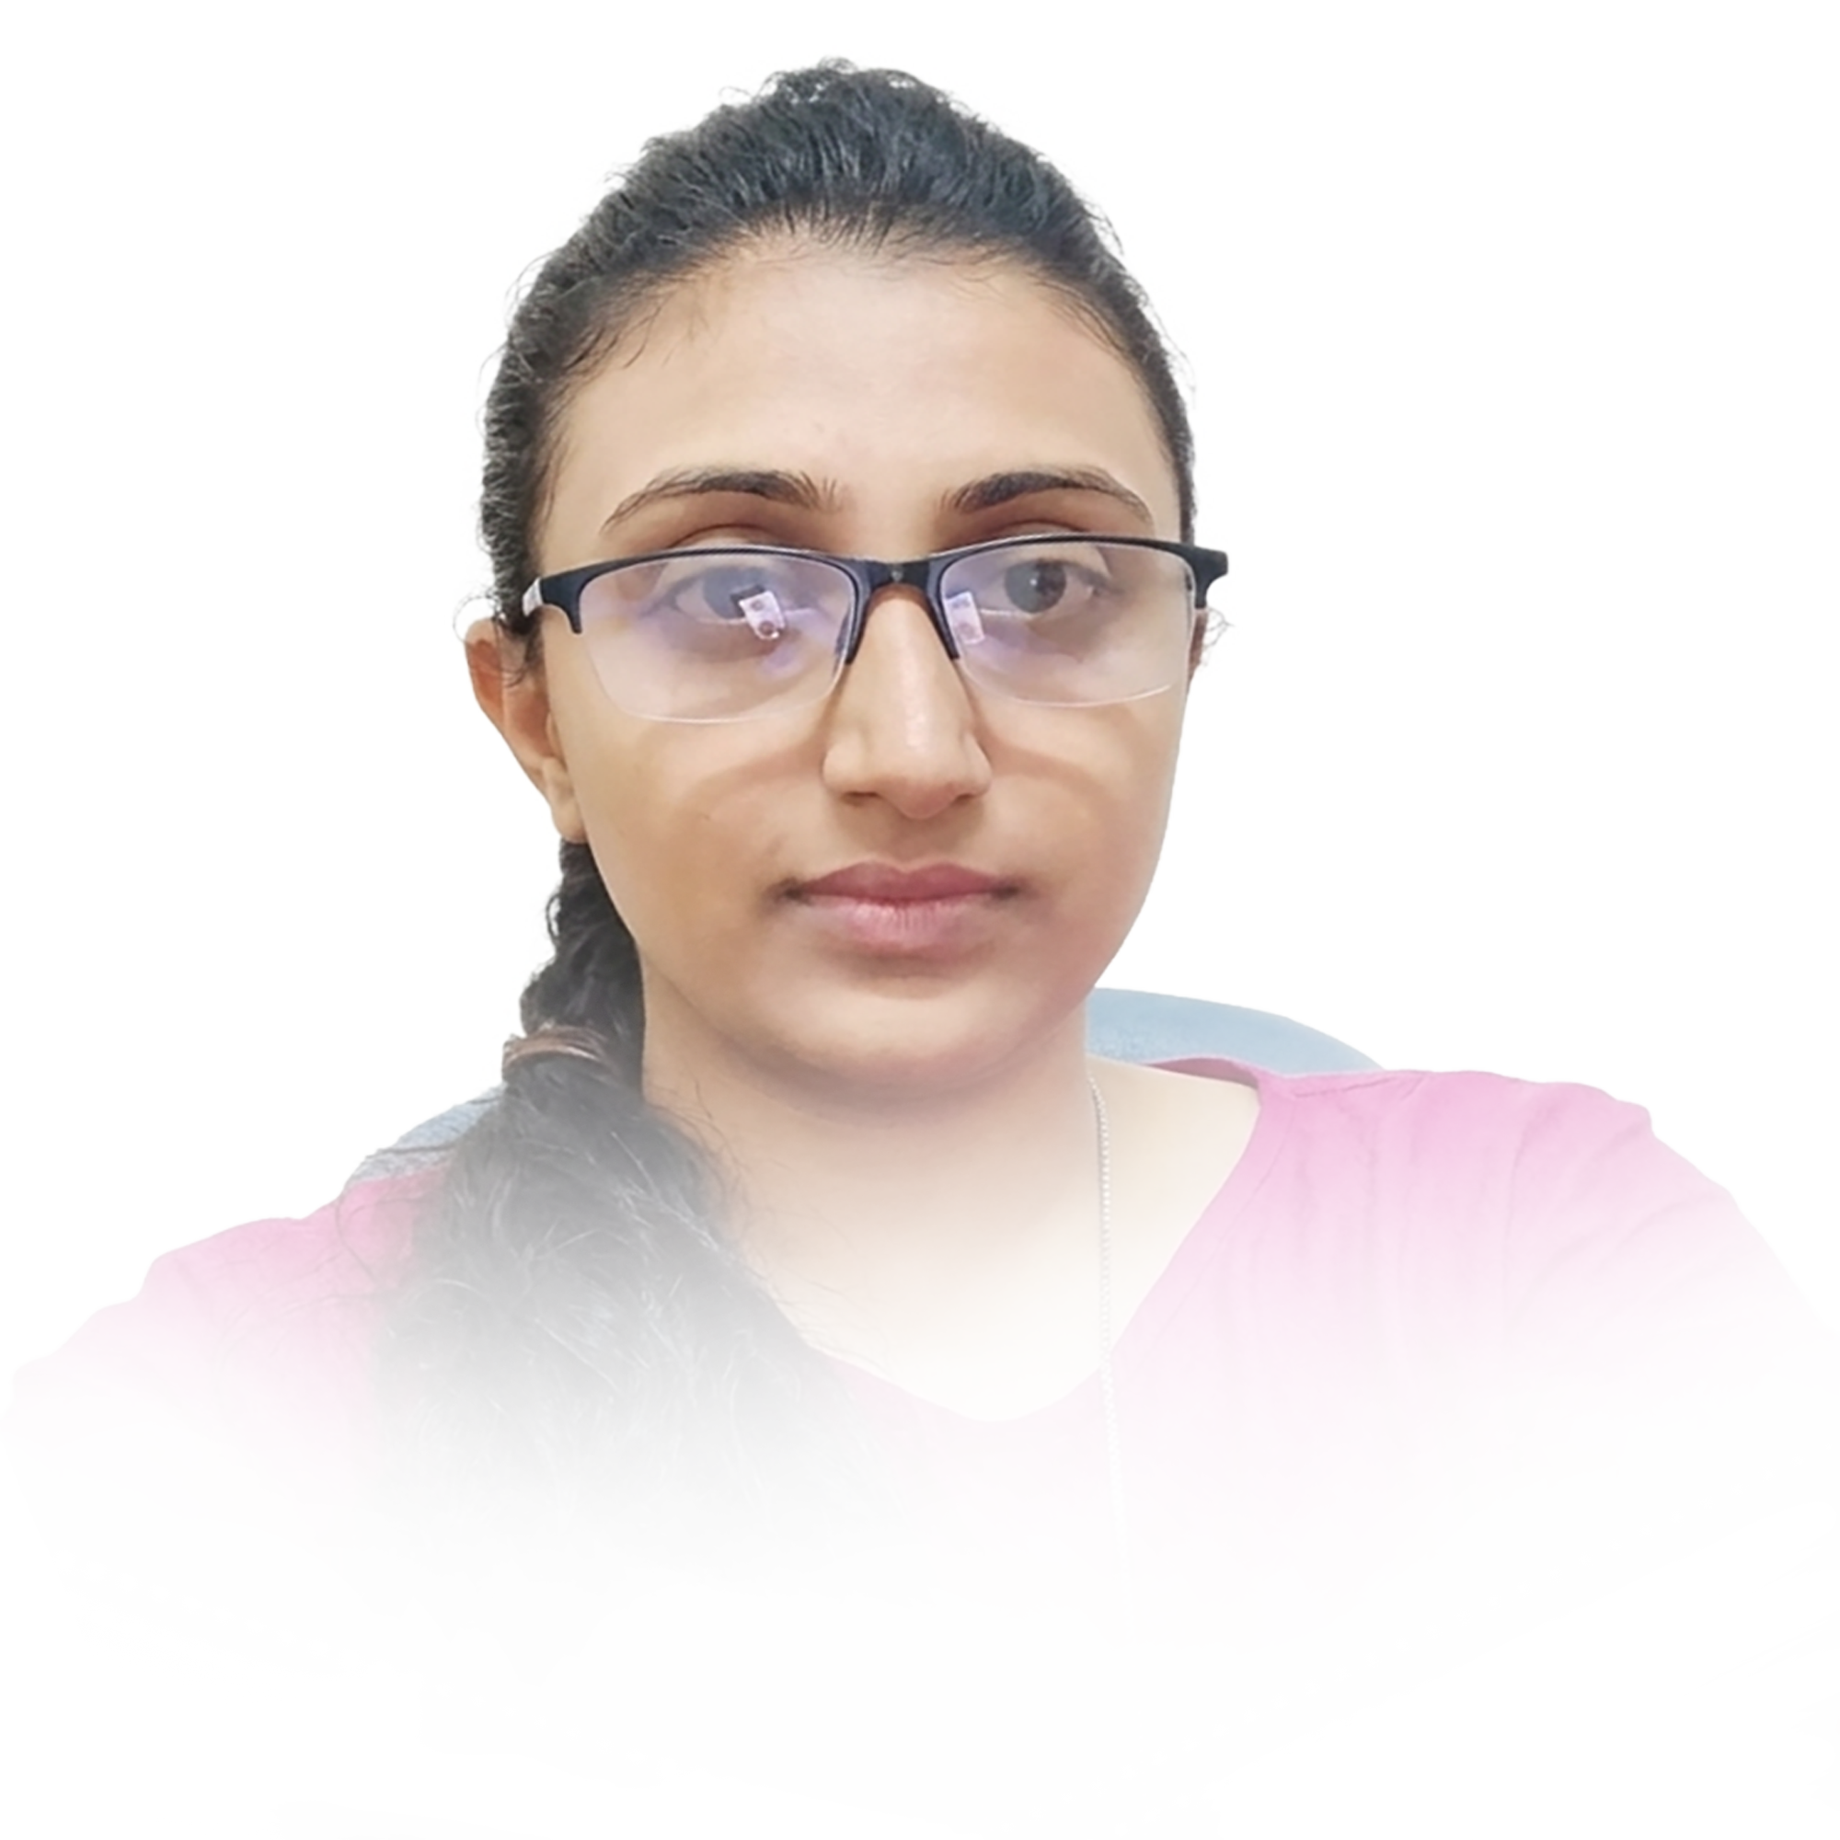


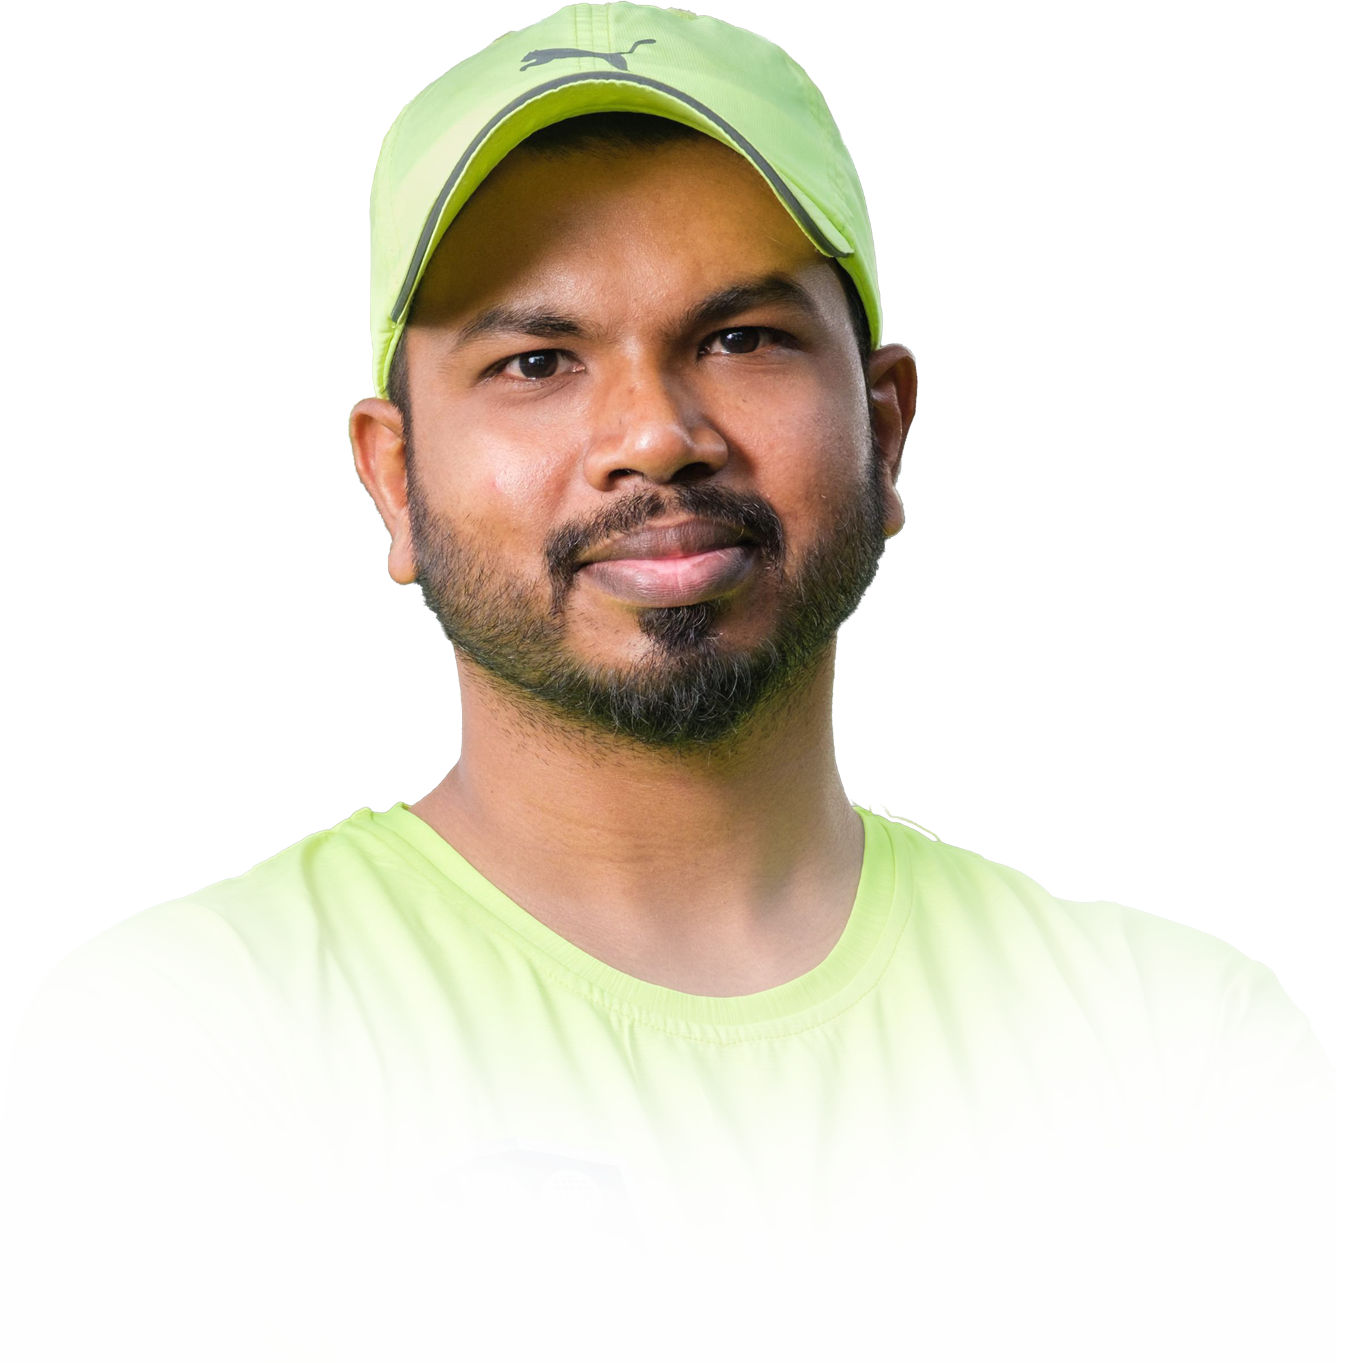

RESOURCES
Current Structure
3
4
5
R

Slide 31
RESOURCES
SWOT
MAS, Genomics
Informed breeding
MAS, Genomics
Hybridizations
Trails & Selections
Field operations
Silviculture
Core academic expertise not necessarily be the current expertise, they are known for.
Agronomy
Trials & Selections
Field operations
Genomics, Epi, Pathology
Genomics; Breeding
Pathology

Slide 32
RESOURCES
PLATFORM
CURRENT RESEARCH AREA
PROPOSED PLATFROM
Resource assigned ~Species wise
Resource assigned platform wise
HYBRIDIZATION & SELECTIONS
Hybrids / Base selections, – Gene bank to CPTs to Demo to Farmers
1. GENOVATE
A breeding platform spans accountable from Gene bank to CPTs
SELECTIONS
CPTs; MLTs; FTC; Demo, Nutrient management, Technology Transfer, Release & follow-ups
GENOMICS
2. SILVICULTURE
Creation of Variation; MAS; Gene Finding; Selection +/-; Epigenetics
Translational research platform accountable from CPTs > PSPD > Farmers for materials & technology
PLANT PROTECTION
Diagnostics; Method development; Recommendation; Pre-screening
3. PREDICTION BREEDING
Informed breeding platform holds accountable for measurables at chemical / molecular level for Back End Efficiency and derisking
Wood Chemistry
Measuring wood properties:

Slide 33
RESOURCES
Platforms & boundaries
# | PLATFORMS | Description | START-to-END | TASKS | Outcome metrics | STAKE HOLDER
1 | Genovate | Development of Genotypes (clone / seed) | Germplasm to CPTs | Gene bank, SSO, CSO Adaptive Trials; Base selections & Hybridizations; CPTs | Benchmarked CPT selections | Translational Research Team
2 | Silviculture | Translation of GTs / Technology | CPTs to Farmers | CPTs; MLTs; FTC; Demo, Nutrient management, Digital deployments Technology Transfer, Release & follow-ups Farm practices | Farmers / Business feedback | Farmers / business team
3 | Prediction Breeding | Informed Breeding, Wood properties & Risk mitigation for biotic stress | MAS; Creation of Variation, Pulp Measurements | Creation of Variation; MAS; Gene Finding; Selection +/-; Epigenetics Method development; Recommendation; Pre-screening Wood measures | Time / cost reduction Risk Free deployments Pulp cost reduction | Platform 1 & 2

Slide 34
RESOURCES
Resource optimization
Platform Leader
Second GEN
Genovate
Gene bank to CPTs
SWOT..
SILVICULTURE
Translation of CPTs > PSPD > Farmers
To be mentored for the respective role
Predictive Breeding
Back End Efficiency and derisking

Slide 35
RESOURCES
Smooth Transition
Yr 0.5
Yr 1
Yr 1.5
Current
Hybridization; Selections; Kovai Mgt
Euca / Corymbia
Genovate
Continue the current task
SOP to “educate” Euca/Casuarina/Corymbia resources / materials trials
Template to move the responsibility
Gradual handover
Integration of DATA LAKE
All species
Subabul
Pure sp selections; Agronomy
Euca
Silviculture
All species
Continue the current task
SOP to “educate” Trials / resources / materials
Setting UP the Field Team
Understand the data structure
Template to move the responsibility
Creation of digital infra
/ Data Lake
Integration of DATA LAKE
Casuarina
Epi selections; Plant Protection
All
Predictive Breeding
Continue the current task
SOP to “educate” Trials / resources / materials
Setting wood chemistry
Understand the data structure
Template to move the responsibility
Integration of informed breeding / wood chemistry / plant protection
Gradual handover
Integration of DATA LAKE
All species
Multiplication / Translation
Corymbia & Subabul

Slide 36

RESOURCES
Ideal Structure
Global Directions
Board Communication
New Opportunities
Strategic layer
3
operational layer
Operational Directions
Business communication
New Opportunities
Prediction breeding
Genovate
Silviculture
4
Operational Genomics
New variations
BwB
Plant protection
Wood chemistry
Clonal / Seed development (Gene Bank, Hybrids, Selections. Multiplications)
Selection & Translation
Agronomy
Selection & Translation
Field Operations; Commercial multiplications,
Digital (Apps; SI, Integrations)
5
R
Plant Protection
Chemist
(Immediate)
New
Yr3
New
Yr5

Slide 37
Resource Road Map
Platform Based Leadership
2027
‘28
‘29
‘30
‘31
‘32
‘33
‘34
‘35
‘36
‘37
‘38
‘39
2040
PLATFORMS
TIER 1 Leadership
TIER 2 Leadership
TIER 3 Leadership
Genovate
Silviculture
Prediction
Breeding

Slide 38
Resource Road Map
Agroforestry Domain Lead
AF Leadership
Global Directions
Board Communication
New Opportunities
‘27
‘28
‘29
‘30
‘31
‘32
‘33
‘34
‘35
‘36
‘37
‘38
‘39
‘40
L3+
L3
L4+
L4
L4+
L4
L4
L4
L4
2042

Slide 39
DATA

Slide 40
DATA
Current Issues
Individualistic. It is “Datum”, rather than “Data”.
No common templates
Traceability, Review / Monitoring - impractical
Historical – integration – Seldom traceable
Outcome is manipulable

Slide 41
DATA
Data Lake that applies to AF
Relational Database
Clone / Seed Dlp.
Silviculture
Diversity ( GD-TD)
Descriptors
Gene Bank
Dynamic Seed health
Pollen Bank
Hybrid – families
Progeny Evaluation
Trials
Location
External data ( weather/soil)
Farm Practices
Selection metrices
Analytics Platform
PLATFORMS
INTEGRATION
Genomics
Plant Protection
Genomic Region
Marker type
SNPs / SSRs / Etc. position
Polymorphism
MASI (Marker Assisted Selection Index)
Ranking
Validation
Disease Index
Prediction

Slide 42

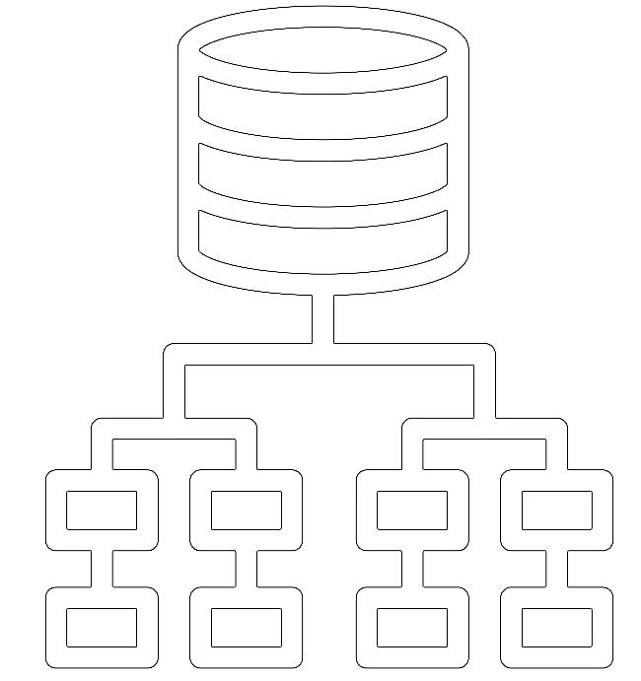
DATA
INDIVIDUAL SPREAD SHEETS
RELATIONAL DATABASE
Development
Evaluation / selection
Trails / demos
Informed breeding / PP / Epi
Impractical / Impossible to integrate
Traceable, Scalable, Reviewable, Inflexible
System driven (not individual driven)
LLMs / analytics - feasibility

Slide 43
DATA
The BACK-END Architecture
Example of a Relational Database Schema
Gene Bank (DB₁)
Trials (DB₂)
Trial
Ranking
Clones
T_ID
Type
Replicates
R_ID
Rank
Family
C_ID
Name
Species
Sub Species
Clones
F_ID
Name
S_ID
Name
SS_ID
Name
Family
C_ID
Name
F_ID
Name
Pedigree
TRIALs
Phenotype 1
Phenotype 2
DNA_Marker
F_Descriptors
Target_Trait
DNA_Marker
Pixel_data
Relations
P_ID
P.Trait 1
P.Trait 2
EP_ID
Est PT 1
Est PT 2
M_ID
Type
Cor_Value
Value
Descriptors
Markers
Infogram
Relations
FD_ID
Name
Target_Trait_ID
TT_Name
Value
TT_ID
TT_Type
Value
M_ID
Type
Cor_Value
Value
D_ID
Type
Marker_ID
Cor_Value
Value
R_ID
Type
Rel_value
performance
Featured properties
Integrates both Development & Translation platforms
Possible to establish the relations between data sets
Scalable
Traceable
Deep analytics such as LLMs
Z_ID
Weather Param
Zone_ID
S_ID
Type
Nutrient_Stat
U_ID
Name
Password
Soil
User
P_ID
Name
Project
FP_ID
Irrigation
Nutrient_App
Interculture
Practice
Credentials
ZONES
T_ID
Age
Range
GPS_Coor
T_ID
Age
Range
GPS_Coor
Time_Log
Time_Log
time
time
T: Field for Database connection
T: Field for Database connection
SELECT Species.ID, tiem_Log.Age, ..., Target_Trait.Breaking_strenth, ... FROM Clones INNER JOIN Pixel_Data ON DNA_Marker.Cor_Valye = pixel_data.marker_ID;

Slide 44
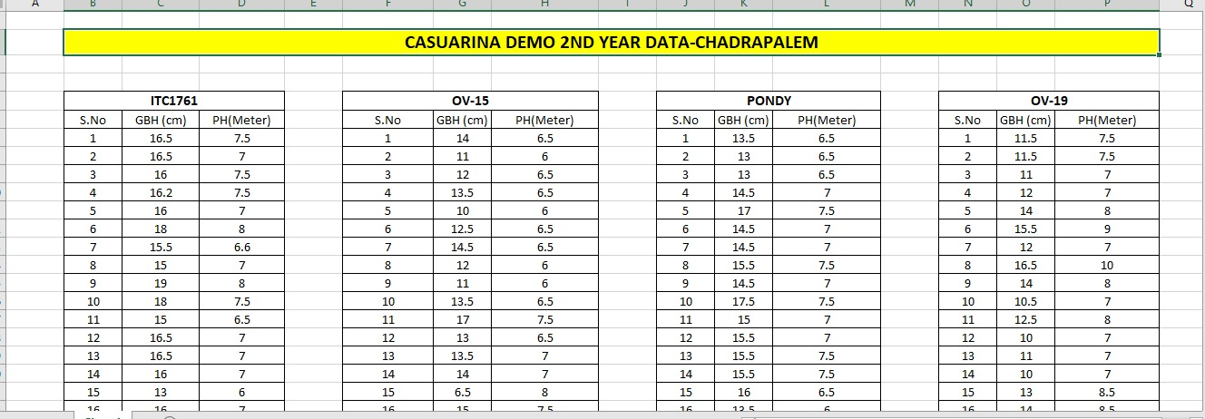
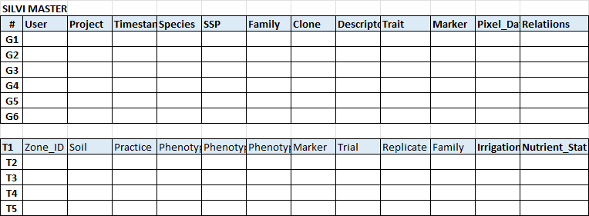
DATA
Architecture implementation
What Scientist will feed IN ?
Current way
Timestamp, relational features from Gene Bank to commercial release will have timestamp traceability, deep analytics and reduce the redundancy
Data Lake Way
Silvi Data Master

Slide 45
EXPECTED SHIFT
My clone / My data to Our Clone / Our data
Systematic breeding
System driven breeding / impact, not Individual driven
Sustainable resource pyramid with failsafe
Use of Expertise to its Max with clear metrics
Traceability, Review, Monitoring – is by design
Digitization > Digitalization > Digital Transformation – is meaningfully / practically Possible

Slide 46
-end-

