Slide 1
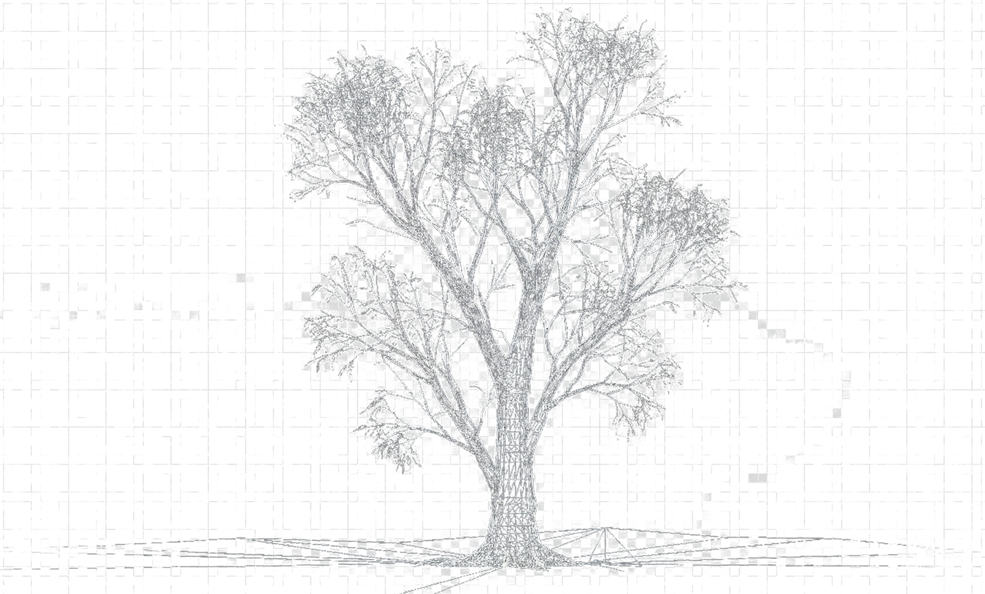
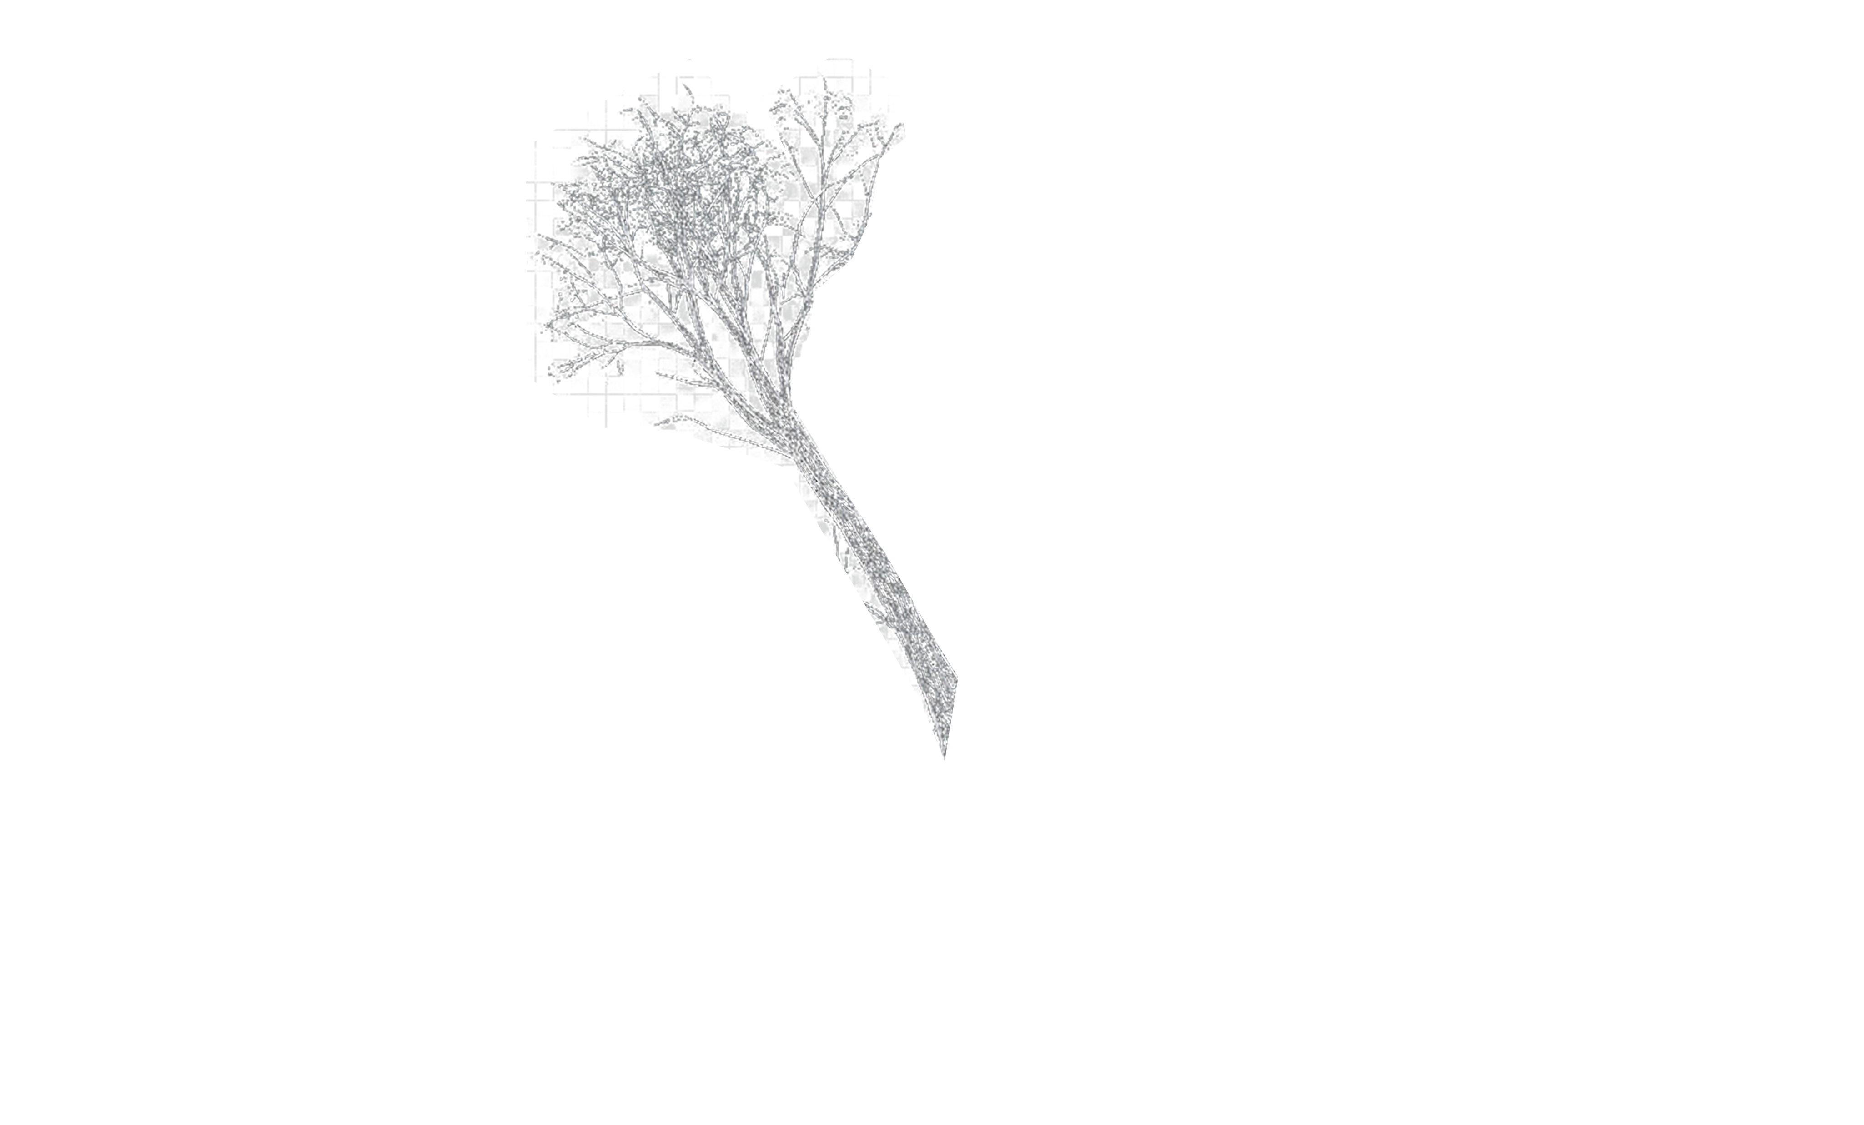
SILVI
The Blueprint for Growth
20 Years of Breeding Lessons, Resource Reality & Next-Gen Strategy

Slide 2
Contents
Tree Improvement
DATA
Resources
Euca
Poplar
Subabul
Casuarina
Corymbia
Current Pipeline
Data-Lake
Implementation
Current Issues
SWOT
Platform Based Structure
RoadMap (Platform)
RoadMap (Leadership)

Slide 3
TREE IMPROVEMENT

Slide 4
EUCALYPTUS

Slide 6
POPLAR

Slide 7
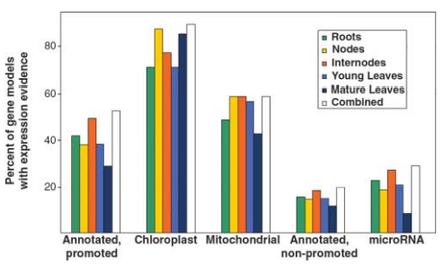
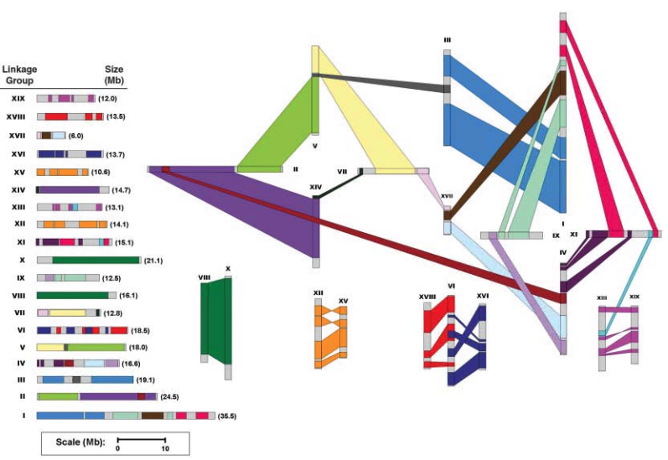
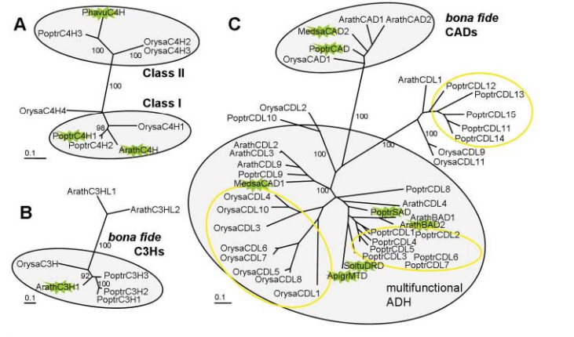
FACTs
Well annotated 45K genes
A model system for plant Biology
Dioeceous
Anemophilic pollination
Crossable with available species
Genome size: ~500mb
Ploidy: 2n = 2x = 38 (Earlier 4x)
Rich Genomics / functional genomics tools
Availability of high-density genetic map.
Well established orthologues / paralogues
Gene families' classifications

Slide 10
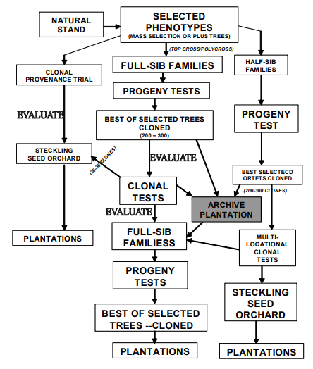
Seed orchard Design
Genetic thinning
Breeding without Breeding (BwB)
Assessment of existing collections
Assessment of GCA/SCA for heterotic vigor
Current Clones

Slide 11
SUBABUL

Slide 12
SUBABUL
Seed deployment - potential
Subabul Planting Propagules
Yield potential
Strategies for subabul productivity
2%
Hyco seedlings
Promoting clonal plantations
Seeds on par with clones
95%
Direct seeds
3%
Clones
Potential WY @ 3 Yrs. (MT / ac)
Seeds from unknown
Seeds from K8
Seeds from Clones
C16
C146
ITC 2553
ITC 2554
ITC 2555
Lack of uniformity
Poor survival due to inbreeding depression
Termination of genetic gain
Seeds:
biotic stress tolerant
Less expensive propagules
No lodging
Clones:
High yielding

Slide 13
SUBABUL
plan for B_{w}B: seed = clone
LEUCAENA
CURRENT PRACTICE
APPROACH TO IMPROVE THE SEED PERFORMANCE
L. Leucocephala ssp. leucocephala.
L. Leucocephala ssp. glabra.
L. diversifolia
G. Gain in seeds from developed clone
Orchard with Genetically diverse material
µ₁
µ_{x}
Short
Bushy
high seeding
Tall
Straight
Poor seeding
Shy rooter
Superior WY
µ_{x}
µ₁
C 16
K 636
C 146
∂₁
∂₁
∂_{y}
∂_{x}
∂_{1,} ~ ∂_{x}
µ_{1 <} µ_{x}
∂_{1,} µ_{1 >} ∂_{x,} µ_{x}
Self pollinated species ~> 95 % selfing
Seeds directly from clones is a selfed seeds; will continue to loosen the genetic vigor due to inbreeding depression
Seeds from diverse material has potential improve the population mean

Slide 14





SUBABUL
Breeding plan
Germplasm collection
SHORT TERM
Pre-selection
Pure seed orchard
Seed delivery
Understand the genetic diversity
Business Directives
LONG TERM
Families pre-selected with high “He”
Families pre-selected with high “Ho”
Clone (~<20%)
WY > 30 t/ac
Low Lodging
Low branching
Wilt free
Seed: (~>80%)
On par with Clone
CC - Hybrids
Segregants
Clonal Trials
Seed orchard
Seed delivery
DNA Markers
Epigenetics
External Collaboration
Disease resistance

Slide 15
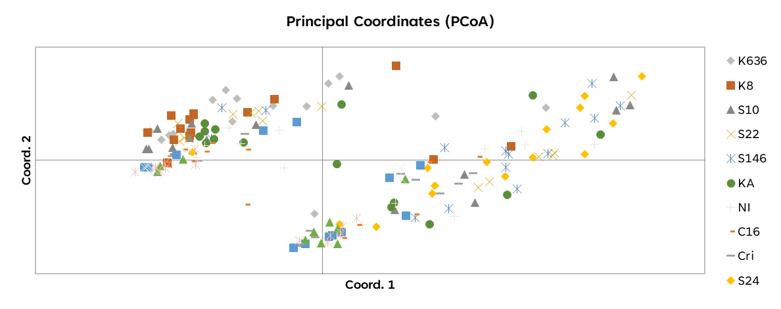
SUBABUL
plan for B_{w}B: seed = clone
Genetic affinity-based grouping
L. l. ssp. Leucocephala outcrossing proportion
Original Hawaii collection
Crida collections
Based on Parental Progeny allelic frequencies
3 families were isolated for seed orchard
Identified two major genetic groups to exhibit the potential of heterotic seeds
SSP: Leucocephala : 3 out of 12 families showed signs of outcrossing rate
SSP: diversifolia & glabra: being tested.
Self Pollination ( ~> 95%) being the serious challenge, families in all the collections are being tested for high outcrossing rate

Slide 16
SUBABUL
Actionable
Weakness
Challenging hybridization
Under Resourced for various development pipeline
Poor integration
Opportunities
Seed on par with clone
actionable
FTEs: Move from species to platform-based approach
Requires strong integration with Genomics

Slide 17
CASUARINA

Slide 18
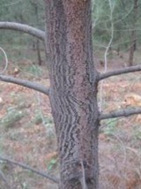
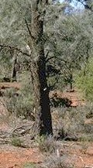
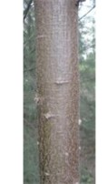
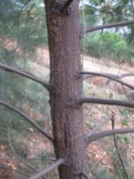
CASUARINA
15 cultivable species
Important Casuarina sps and unique traits
Ranking from 1 - 100 (100-best)
Growth
Adaptability
Stem
straightness
Wood
properties
coppicing
CR
CJ
CC
CE
Coastal species lacks adaptation & coppicing
C. equisetifolia
C. cristata
C. cunninghamiana
C. junghuhniana
2012
Introduced 115 families
18 seed lots
Decent He (Intra >0.5; Inter >0.6) for improvement
Smooth stem, Upward branches
Rough stem, Upward branches
Slight yellow, greenish stem
Rough stem, Drooping branches
Domestication of C.j was the way forward for India

Slide 19

CASUARINA
A farmers’ friendly alternative
GEN^{n}
STRENGTH
PET
K Series clones / Seeds
GEN1
PET
CSO
M, S series
Farmers’ Friendly
BCTMP suitability
Decent H_{e} (Intra >0.5; Inter >0.6) for improvement
Trait value
SSO
ITC1761
Weakness
G.thinning
Poor collection & Flowering distribution of C.e
Under Resourced for various development pipeline
Genetic Gain
∆g
$$\text{∆}\text{g} =h2.δ p.\frac{Si}{l}$$
ℎ2:𝐻𝑒𝑟𝑖𝑡𝑎𝑏𝑖𝑙𝑖𝑡𝑦
δ 𝑝:𝑃ℎ𝑒𝑛𝑜𝑡𝑦𝑝𝑖𝑐 𝑣𝑎𝑟𝑖𝑎𝑡𝑖𝑜𝑛
S𝑖:𝑆𝑒𝑙𝑒𝑐𝑖𝑡𝑜𝑛 𝐼𝑛𝑡𝑒𝑛𝑠𝑖𝑡𝑦
𝑙:𝐺𝑒𝑛𝑒𝑟𝑎𝑡𝑖𝑜𝑛 𝑐𝑦𝑐𝑙𝑒
Opportunities
Directional selection with generation advancement improves trait value (WY/PY/etc.)
Well validated with GEBV, hence model can be developed in hybrids
Responses well in Epi-treatments
Expects
FTEs: Move from species to platform-based approach
Back-end pipeline requires – Land for SO, GGTs, particularly C.g and C.c

Slide 20
CORYMBIA

Slide 21
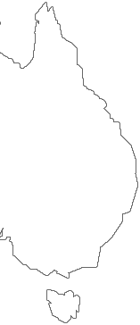
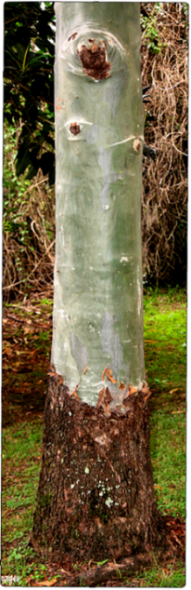
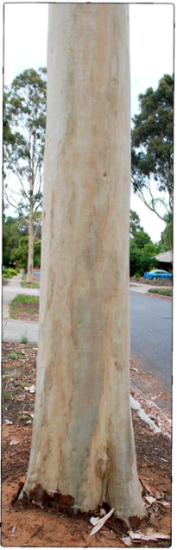
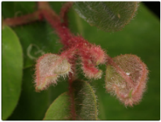
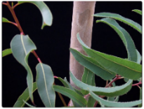

CORYMBIA
A High pulp yield candidate
Major PURE species & kraft pulp yield
World wide – Corymbia: Timer wood
E. globulus (54%)
E. obliqua
E. Camaldulensis (43-46%)
E. tereticornis
E. Deglupta
Distribution in Australia
E. grandis (57%)
E. camaldulensis
E. cladocalyx
E. diversicolor
E. lehmannii
E urophylla (54%)
E. saligna
✔
E. globulus (54%)
E. viminalis
E. rostrata.
E. nitens (54%)
E. camaldulensis
E. Tereticornis
C. torelliana
C. citriodora
1–15% survival
E.uro.
E.glo.
E.gran.
Array of Hybrid clones
✗
ITC 2081 (50.5%)
[First Corymbia Hybrid]
✔
E.camal
✗
Initial challenges
Rooting (corrected to 62%+)
Grading procedure (standardised)
Bushy in the first 1.5 years
Yield is 5-8% less than current hybrids
Successful hybrids
Has upper limit on PY (46-48%)
Abiotic stress susceptibility

Slide 22
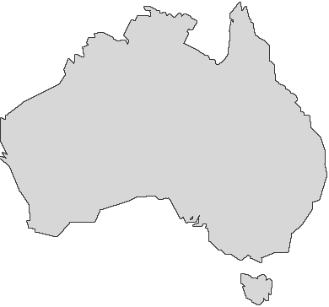
CORYMBIA
A High pulp yield candidate
CORYMBIA CURRNET BREEDING PIPLELINE
2030
Two New Hybrid Clones
STRENGTH
2027
Two New Hybrid Clones
Global first commercial hybrids of CT x CCc, CCv
Family collection represent H_{e} >0.6
150 Selections
Ideotype
22 Selections
Grafted slns. for canopy, Leaf size, & Low branch
2023
Weakness
ITC 2081
2019
Poor flowering / seeding
Lack of Parental genetic gain trails
Under Resourced & Hybrid model requirement for GS
Grafted selections for Stem borer tolerance
15 selections from CT and CV
2016
Opportunities
60 selections from CC, CT and CV
Exploration of C. citriodora (pure species)
Direct commercial hybrids (due to 365 flowering of CT)
Grafted selections for PY
2015
120 selections from CC, CT and CV
Grafted selections for GROWTH
2012
Expects
CSIRO New Germplasm - Evaluation
CT, CC & CV
FTEs: Move from species to platform-based approach
Back-end pipeline requires – Land for SO, GGTs

Slide 23
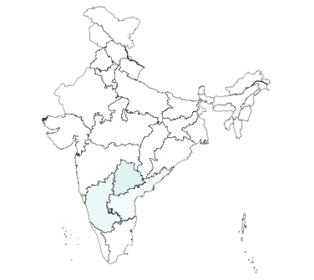
CORYMBIA
CREATION OF NEW OPPORTUNITIES FOR CORYMBIA MULTIPLICAITON
Guided multiplication units (for next season)
# | Place | Potential no of saplings (Lakhs) | Current Status | Expected from PSPD
1 | Malvalli (Mysore) | 2 | Mother plants ready | Sale Order
2 | Forest Department (KA) - MoU | 3 | Proposed, Identified | Sale Order
3 | BCM (Private Nursery) | 2 | Mother bed established | Sale Order
4 | Trichy | 3 | Mother bed planted | Experimental
5 | Laxmipuram (Ours) | 3 | Established system | -
6 | Ongole (Mannetikota) | 2 | Mother bed established | Sale Order
The growth of Corymbia multiplication can be significantly improved from second rotation onwards
15 lakhs of 2081 will be available for 2027 planting

Slide 25
DATA

Slide 26
DATA
Current Issues
Individualistic. It is “Datum”, rather than “Data”.
No common templates
Traceability, Review / Monitoring - impractical
Historical – integration – Seldom traceable
Outcome is manipulable

Slide 27
DATA
Data Lake that applies to Silvi
Relational Database
Clone / Seed Dlp.
Selection & Translation
Diversity ( GD-TD)
Descriptors
Gene Bank
Dynamic Seed health
Pollen Bank
Hybrid – families
Progeny Evaluation
Trials
Location
External data ( weather/soil)
Farm Practices
Selection metrices
Analytics Platform
PLATFORMS
INTEGRATION
Genomics
Plant Protection
Genomic Region
Marker type
SNPs / SSRs / Etc. position
Polymorphism
MASI (Marker Assisted Selection Index)
Ranking
Validation
Disease Index
Prediction

Slide 28
DATA
The BACK-END Architecture
Example of a Relational Database Schema
Gene Bank (DB₁)
Trials (DB₂)
Trial
Ranking
Clones
T_ID
Type
Replicates
R_ID
Rank
Family
C_ID
Name
Species
Sub Species
Clones
F_ID
Name
S_ID
Name
SS_ID
Name
Family
C_ID
Name
F_ID
Name
Pedigree
TRIALs
Phenotype 1
Phenotype 2
DNA_Marker
F_Descriptors
Target_Trait
DNA_Marker
Pixel_data
Relations
P_ID
P.Trait 1
P.Trait 2
EP_ID
Est PT 1
Est PT 2
M_ID
Type
Cor_Value
Value
Descriptors
Markers
Infogram
Relations
FD_ID
Name
Target_Trait_ID
TT_Name
Value
TT_ID
TT_Type
Value
M_ID
Type
Cor_Value
Value
D_ID
Type
Marker_ID
Cor_Value
Value
R_ID
Type
Rel_value
performance
Featured properties
Integrates both Development & Translation platforms
Possible to establish the relations between data sets
Scalable
Traceable
Deep analytics such as LLMs
Z_ID
Weather Param
Zone_ID
S_ID
Type
Nutrient_Stat
U_ID
Name
Password
Soil
User
P_ID
Name
Project
FP_ID
Irrigation
Nutrient_App
Interculture
Practice
Credentials
ZONES
T_ID
Age
Range
GPS_Coor
T_ID
Age
Range
GPS_Coor
Time_Log
Time_Log
time
time
T: Field for Database connection
T: Field for Database connection
SELECT Species.ID, tiem_Log.Age, ..., Target_Trait.Breaking_strenth, ... FROM Clones INNER JOIN Pixel_Data ON DNA_Marker.Cor_Valye = pixel_data.marker_ID;

Slide 29
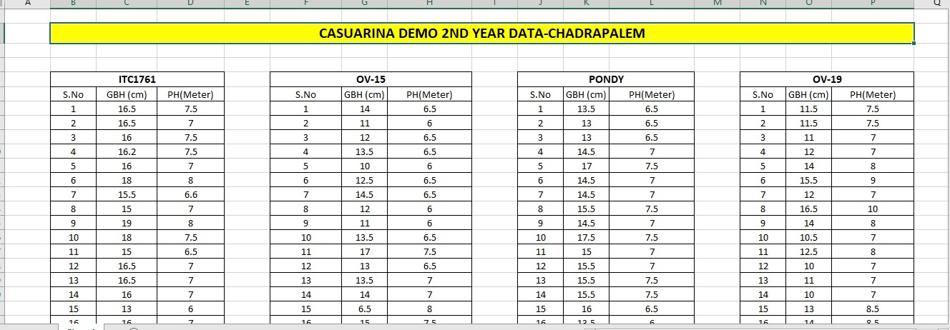
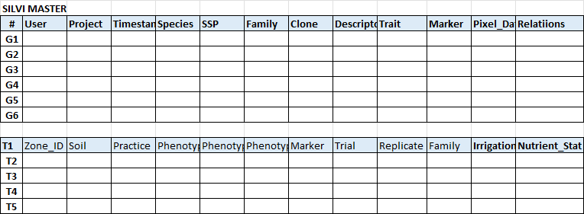
DATA
Architecture implementation
What Scientist will feed IN ?
Current way
Timestamp, relational features from GenBank to commercial release will have timestamp traceability, deep analytics and reduce the redundancy
Data Lake Way
Silvi Data Master

Slide 30
Resources

Slide 31
Resources
Current Issues
Gaps in expertise vs operative
Data Lake – almost impractical
Most FTEs are under utilized
Lack of Junior FTEs and unstructured L5

Slide 32
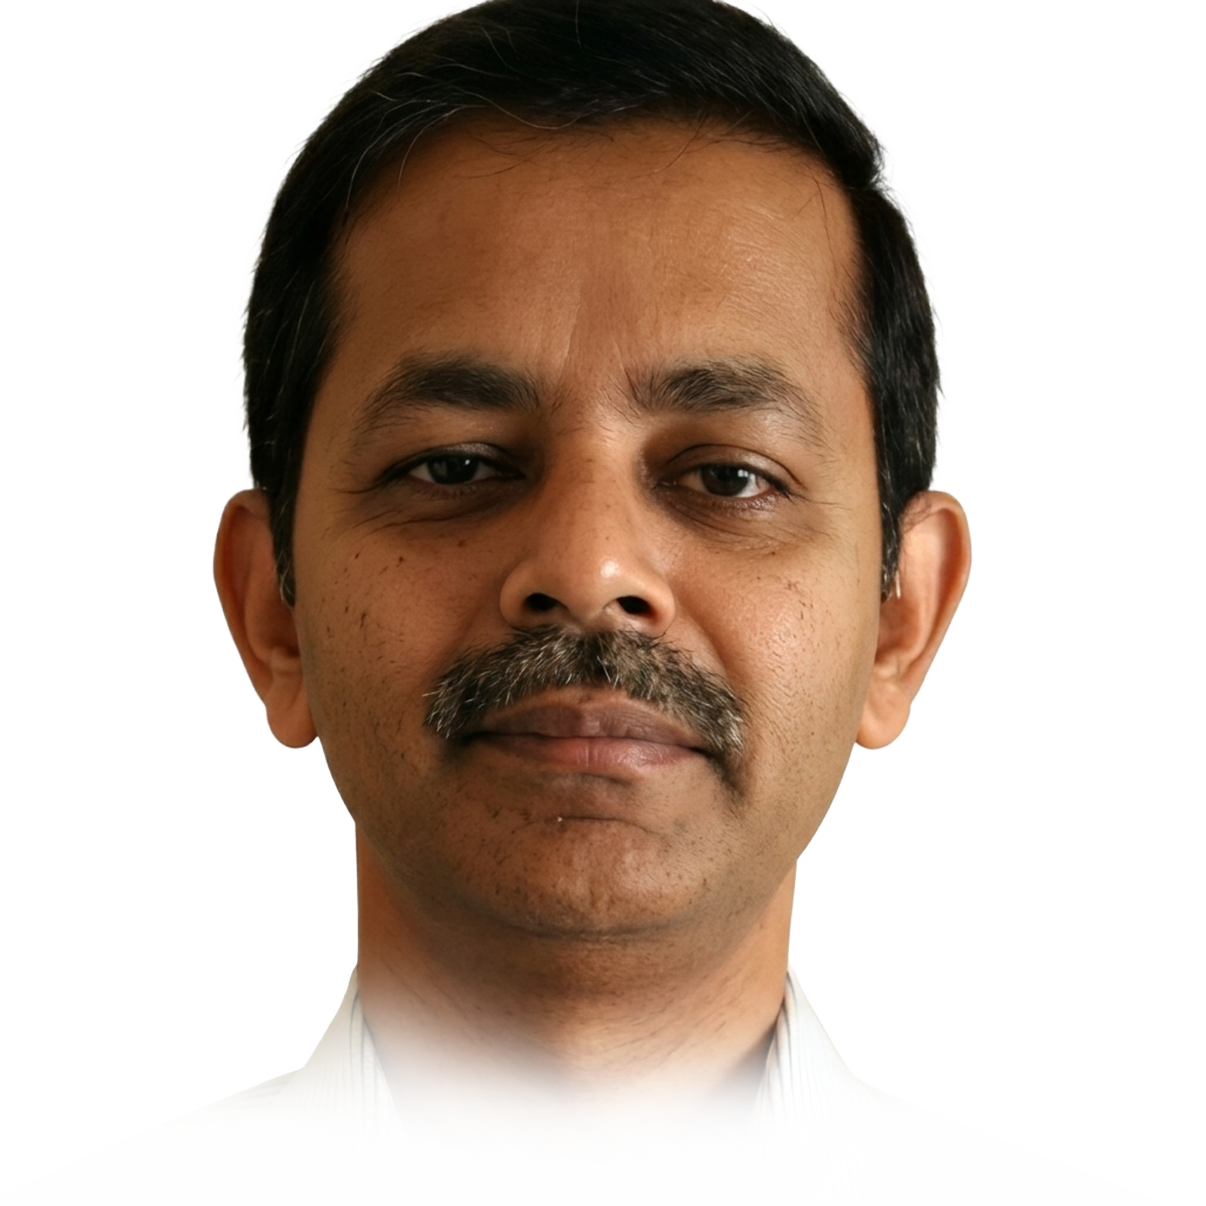


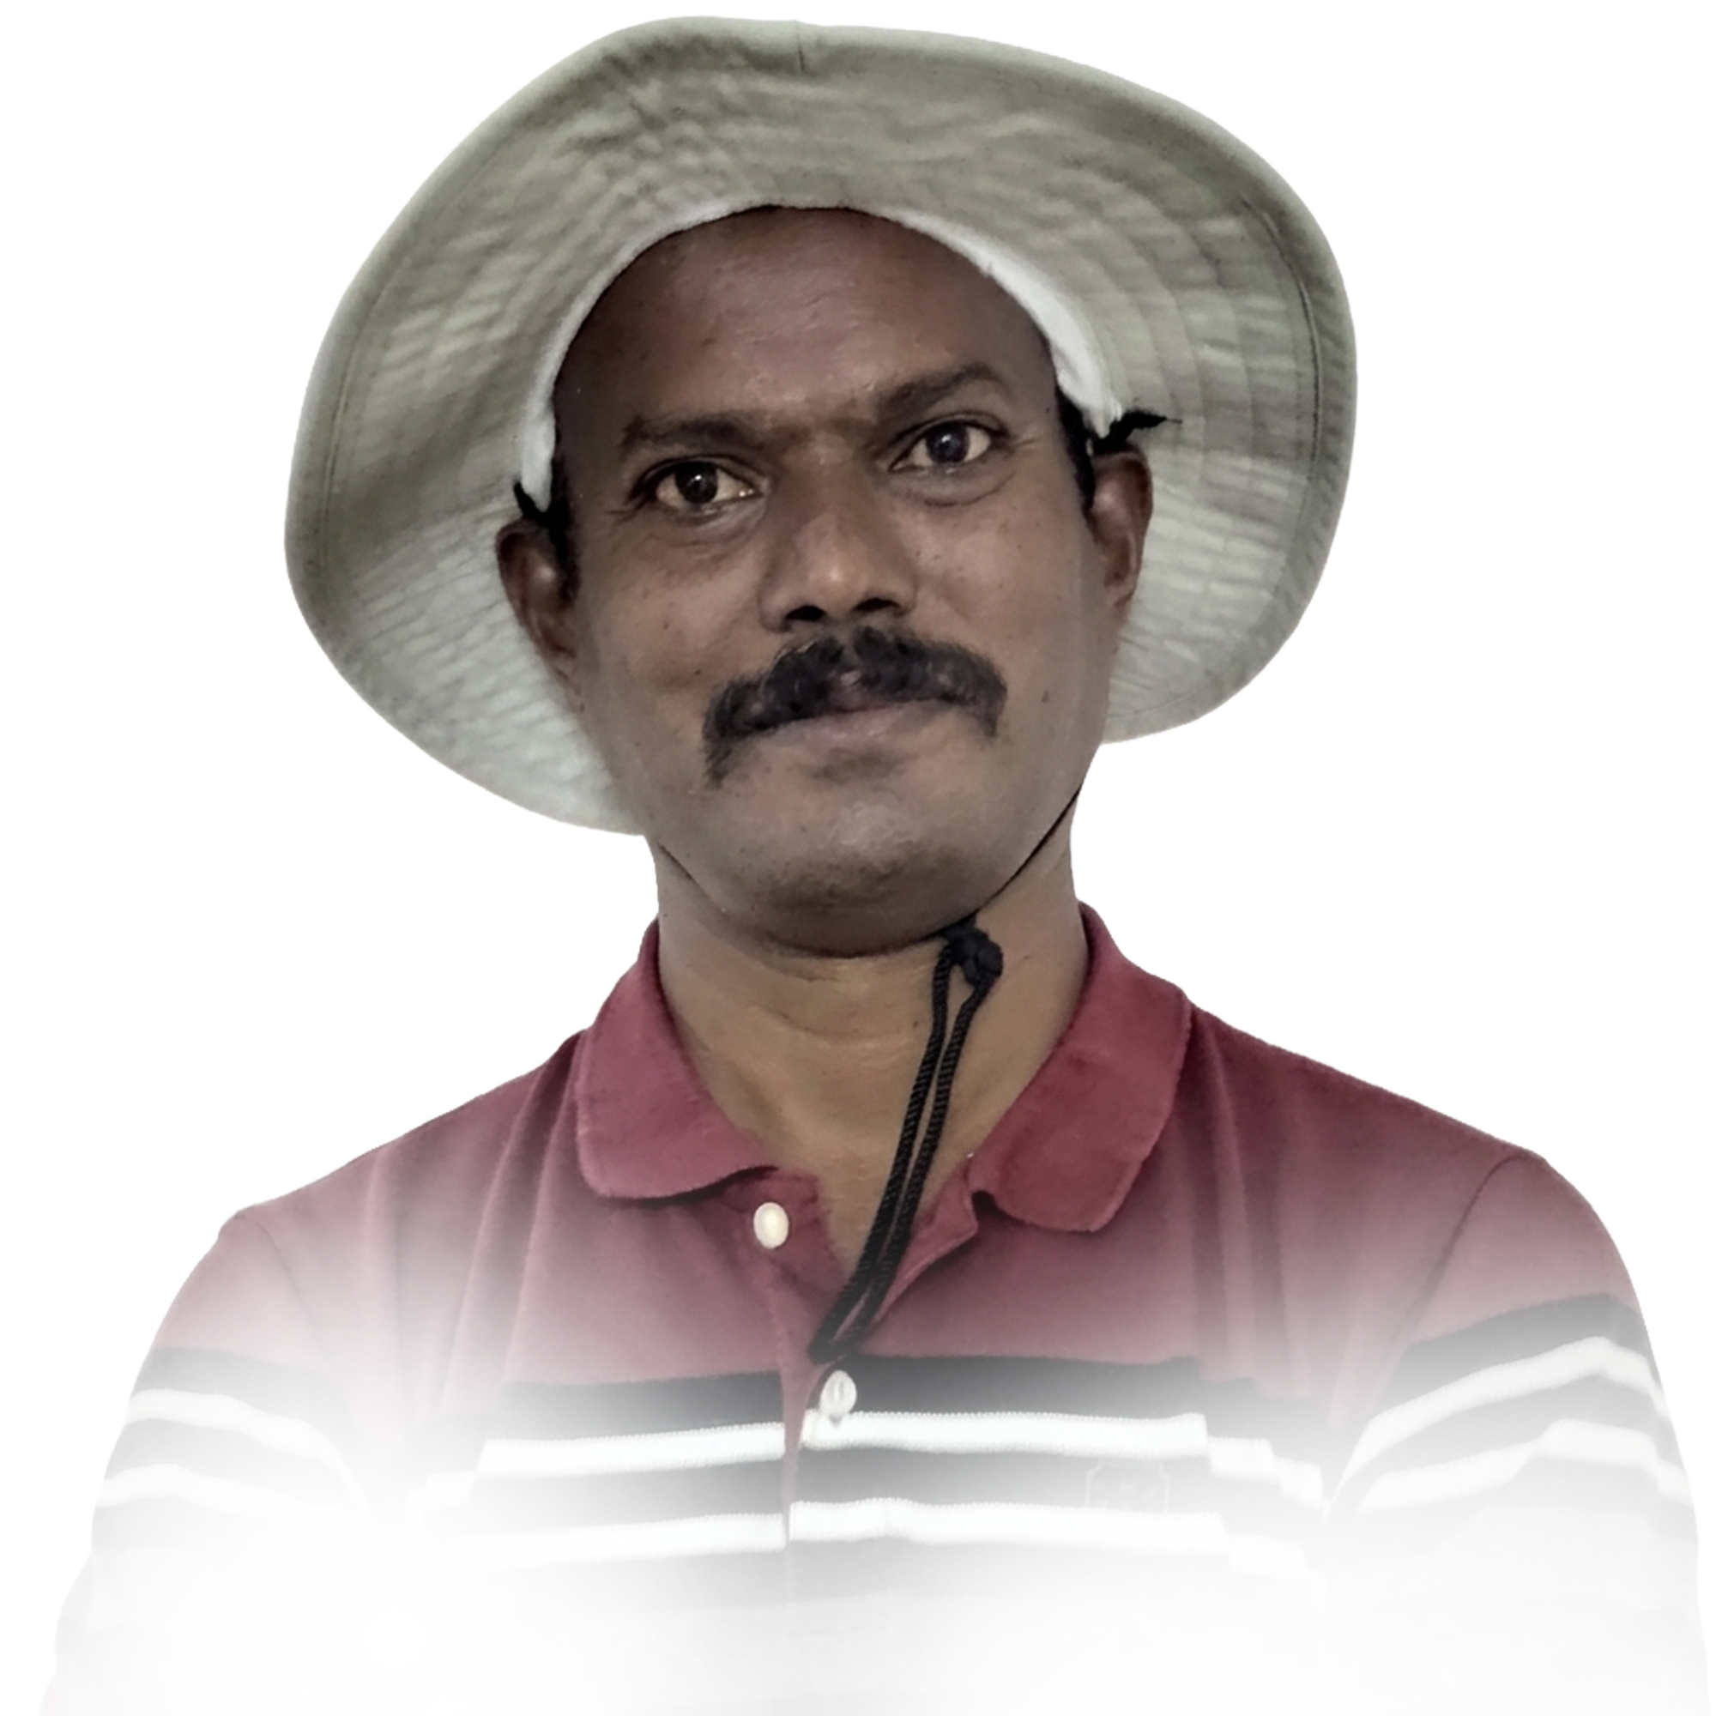

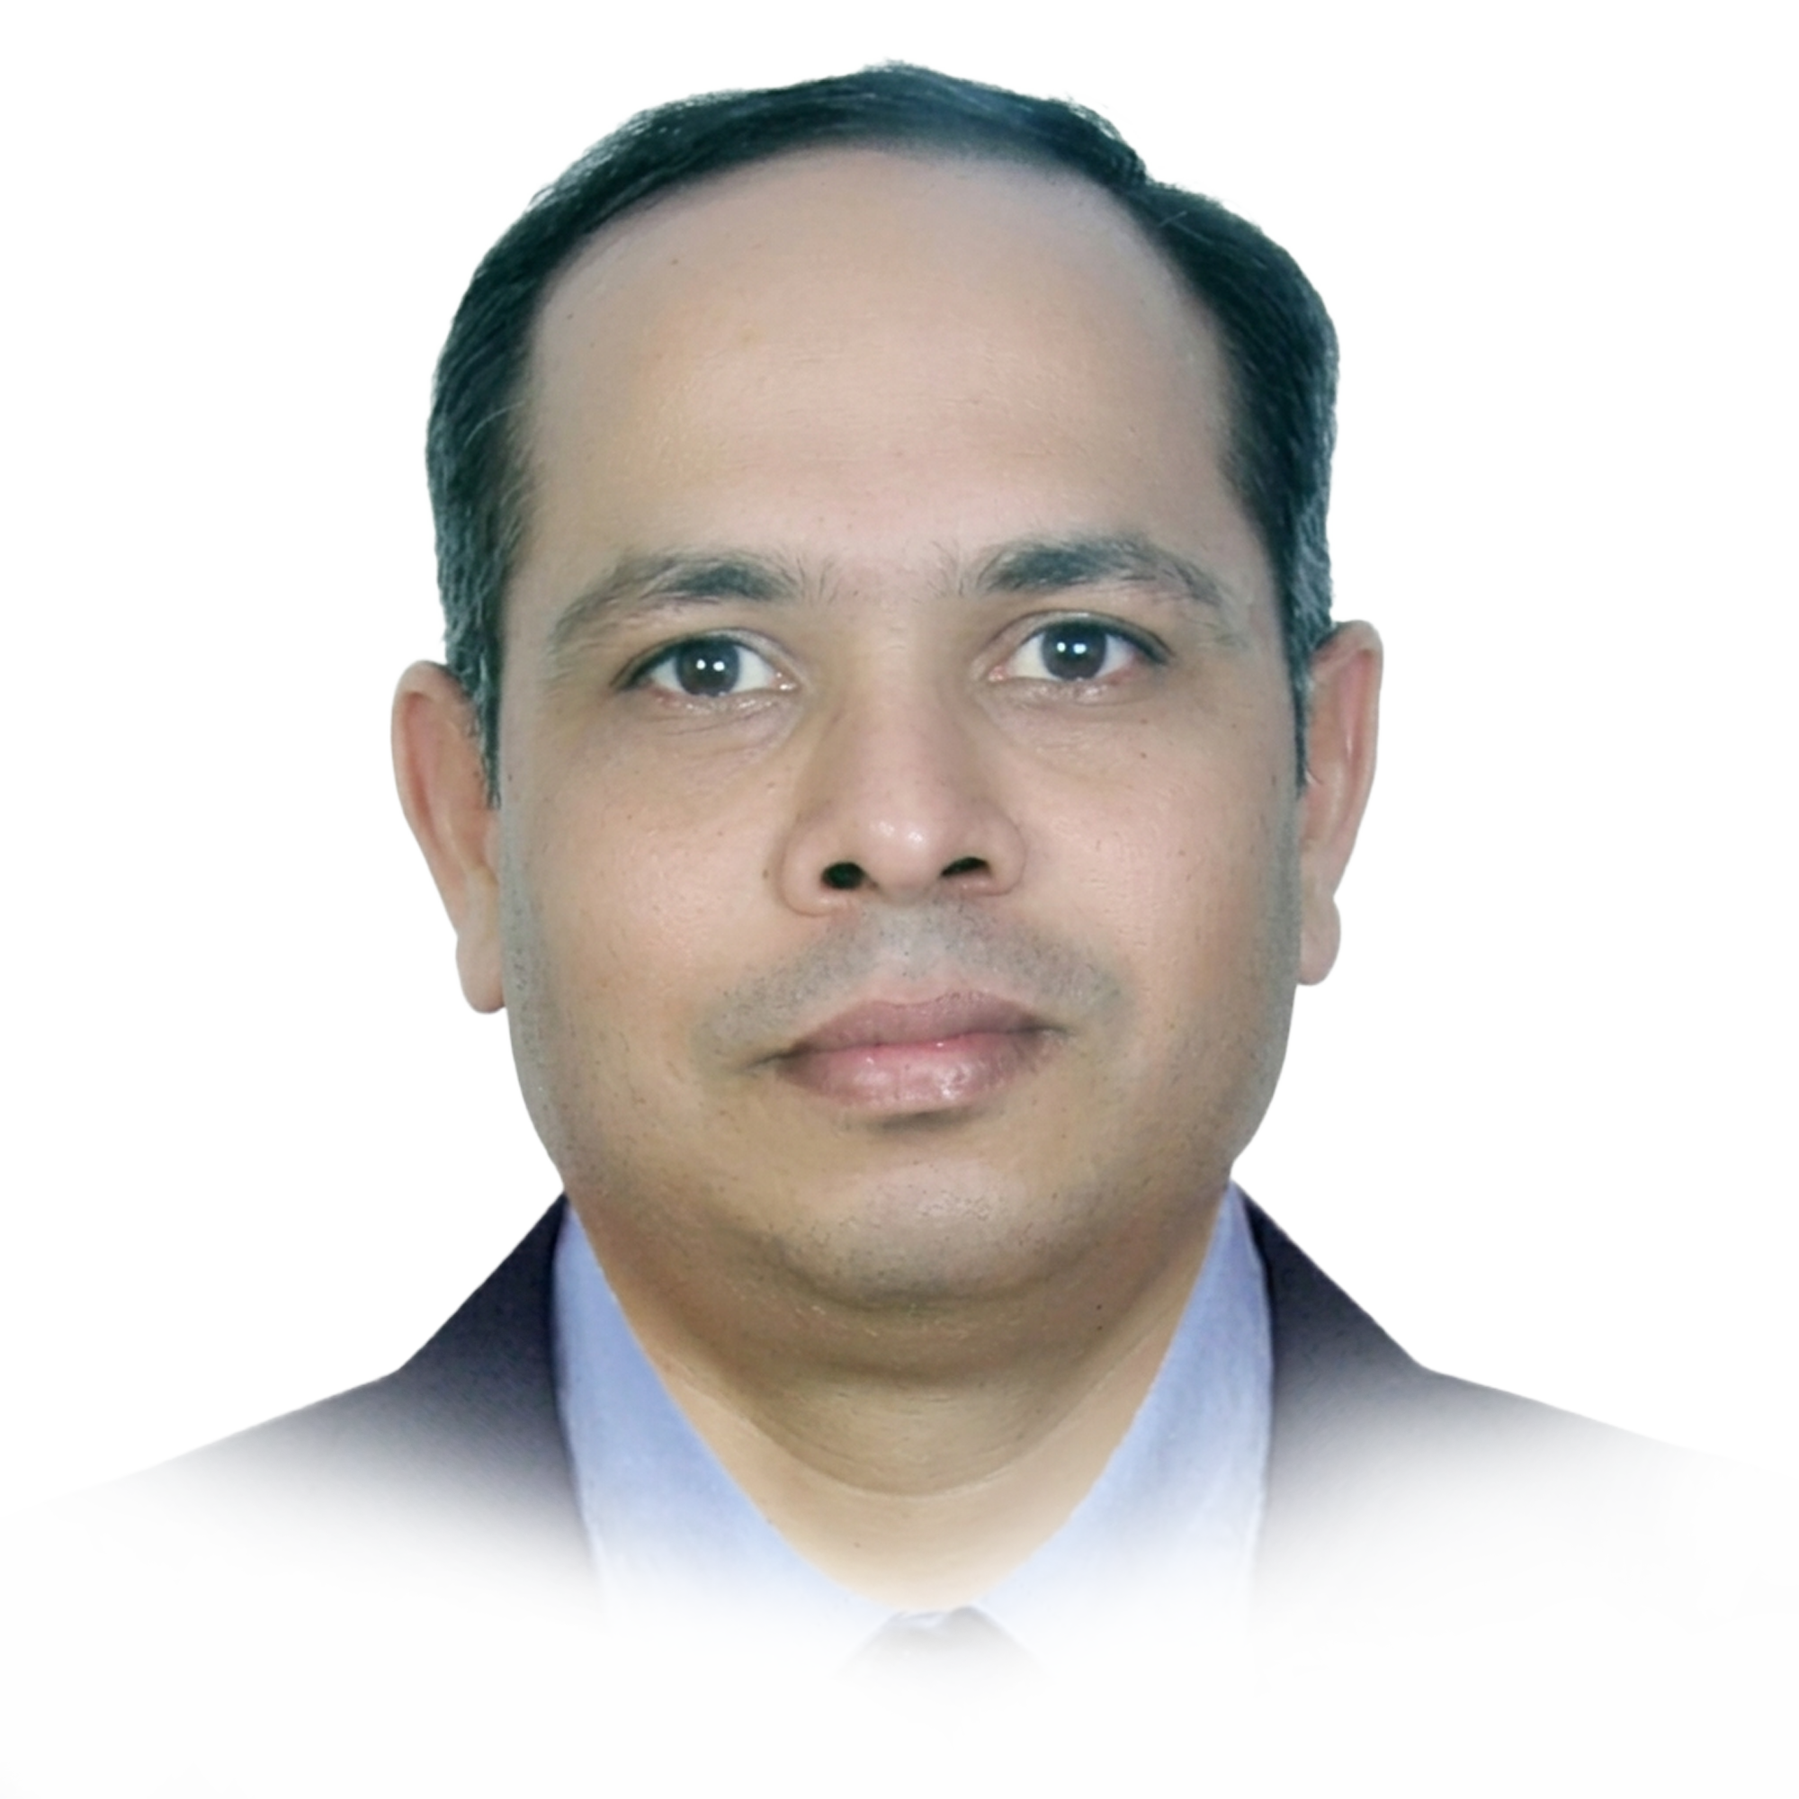
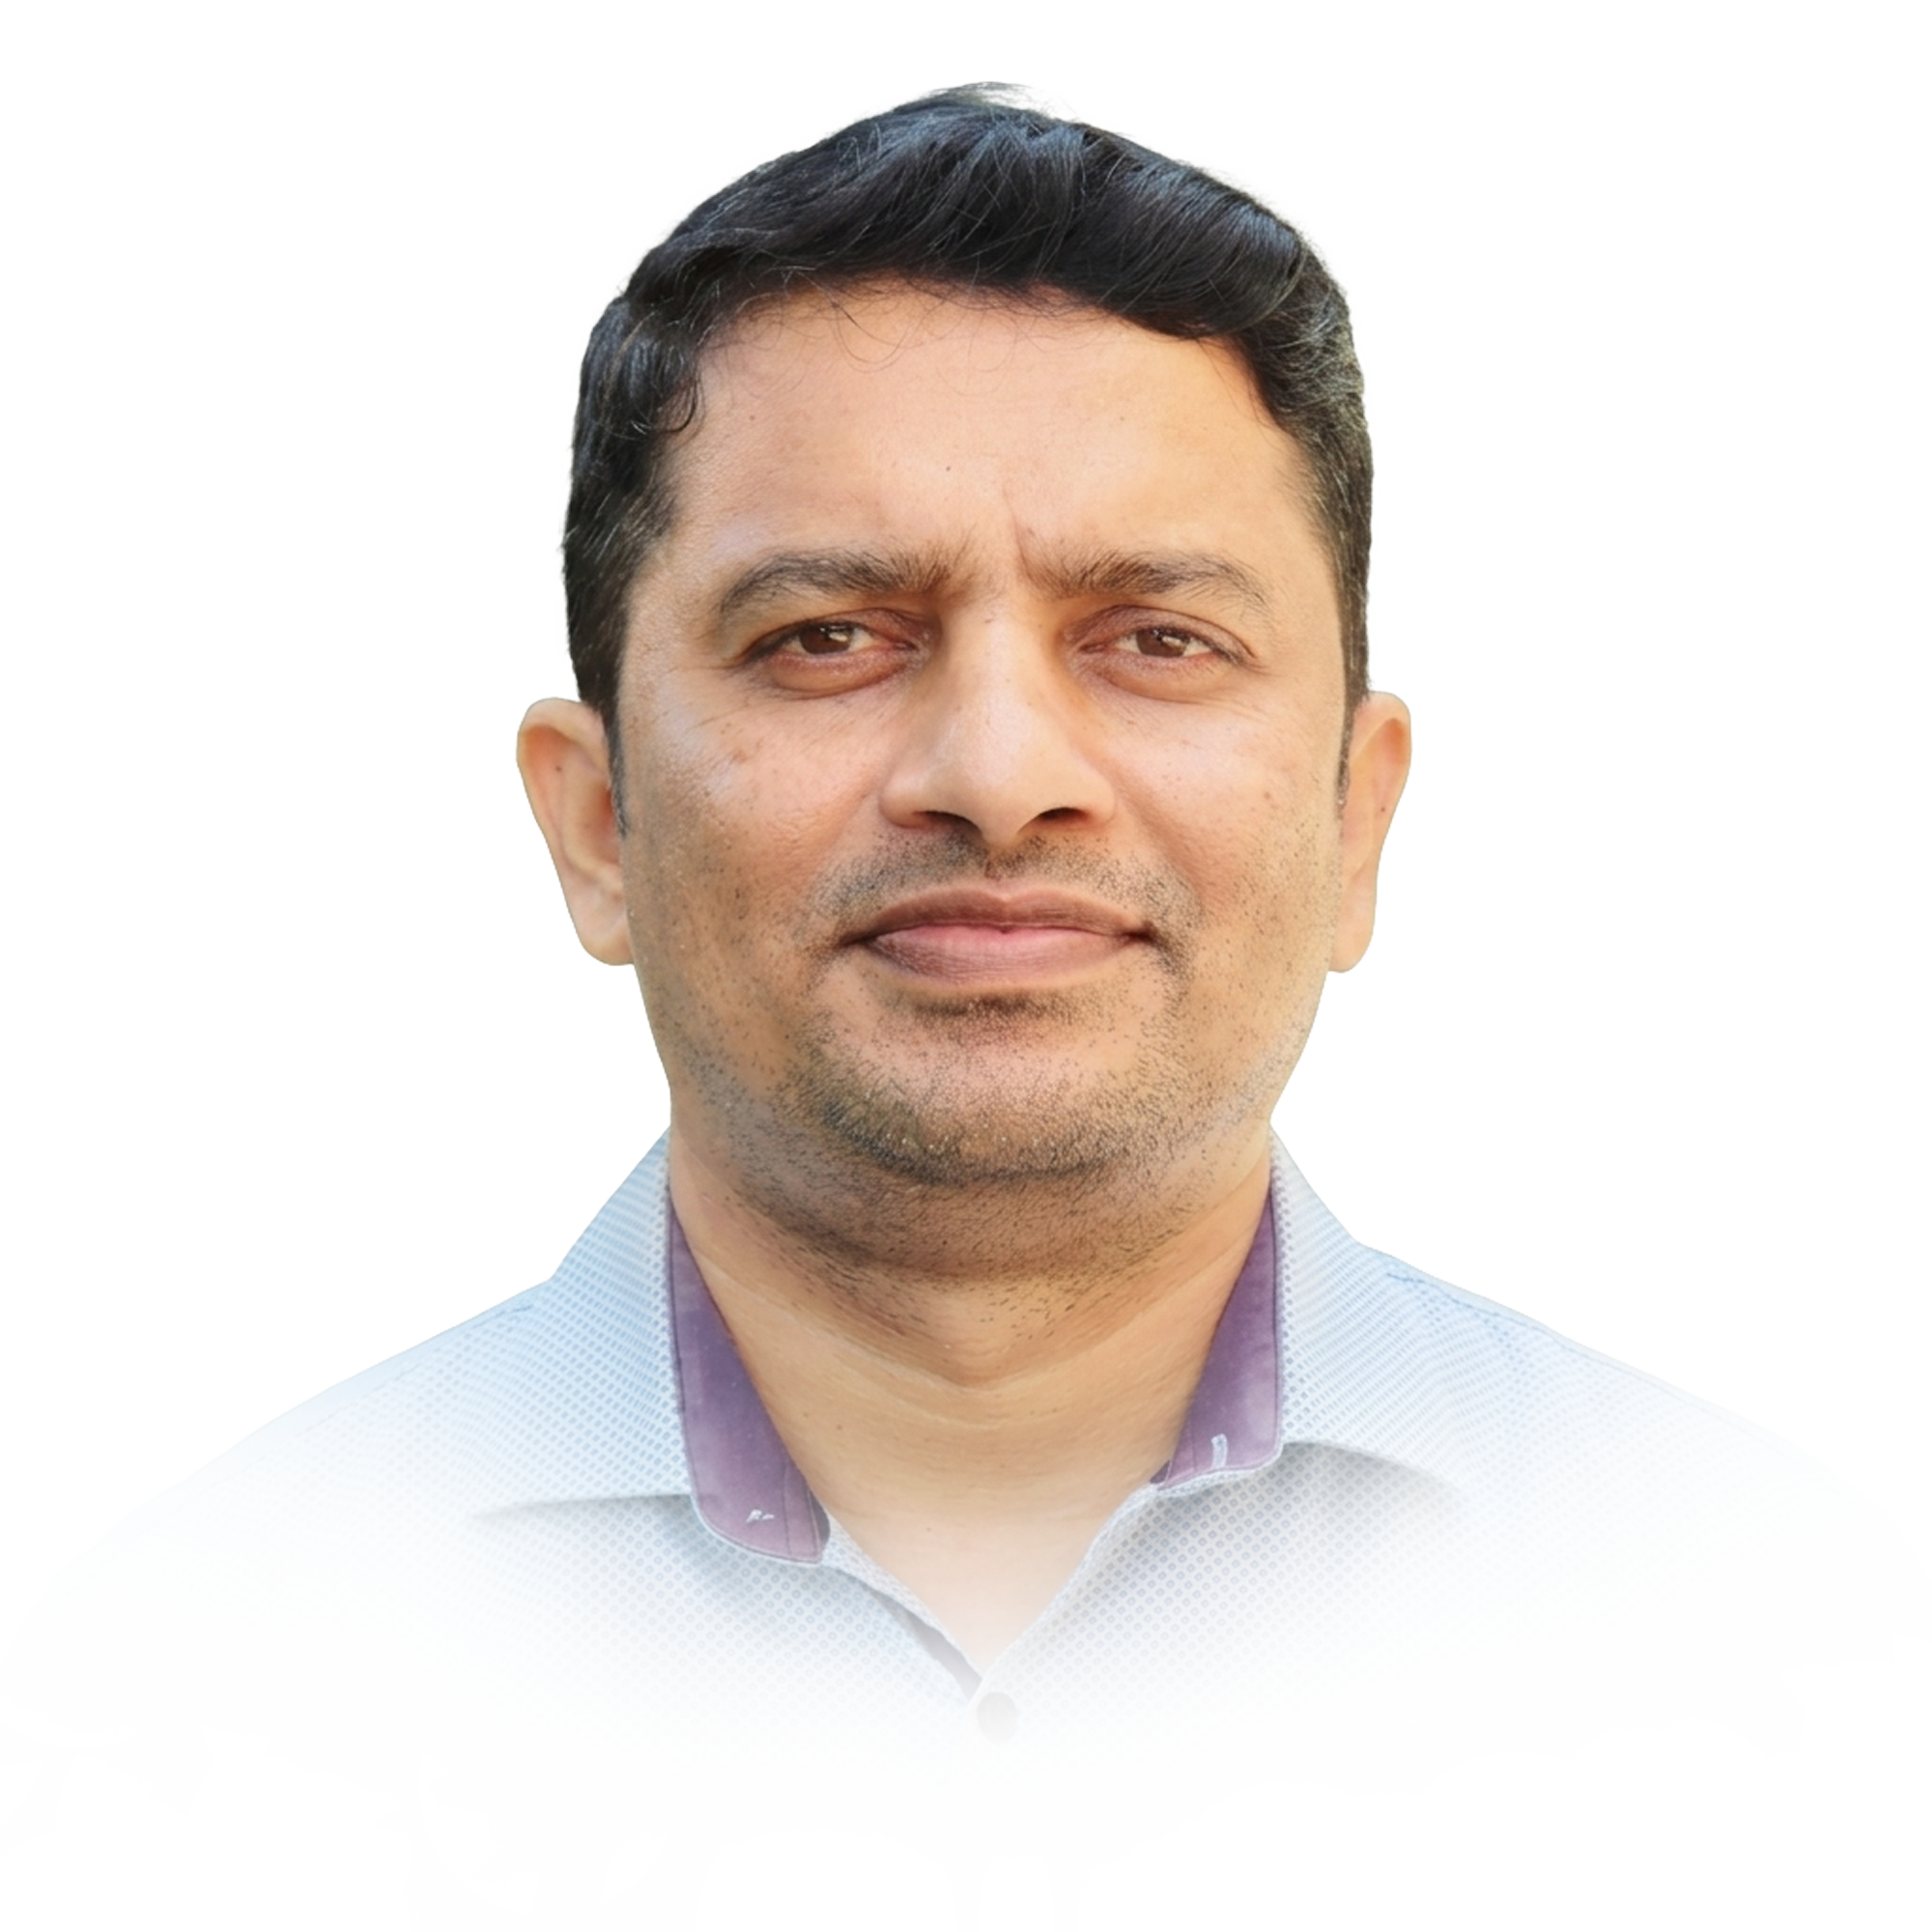
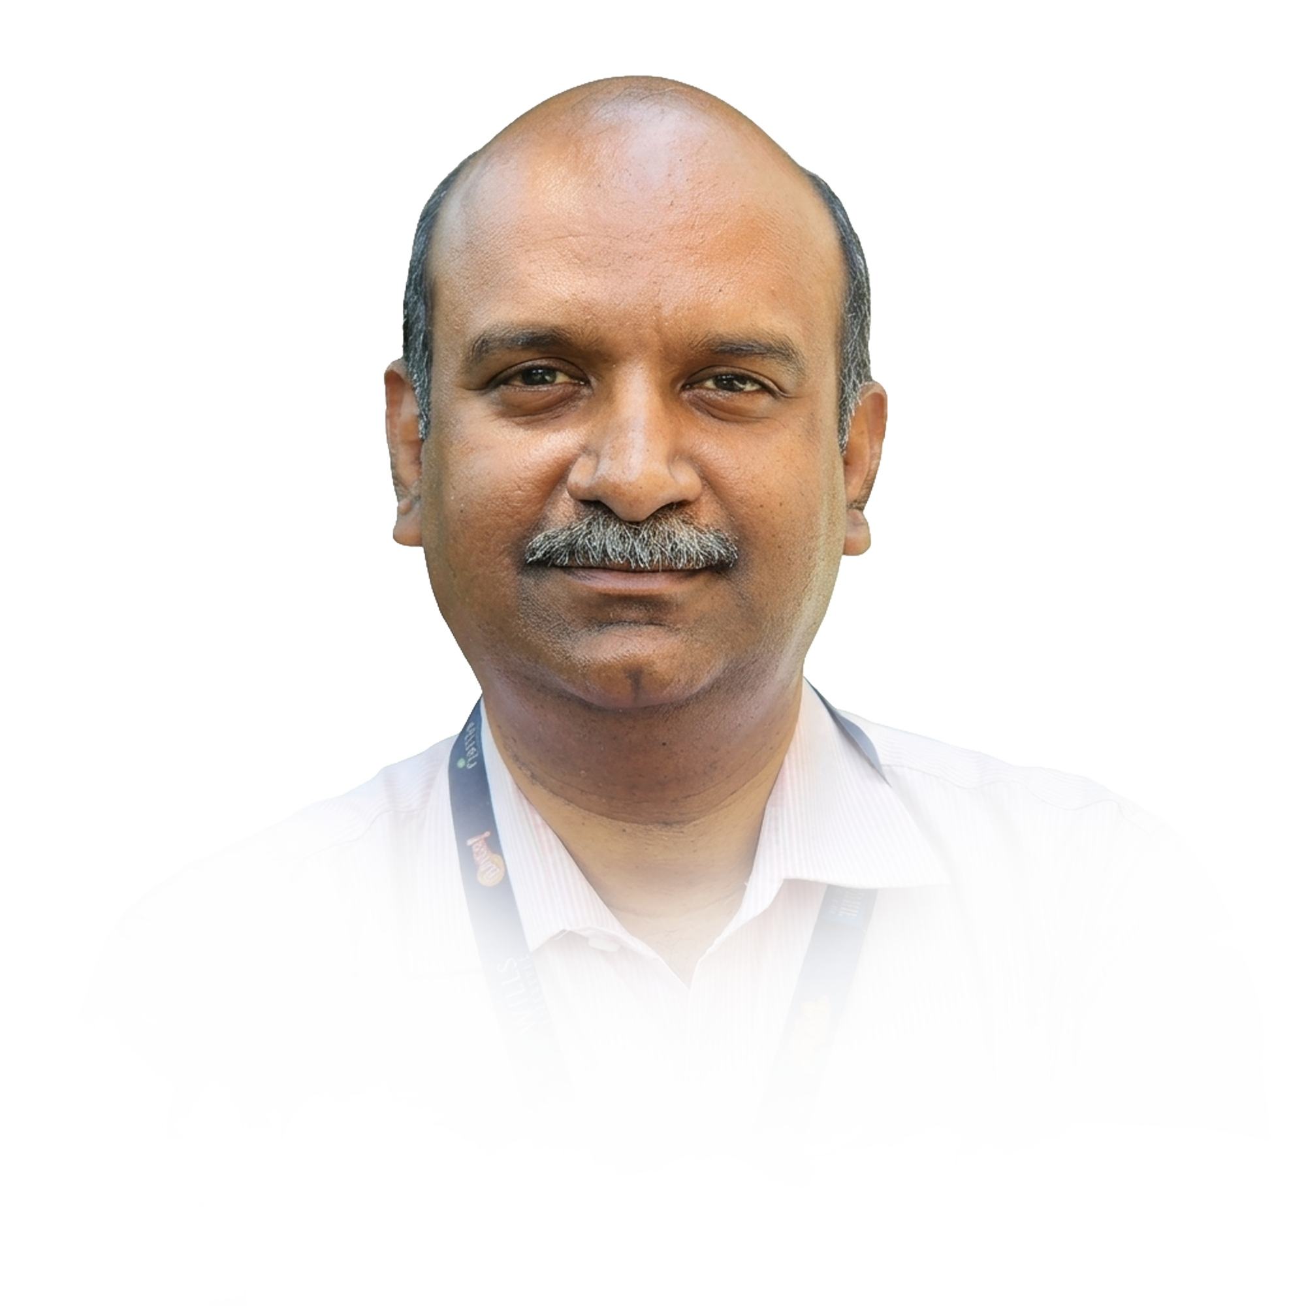
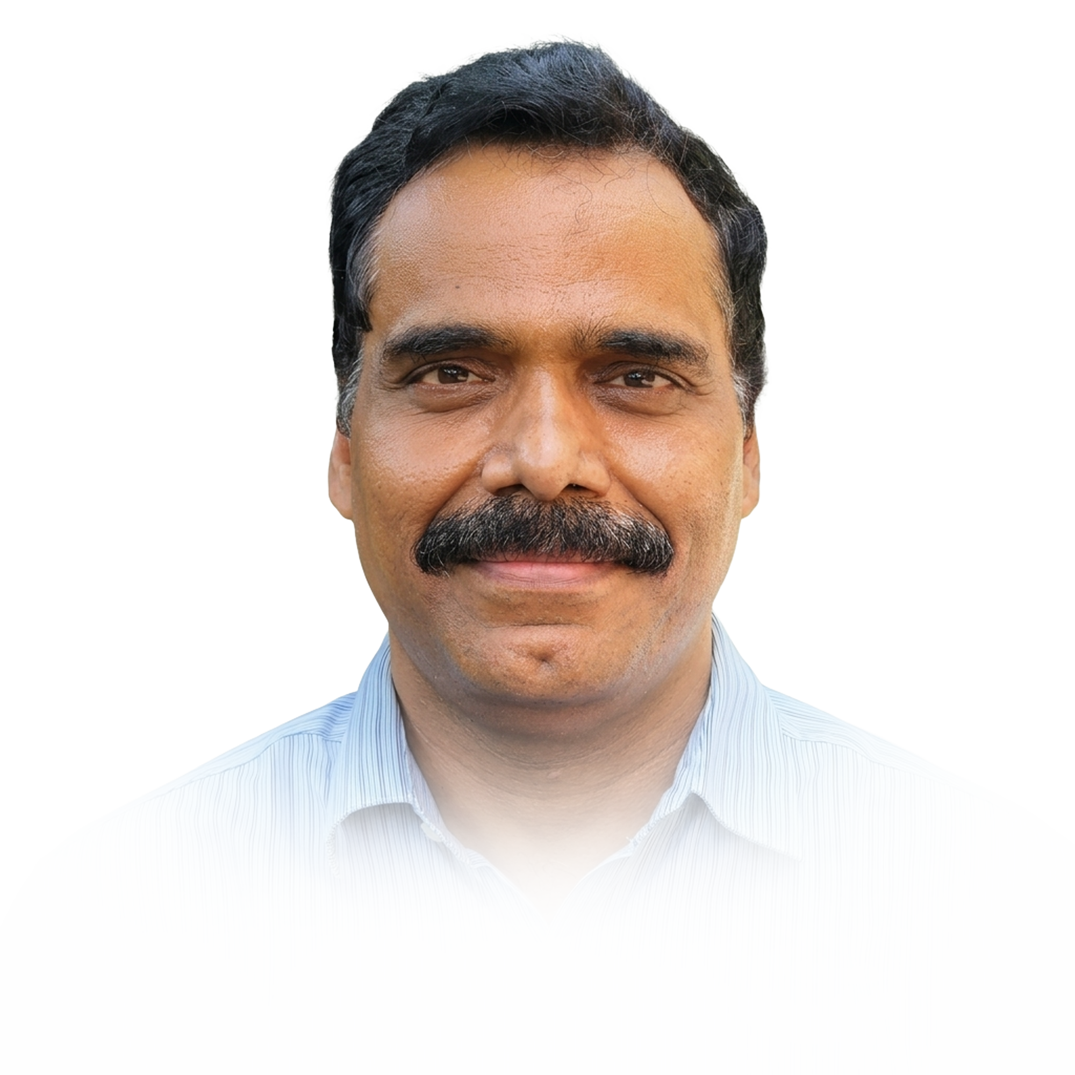
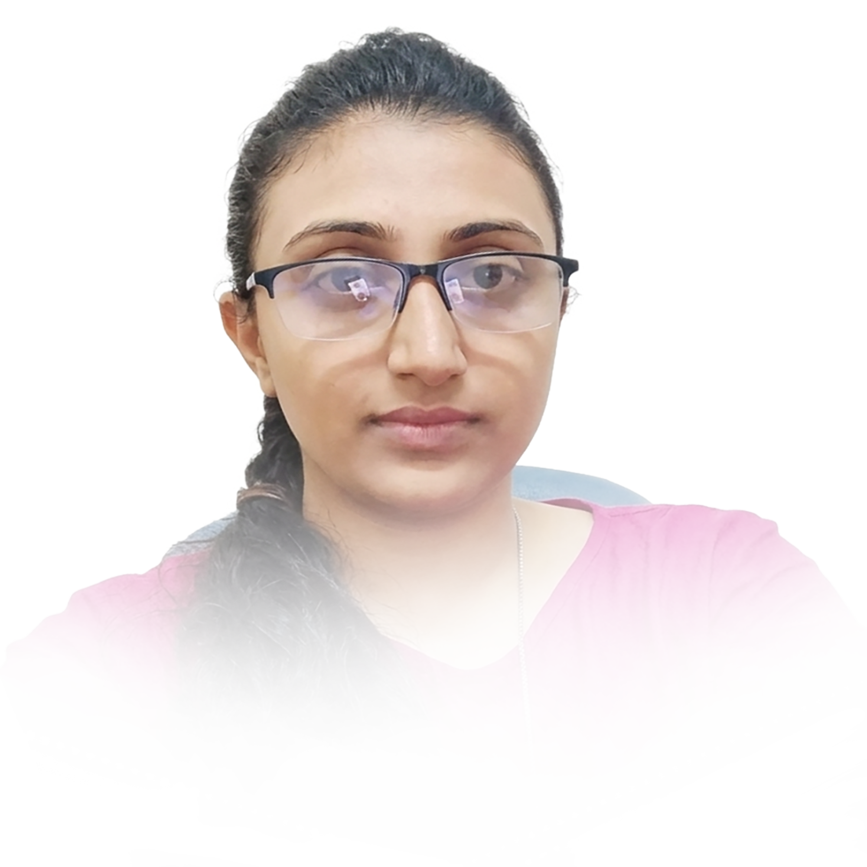


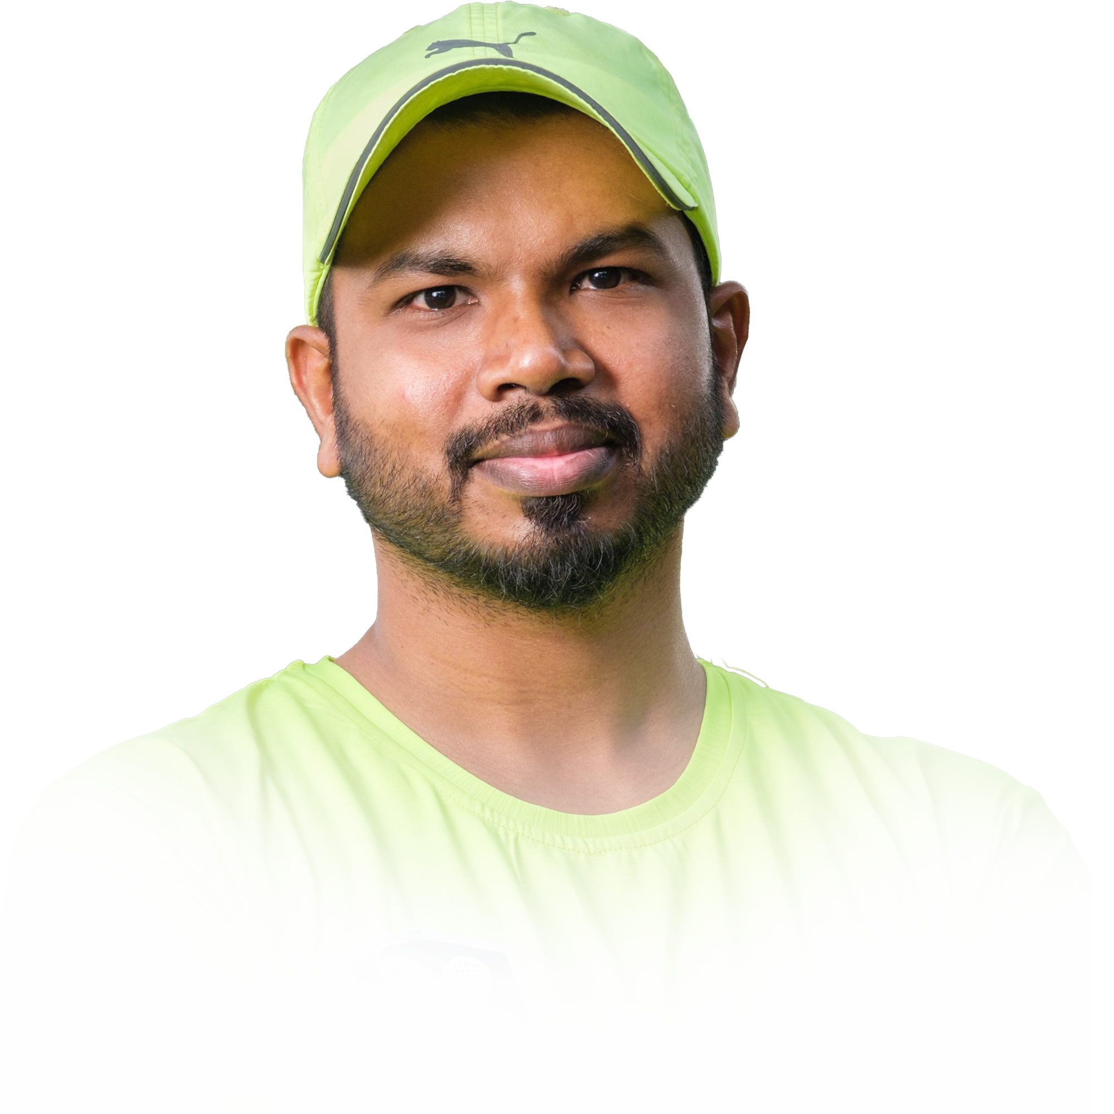

Current Structure
3
4
5
R

Slide 33
SWOT..
MAS, Genomics
Methodical
Core breeding
MAS, Genomics
Hybridizations
Trails & Selections
Field operations
Silviculture
Methodical
Core academic expertise not necessarily be the current expertise, they are known for.
Agronomy
Trials & Selections
Genomics, Epi, Pathology
Field Operations
Farmers’ Connect
Digital enthusiastic
Pathology

Slide 34

Accountability
Orbit 1
Orbit 2
Orbit 3
PLATFORMS
Y¹-Y⁵
Y⁶-Y¹⁰
Y¹¹-Y¹⁵
Clonal / Seed Development
Hybrids / Base selections
Euca; Casuarina; Subabul; Corymbia, Poplar, etc. – Gene bank to CPTs
Translation Research
CPTs; MLTs; FTC; Demo, Nutrient management, Technology Transfer, Release & follow-ups
New
Genomics
Creation of Variation; MAS; Gene Finding; Selection +/-; Epigenetics
Plant Protection
Diagnostics; Method development; Recommendation; Pre-screening
New
Wood Chemistry
Wood properties:
Prasanth
Prasanth
Prasanth

Slide 35
Ideal Structure
Global Directions
Board Communication
New Opportunities
Strategic layer
3
operational layer
Operational Directions
Business communication
New Opportunities
4
Clonal / Seed development (Gene Bank, Hybrid, Selections. Multiplications)
Genomics
new variations
Selection & Translation
Agronomy
Gene Bank
Hybridizations
Seed / Clonal Development
Operational Genomics,
New variations,
BwB
Selection & Translation
Field Operations; commercial multiplications,
Digital (Apps; SI, Integrations)
5
New variations
Genomics
Plant Protection
R
Prasanth
Riyas
Lok Kumar
New

Slide 36
Resource optimization
Platform Leader
Second GEN
Clonal / Seed Development
Gene bank to CPTs
SWOT..
Translation Research
CPTs > PSPD > Farmers
To be mentored for the respective role
Genomics, Plant protection & New variation
Back End Efficiency and derisking

Slide 37
Resource Road Map
Platform Based Leadership
TIER 2&3 Leadership
Global Directions
Board Communication
New Opportunities
‘27
‘28
‘29
‘30
‘31
‘32
‘33
‘34
‘35
‘36
‘37
‘38
‘39
‘40
PLATFORMS
Clone / Seed Dlp.
Translation Research
Genomics
Plant Protection

Slide 38
Resource Road Map
Agroforestry Domain Lead
TIER 2 Leadership
Global Directions
Board Communication
New Opportunities
‘27
‘28
‘29
‘30
‘31
‘32
‘33
‘34
‘35
‘36
‘37
‘38
‘39
‘40
L3+
L3
L4+
L4
L4+
L4
L4+
L4
L4

